Slide 1
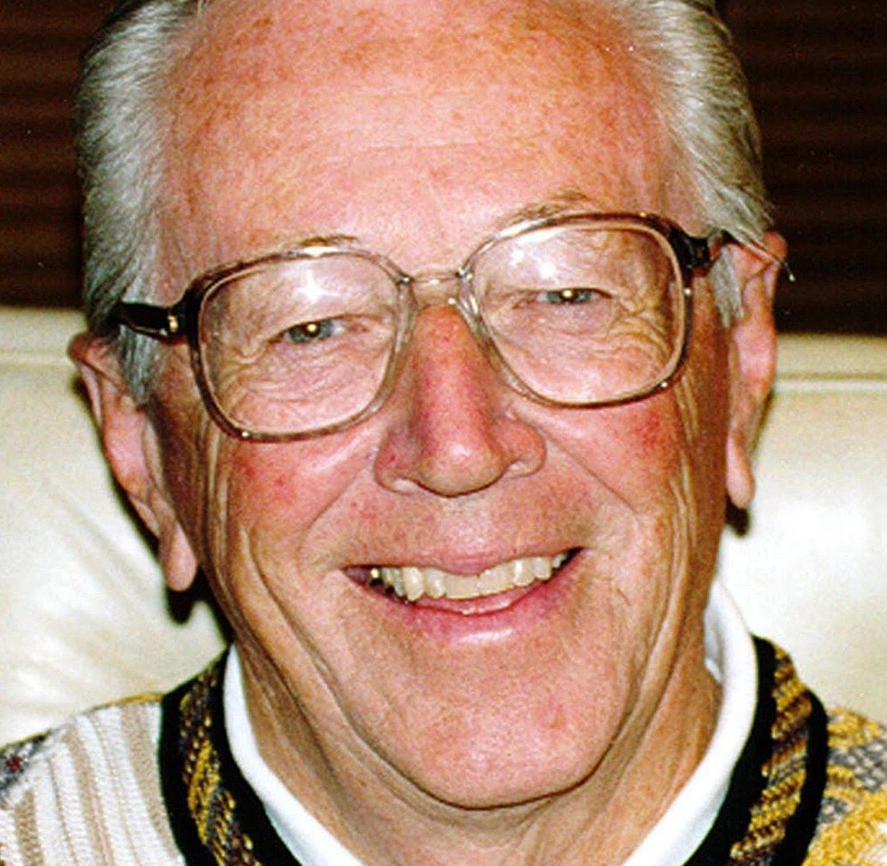
Charles M. Schulz… creator of “Peanuts”

Slide 2
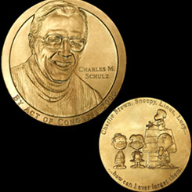
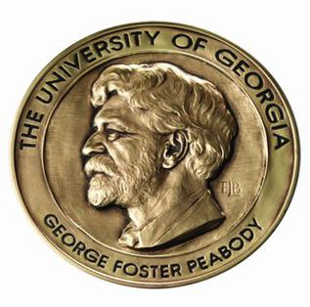
Received many honourable rewards…

Slide 3
…became part of national vocabulary

Slide 4
“Unshell” the Peanuts and you’ll find the fingerprints of his faith…

Slide 5
Schulz stood his ground with CBS

Slide 6
A CHARLIE BROWN CHRISTMAS was created…

Slide 7
Linus reads story of Jesus Birth in Gospel of Luke…

Slide 8
… just turn the other muzzle

Slide 9
Jesus parable of foolish man building house on sand…. Matthew 7

Slide 10
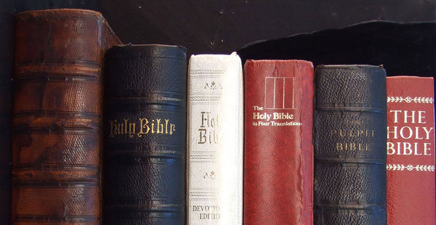
Schulz said in 1966…
Just the mere fact of quoting from
the Bible, of course, for a long while
was forbidden in comic strips
because somehow
they just didn’t want you
to go near these areas”

Slide 11
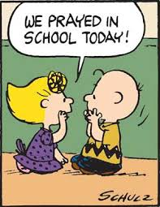
When do we pray?????

Slide 12
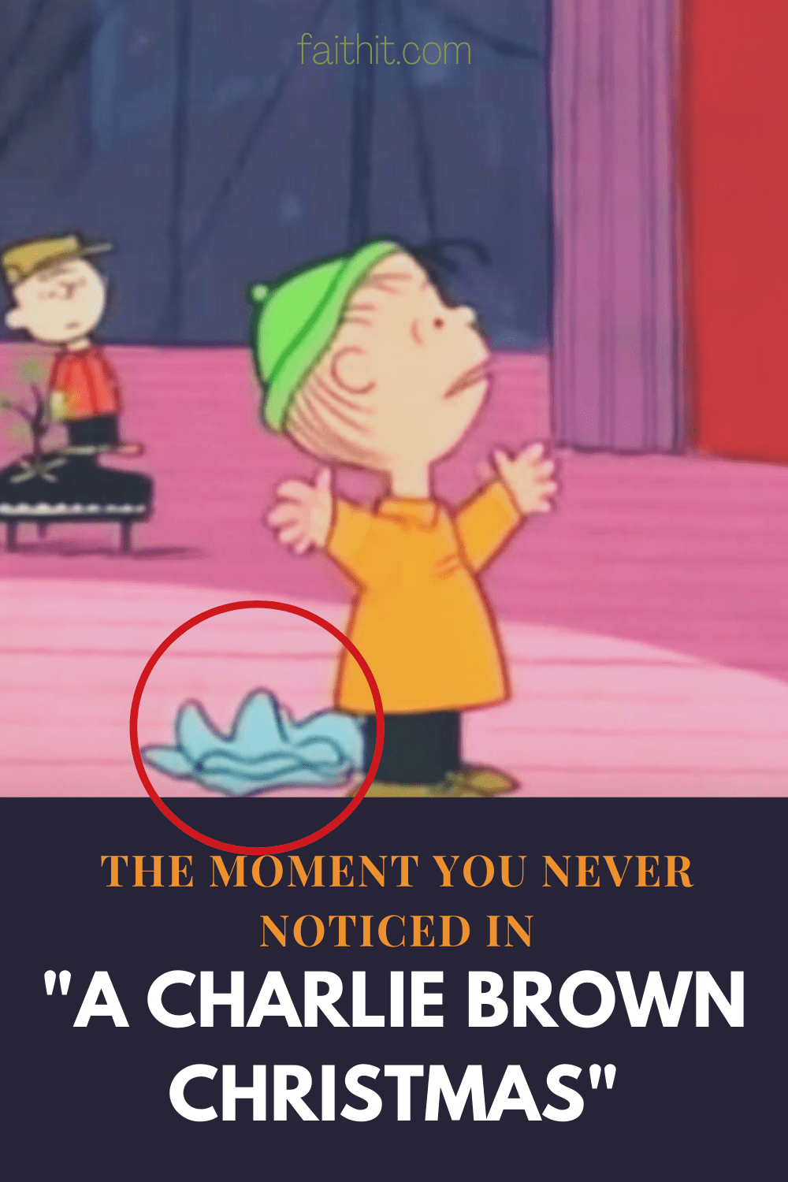
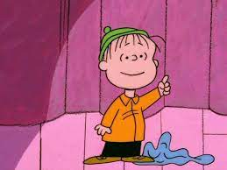
FEAR NOT!!!!

Slide 13
A Little Love can make ALL the difference

Slide 14
Christmas…. More than gifts… it’s the gift of life

Slide 15
BLESSINGS OF PEACE AND JOY AND LOVE BE YOURS THIS CHRISTMAS

