Slide 1
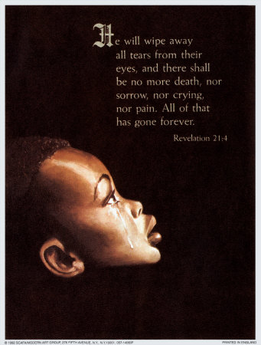
A DAY OF MOURNING
Text: Zechariah 7:3b

Slide 2
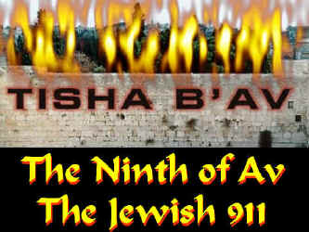
What Is So Significant about this Date That Our Jewish Friends Take this Time to Weep and Mourn?

Slide 3
I. A LOSS OF FREEDOM
Numbers 14:21-24;
Galatians 3:13,15

Slide 4
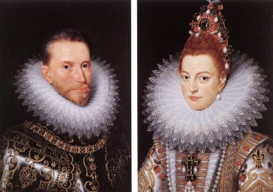
Spanish monarchs Ferdinand and Isabella issued a royal decree against all Jews on March 31, 1492

Slide 5
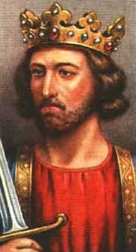
The Expulsion of Jews from England It was on the 9th of Av that the signing of the edict by King Edward I in 1290 took place expelling the Jews

Slide 6
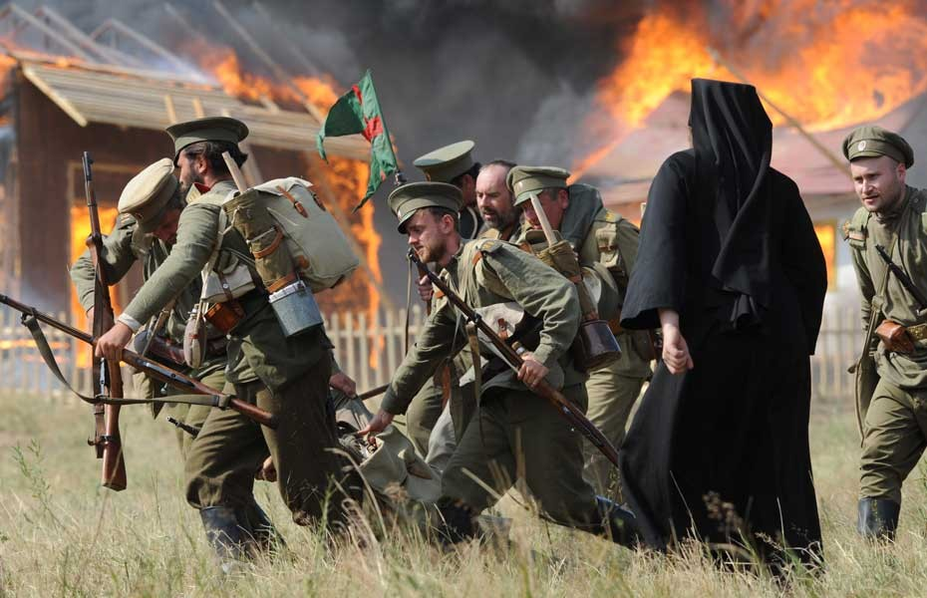
The start of the First World War in 1914 was on the 9th of Av

Slide 7
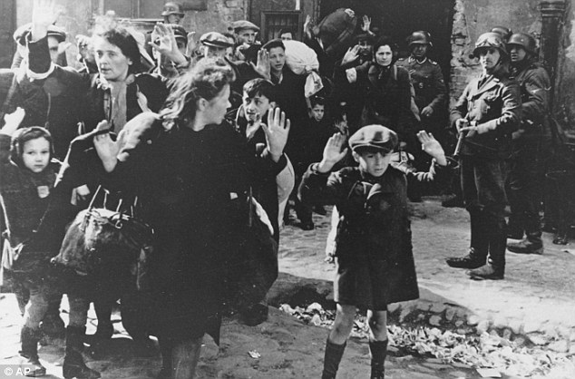
The mass deportation of Jews from the Warsaw Ghetto to the Treblinka extermination camp took place in Poland in 1942

Slide 8
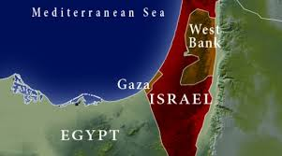
The beginning of the Israeli withdrawal from the Gaza Strip in 2005 took place on the 9th of Av

Slide 9
“You my brothers were called to be free. But do not use your freedom to indulge the sinful nature; rather, serve one another in love . . .
15. If you keep on biting and devouring each other, watch out or you will be destroyed by each other.”
Galatians 5:13,15

Slide 10
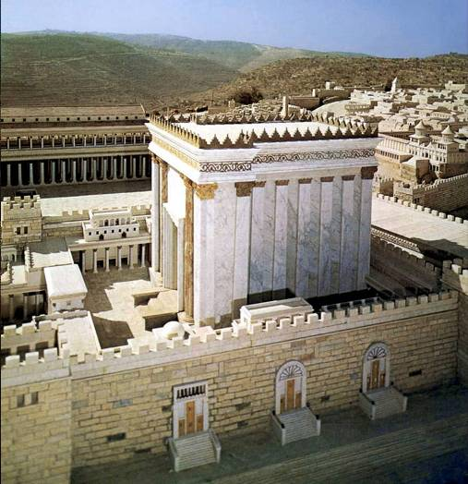
II. A LOSS OF WORSHIP
II Kings 25:8,9
cf. Jeremiah 52:12,13

Slide 11
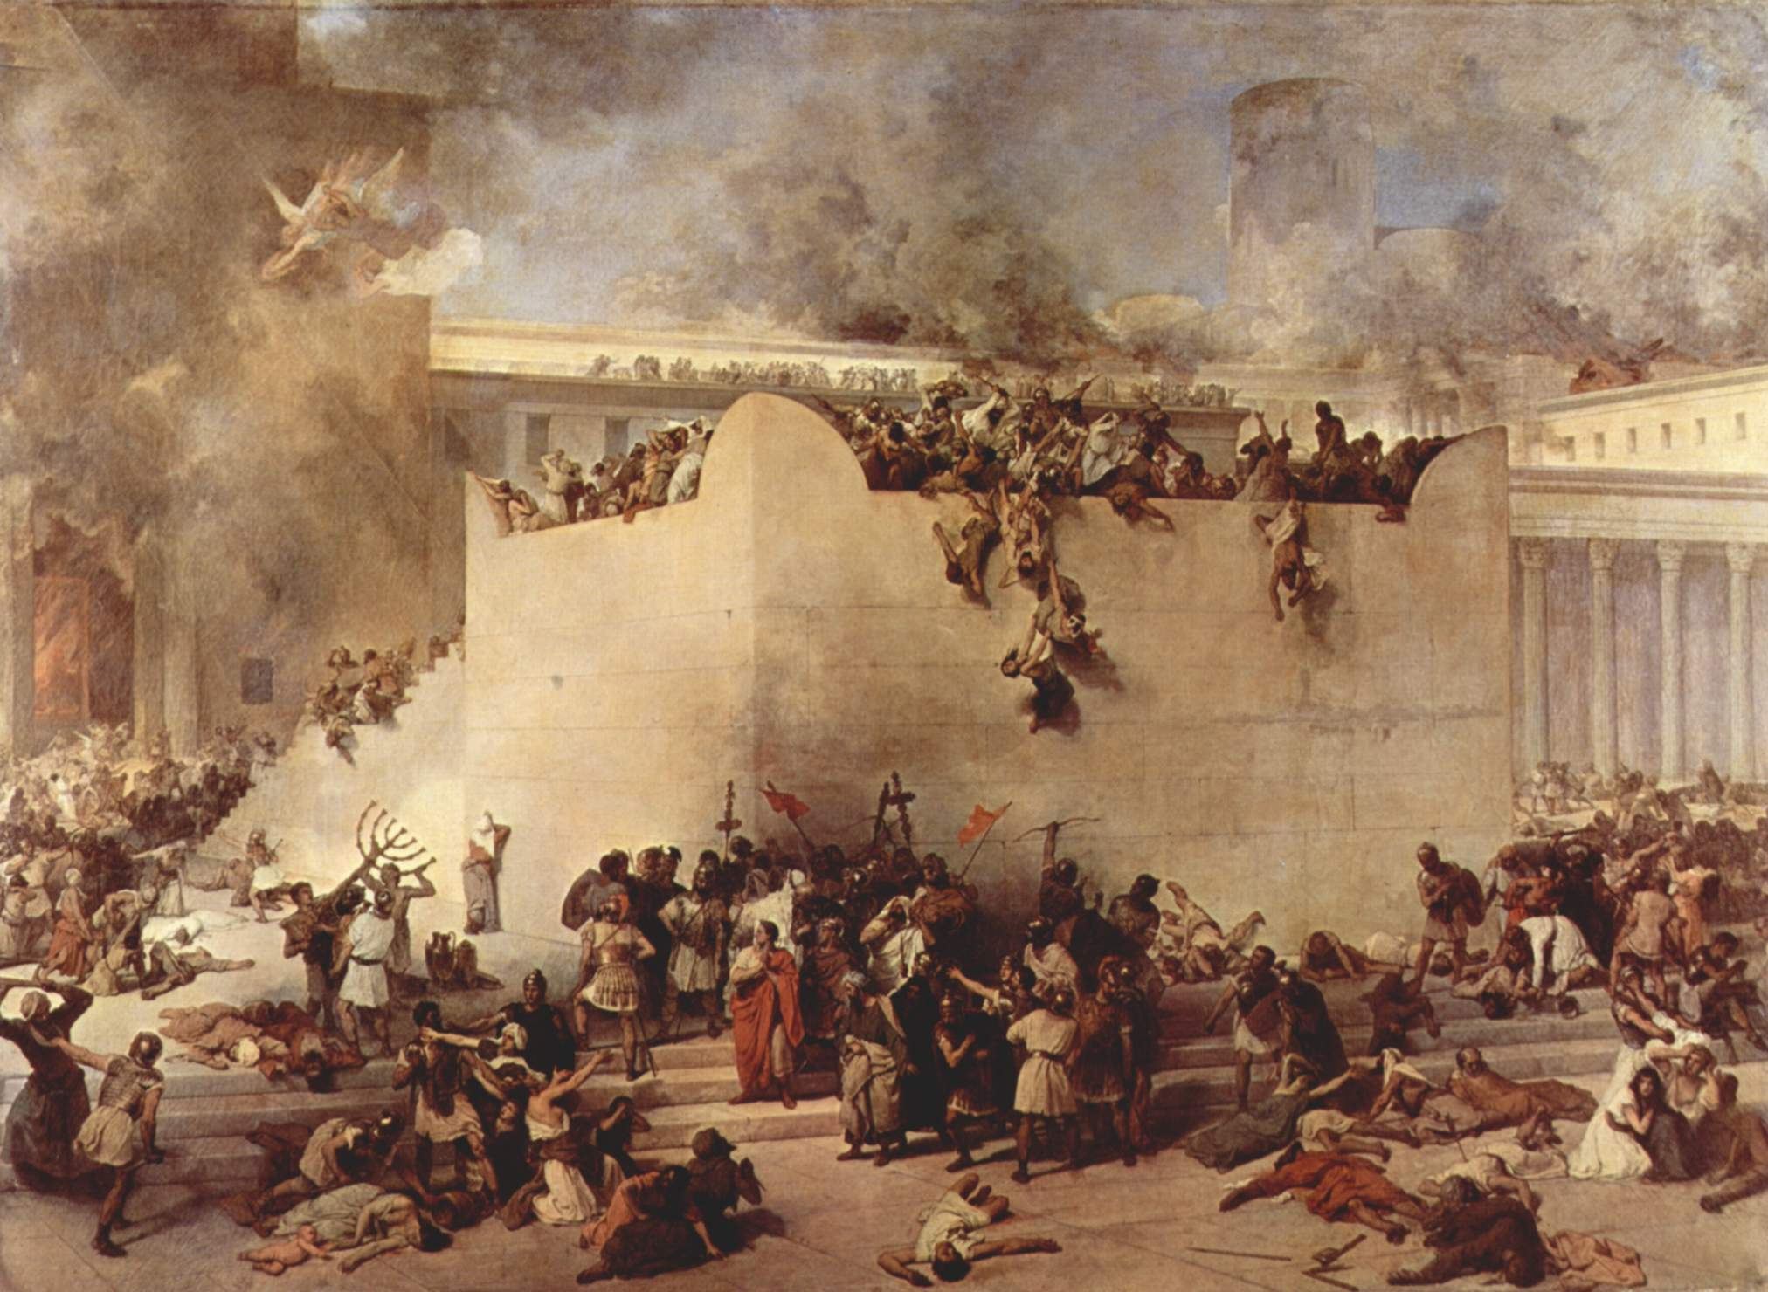
The Destruction of the 2nd Temple by the Romans in 70 AD took place on the 9th of Av

Slide 12
“The day will come upon you when your enemies will build and embankment against you and encircle you and hem you in on every side. 44. They will dash you to the ground, you and the children within your walls. They will not leave one stone upon another, because you did not recognize the time of God’s coming to you.” Luke 19:43,44

Slide 13
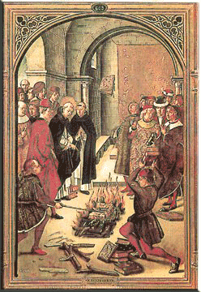
The burning of the Talmud took place in 1242 on the 9th of Av.

Slide 14
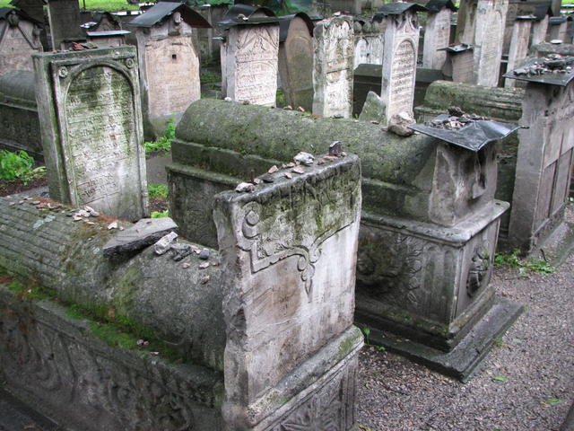
III. A LOSS OF LIFE
Psalm 30:5 ;
Zechariah 8:19;

Slide 15
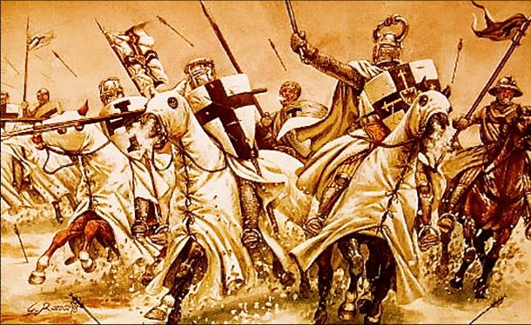
It was on this very day the declaration of the Crusades by Pope Urban II was issued in 1095.

Slide 16
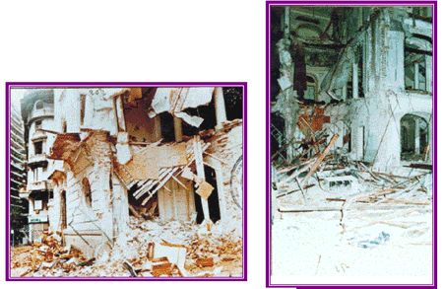
The bombing of the AMIA Jewish community center by Arab terrorists happened on the the 9th of Av in 1994 in Buenos Aires, Argentina

Slide 17
. . . weeping may remain for a night, but rejoicing comes in the morning.” Psalm 30:5

Slide 18
Zechariah 8

