Slide 1
A MOTHER’S DAY CARD FROM GOD
GOD’S TENDER PROMISES FOR MOTHERS.

Slide 2
Motherhood has affected each and everyone here today,
EVERYONE HERE EITHER
* HAS A MOTHER
* HAD A MOTHER
* IS A MOTHER
* IS MARRIED TO A MOTHER
* OR KNOWS A MOTHER
* OR CARES LIKE A MOTHER.

Slide 3
1. WHEN YOU FEEL DISCOURAGED… * Isaiah 40:28-31 * Philippians 4:13

Slide 4
2. WHEN YOU FEEL ANGRY… * Ephesians 4:26, 31,32 * Proverbs 15:1

Slide 5
3. WHEN YOU NEED HELP… * Proverbs 3:5,6 * Psalm 32:8 * Psalm 46:1 * Psalm 27:14 * Philippians 4:19 * Galatians 6:9

Slide 6
4. WHEN YOU FEEL ALONE… * Jeremiah 33:3 * John 14:18 * Hebrews 13:5 * Matthew 28:20

Slide 7
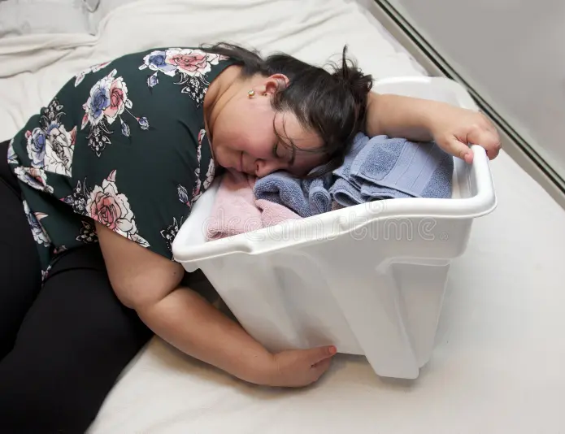
5. WHEN YOU FEEL TIRED… * Matthew 11:28 * Psalm 46:1 Come to Jesus for some much deserved REST!!

Slide 8
6. WHEN YOU ARE WORRIED…
* Philippians 4:6,7
* I Peter 5:7
MOTHERS, YOU DON’T HAVE TO WORRY. YOU HAVE SOMEBODY TO GO TO…DON’T DENY JESUS THE PRIVILEGE OF CARYING YOUR BURDENS FOR YOU!!!

Slide 9
MOTHERS, GOD HAS SENT YOU A MOTHER’S DAY CARD…

Slide 10
REMEMBER, YOU ARE NOT ALONE IN MOTHERHOOD… YOU CAN COUNT ON YOUR HEAVENLY FATHER!!

