Slide 1
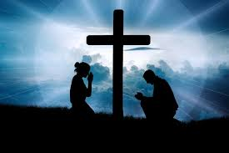
A Prayer of the Destitute
Text: Psalm 102

Slide 2
I. Description of Distress (102:3-11)
“destitute” - “extremely poor and lacking the means to provide for oneself.”

Slide 3
I. Description of Distress (102:3-11)
“This is a patriot’s lament over his country’s distress.”
Charles Spurgeon

Slide 4
I. Description of Distress (102:3-11)
“For my days vanish like smoke; my bones burn like glowing embers.
4. My heart is blighted and withered like grass; I forget to eat my food.
5. In my distress I groan aloud and am reduced to skin and bones.”
Psalm 102:3-5

Slide 5
I. Description of Distress (102:3-11)
6. “I am like a desert owl, like an owl among the ruins.
7. I lie awake; I have become like a bird alone on a roof.
8. All day long my enemies taunt me; those who rail against me use my name as a curse.”
Psalm 102:6-8

Slide 6
I. Description of Distress (102:3-11)
9. “For I eat ashes as my food and mingle my drink with tears
10. because of your great wrath, for you have taken me up and thrown me aside.
11. My days are like the evening shadow; I wither away like grass.”
Psalm 102:9-11

Slide 7
II. Assurance IN Time (102:12-16)
12. “But you, Lord, sit enthroned forever; your renown endures through all generations.
13. You will arise and have compassion on Zion, for it is time to show favor to her; the appointed time has come.” Psalm 102:12-13

Slide 8
II. Assurance IN Time (102:12-16)
14. “For her stones are dear to your servants; her very dust moves them to pity.
15. The nations will fear the name of the Lord, all the kings of the earth will revere your glory.
16. For the Lord will rebuild Zion and appear in his glory.”
Psalm 102: 14-16

Slide 9
II. Assurance IN Time (102:12-16)

Slide 10
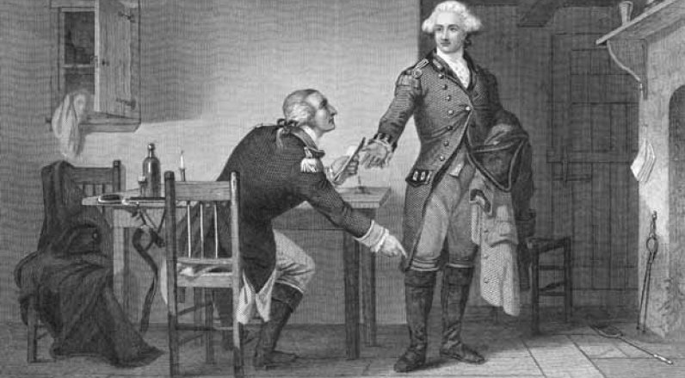
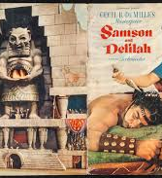
II. Assurance IN Time (102:12-16)

Slide 11
III. Recording God’s Greatness (102:17-22)
17. “He will respond to the prayer of the destitute; he will not despise their plea.
Let this be written for a future generation, that a people not yet created may praise the Lord:”
Psalm 102:17-18

Slide 12
III. Recording God’s Greatness (102:17-22)
19. “The Lord looked down from his sanctuary on high, from heaven he viewed the earth,
20. to hear the groans of the prisoners and release those condemned to death.”
Psalm 102:19-20

Slide 13
III. Recording God’s Greatness (102:17-22)
21. “So the name of the Lord will be declared in Zion and his praise in Jerusalem
22. when the peoples and the kingdoms assemble to worship the Lord.”
Psalm 102:21-22

