Slide 1
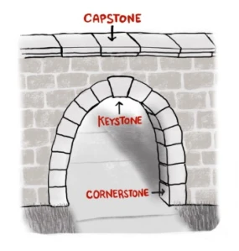
ACCEPTING THE CAPSTONE
Text: Luke 20:9-19

Slide 2
What Are the Benefits of Accepting Christ as the Capstone of Our Lives?

Slide 3
I. SANCTIFICATION
The word “sanctification” refers to the process of being “set apart as holy or for holy purposes.”

Slide 4
I. SANCTIFICATION
“15. So they threw him out of the vineyard and killed him.
“What then will the owner of the vineyard do to them?
16. He will come and kill those tenants and give the vineyard to others.” When the people heard this, they said, “May this never be!”
Luke 20:15,16

Slide 5
II. SIGNIFICANCE
NOT - power and pleasure
- violence and immorality
- buried conflicts
The Capstone always keeps everything else into its proper place.

Slide 6
II. SIGNIFICANCE
DON”T LACK – a “calling,” or what the early Christians later termed “vocation”
Don’t strive for . . . work/identity ladder . . .
self-serving, and often self-destructive

Slide 7
II. SIGNIFICANCE
If our significance relies on our job, then it dies when we lose our job.

Slide 8
II. SIGNIFICANCE Our Calling is . . .
● Irrevocable – Romans 11:29
● from God - II Thessalonians 2:14
● how God designed us – Ephesians 2:10
● God’s Assurance – I Cor. 1:7-9
● Our True Identity – I Peter 2:5,9
● Carries us through suffering – I Peter 2:19-21
● Rooted in Peace - I Cor. 7:15-24
●Focussed upon Eternal Achievements – Philippians 3:13 - 4:1

Slide 9
II. SIGNIFICANCE
Above all else,
believers are called to character development, service to others, and loyalty to God.
“We know that all things work together for good to those who love God, to those who are called according to His purpose” (Romans 8:28).”

Slide 10
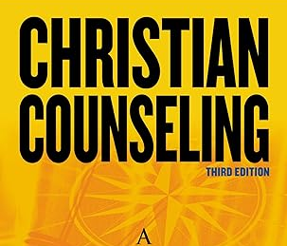
III. SECURITY
Women are very sensitive
to what is truly secure
and what is not.

Slide 11
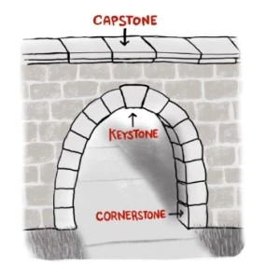
III. SECURITY
If your security is not based upon the
Capstone of all mankind, then what is it that you are depending upon to hold you up and save you?

Slide 12
III. SECURITY
“Everyone who falls on that stone will be broken to pieces, but he on whom it falls will be crushed.”
Luke 20:18

