Slide 1
THE SERMON ON THE MOUNT SERIES “ADULTERY - FROM A LUSTFUL HEART” Text: Matthew 5:27-30

Slide 2
The English word, lust, comes from the Greek word “epithumia.” It is defined as “a longing or a desire.”
A desire in and of itself is not wrong.

Slide 3
Lust is different.
It’s a desire for something forbidden.

Slide 4
I. DEAL WITH IT HONESTLY (Matthew 5:27-28)
A. Recognize That it Contributes to the Degradation of Women

Slide 5
I. DEAL WITH IT HONESTLY (Matthew 5:27-28)
B. It Encourages Teenage Sexual Activity

Slide 6
I. DEAL WITH IT HONESTLY (Matthew 5:27-28)
C. It Leads to Addictive Behaviour

Slide 7
I. DEAL WITH IT HONESTLY (Matthew 5:27-28)
D. It Can Damage/Destroy a Person’s Conscience

Slide 8
I. DEAL WITH IT HONESTLY (Matthew 5:27-28)
"The eye is the lamp of the body. So, if your eye is healthy, your whole body will be full of light; but if your eye is unhealthy, your whole body will be full of darkness.
23. If then the light in you is darkness, how great is the darkness?"
Matthew 6:22-23

Slide 9
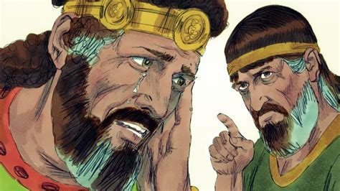
I. DEAL WITH IT HONESTLY (Matthew 5:27-28)
E. It Destroys Our Relationship with God

Slide 10
II. DEAL WITH IT DRASTICALLY (Matthew 5:29-30)
"If your right eye causes you to sin, gouge it out and throw it away. It is better for you to lose one part of your body than for your whole body to be thrown into hell.
30. And if your right hand causes you to sin, cut it off and throw it away. It is better for you to lose one part of your body than for your whole body to go into hell."
Matthew 5:29-30

Slide 11
II. DEAL WITH IT DRASTICALLY (Matthew 5:29-30)
Recognize and Name the Problem
“If we confess our sins, he who is faithful and just will forgive us our sins and cleanse us from all unrighteousness.”
I John 1:9

Slide 12
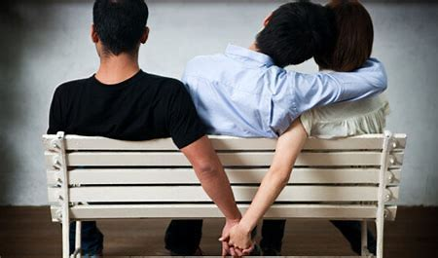
II. DEAL WITH IT DRASTICALLY (Matthew 5:29-30)
B. Stop Feeding Lust
“Flee sexual immorality. Every sin that a man does is outside the body, but he who commits sexual immorality sins against his own body.”
I Corinthians 6:18

Slide 13
II. DEAL WITH IT DRASTICALLY (Matthew 5:29-30)
C. Demythologize it!
“Flee sexual immorality. Every sin that a man does is outside the body, but he who commits sexual immorality sins against his own body.”
I Corinthians 6:18

Slide 14
II. DEAL WITH IT DRASTICALLY (Matthew 5:29-30)
D. Confess the Personal Price
“Flee sexual immorality. Every sin that a man does is outside the body, but he who commits sexual immorality sins against his own body.”
I Corinthians 6:18

Slide 15
II. DEAL WITH IT DRASTICALLY (Matthew 5:29-30)
E. Understand God’s Perspective on Sex
“Let marriage be held in honor by all, and let the marriage bed be kept undefiled, - for God will judge fornicators and adulterers.”
Hebrews 13:4

Slide 16
II. DEAL WITH IT DRASTICALLY (Matthew 5:29-30)
F. Trace the Source of Your Desires
What do you really need?

