Slide 1
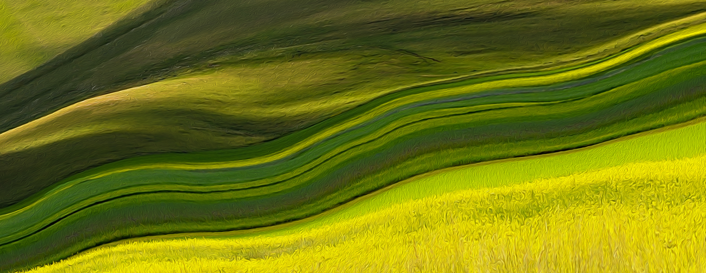
AFRAID YET FILLED WITH JOY
Text: Matthew 28:1-10
Text: Matthew 28:1-10

Slide 2
Let's Take Some Time to Review the Facts in this Story.

Slide 3
I. THE SPICES, SEPULCHRE,STONE & SEAL
Mark 15:33;
Mark 15:42;
John 19:39
Luke 23:56
Matthew 27:63
cf. - Numbers 4:3; Luke 3:21

Slide 4
I. THE SPICES, SEPULCHRE,STONE & SEAL
“The next day, the one after Preparation Day, the chief priests and the Pharisees went to Pilate.
63. “Sir,” they said, “we remember that while he was still alive that deceiver said, ‘After three days I will rise again.’
64. So give the order for the tomb to be made secure until the third day. Otherwise, his disciples may come and steal the body and tell the people that he has been raised from the dead. This last deception will be worse than the first.”

Slide 5
I. THE SPICES, SEPULCHRE,STONE & SEAL
65. “Take a guard,” Pilate answered. “Go, make the tomb as secure as you know how.”
66. So they went and made the tomb secure by putting a seal on the stone and posting the guard.”
Matthew 27:62-66

Slide 6
I. THE SPICES, SEPULCHRE,STONE & SEAL
“There was a violent earthquake, for an angel of the Lord came down from heaven and, going to the tomb, rolled back the stone and sat on it.”
Matthew 28:2

Slide 7
I. THE SPICES, SEPULCHRE,STONE & SEAL
Then one of the elders said to me, “Do not weep! See, the Lion of the tribe of Judah, the Root of David, has triumphed. He is able to open the scroll and its seven seals.”
Revelation 5:5

Slide 8
I. THE SPICES, SEPULCHRE,STONE & SEAL
“You are worthy to take the scroll and to open its seals,
because you were slain,
and with your blood you purchased for God persons from every tribe and language and people and nation.
10. You have made them to be a kingdom and priests to serve our God, and they will reign on the earth.”
Revelation 5:9-10

Slide 9
I. THE SPICES, SEPULCHRE,STONE & SEAL
11. Then I looked and heard the voice of many angels, numbering thousands upon thousands, and ten thousand times ten thousand. They encircled the throne and the living creatures and the elders.
12. In a loud voice they were saying:
“Worthy is the Lamb, who was slain,
to receive power and wealth and wisdom and strength and honor and glory and praise!”

Slide 10
I. THE SPICES, SEPULCHRE,STONE & SEAL
13. Then I heard every creature in heaven and on earth and under the earth and on the sea, and all that is in them, saying:
“To him who sits on the throne and to the Lamb
be praise and honor and glory and power,
for ever and ever!”
Revelation 5:11-13

Slide 11
II. THE PASSOVER
“
Then Moses summoned all the elders of Israel and said to them, “Go at once and select the animals for your families and slaughter the Passover lamb.
22. Take a bunch of hyssop, dip it into the blood in the basin and put some of the blood on the top and on both sides of the doorframe. None of you shall go out of the door of your house until morning. Exodus 12:21-23

Slide 12
II. THE PASSOVER
23. When the Lord goes through the land to strike down the Egyptians, he will see the blood on the top and sides of the doorframe and will pass over that doorway, and he will not permit the destroyer to enter your houses and strike you down.
Exodus 12:21-23

Slide 13
II. THE PASSOVER
Its clear that the name for this day should be “passover” and nothing else. It comes from the Latin word pascha, from the Ancient Greek πάσχα (paskha, “Passover”), from Aramaic פסחא (paskha), from Hebrew פסח (pesakh).
I can’t believe that the word “Easter” replaces “Passover” in the KJV in Acts 12:4. It has nothing to do with animal reproduction.

Slide 14
III. THE RESURRECTION
“Why do you look for the living among the dead?
6. He is not here: he has risen! Remember how he told you when he was still with you in Galilee
7. The Son of Man must be delivered into the hands of sinful men, be crucified and the third day rise again.”
8. Then they remembered his words.”
Luke 24:5-8

Slide 15
III. THE RESURRECTION
The word describing Him being risen is found throughout the New Testament in the books of Matthew, Mark, Luke, John, Acts, Romans (10:6), First Corinthians (2:9), Galatians (2:1-2), Ephesians (4:8-10), and Revelation, the Greek verb “anabaino” meant “go up” or “ascend.”

Slide 16
III. THE RESURRECTION
This verb “anabaino” is first used in Matthew 3:16; Jesus “went up” from the water after being baptized by John.
The word used for baptism is “baptizo” which means “to immerse or dip.”

Slide 17
III. THE RESURRECTION
Jesus replied, “Let it be so now; it is proper for us to do this to fulfill all righteousness.” Then John consented.
16. As soon as Jesus was baptized, he went up out of the water. At that moment heaven was opened, and he saw the Spirit of God descending like a dove and alighting on him.

Slide 18
III. THE RESURRECTION
17. And a voice from heaven said, “This is my Son, whom I love; with him I am well pleased.”
Matthew 3:15-17

Slide 19
III. THE RESURRECTION
Then some of the Pharisees and teachers of the law said to him, “Teacher, we want to see a sign from you.”
39. He answered, “A wicked and adulterous generation asks for a sign! But none will be given it except the sign of the prophet Jonah.

Slide 20
III. THE RESURRECTION
40. For as Jonah was three days and three nights in the belly of a huge fish, so the Son of Man will be three days and three nights in the heart of the earth.”
Matthew 12:38-40

