Slide 1
ANGER – THE CANCER FROM WITHIN (from an unforgiving heart)
Matthew 5:21-26

Slide 2
I. ANGER - CONTROLLED OR RESOLVED (Matthew 5:21-22)

Slide 3
“My dear brothers, take note of this: Everyone should be quick to listen, slow to speak and slow to become angry. For man’s anger does not bring about the righteous life that God desires.” James 1:19-20

Slide 4
“But I tell you that anyone who is angry with his brother will be subject to judgement. Again, anyone who says to his brother, ‘Raca,’ is answerable to the Sanhedrin. But anyone who says, ‘You fool!’ will be in danger of the fire of hell.’ Matthew 5:22

Slide 5
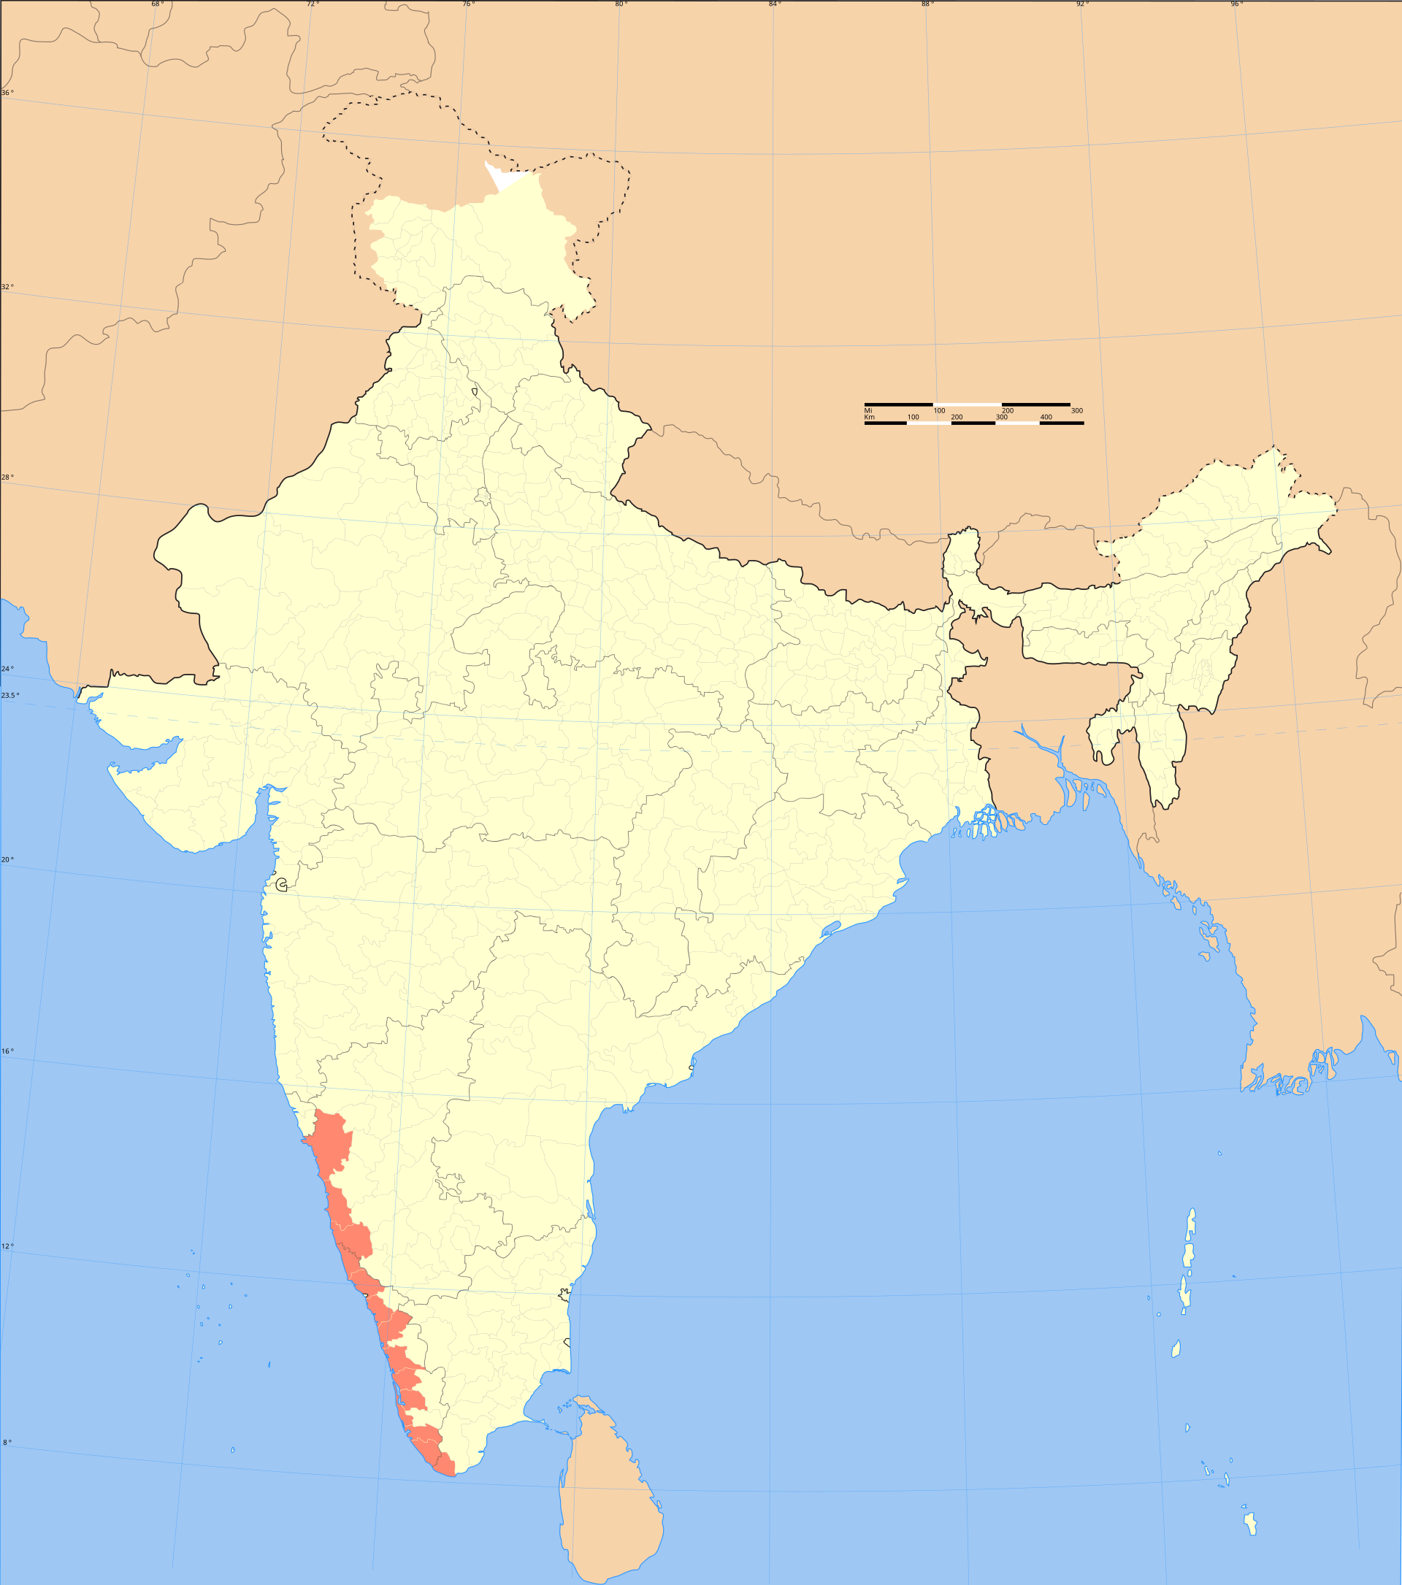
“Anger is as a stone cast into a wasp's nest.” Malabar Proverb

Slide 6
“thumos.” This word describes the flame which comes from a dried straw that catches fire. It quickly blazes but also dies away just as quick.

Slide 7
The other word is “orge” (or-gay) which describes an anger that is long-lived; it is nursed; it is not allowed to die.

Slide 8
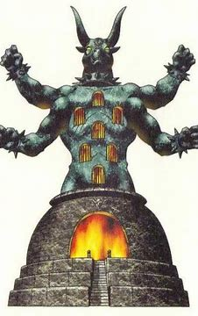
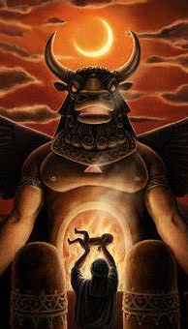
The “fire of hell” is the “fire of Gehenna (Gr.).” Every Jew knew that it meant the “Valley of Hinnom” (Heb.) which was known for its heathen worship of the Ammonite god called Molech

Slide 9
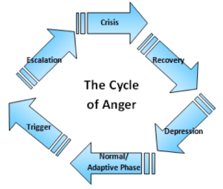
II. ANGER - ESCALATED OR ELIMINATED (Matthew 5:23-24) ◊ Our worship of God can be disturbed, disrupted and even destroyed by thoughts of anger. ◊ Anger can become a clear sign that we need to take the proper steps toward reconciliation.

Slide 10
II. ANGER - ESCALATED OR ELIMINATED (Matthew 5:23-24) “Therefore, if you are offering your gift at the altar and there remember that your brother has something against you, 24. leave your gift there in front of the altar. First go and be reconciled to your brother; then come and offer your gift.” Matthew 5:23,24

Slide 11
II. ANGER - ESCALATED OR ELIMINATED (Matthew 5:23-24) Jesus will accept our gifts of confession and forgiveness when we surrender to Him our “right” to get even and escalate our anger.

Slide 12
III. ANGER - REPRESSED OR EXPRESSED (Matthew 5:25-26) If we let garbage pile up in our lives, we will soon create a dump.

Slide 13
III. ANGER - REPRESSED OR EXPRESSED (Matthew 5:25-26) Some people have given so many others a “piece of their mind” that they’ve left themselves little to use.

