Slide 1
ARE YOU LISTENING??
Listen Up! Can you hear me?
Come here so I know you are listening.

Slide 2
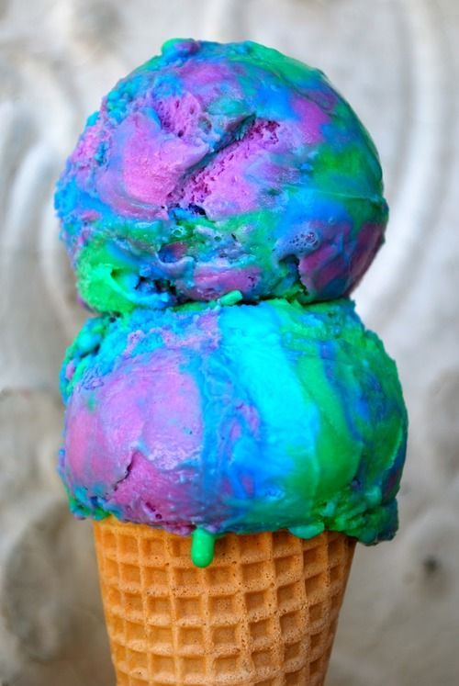
Are you listening????

Slide 3
BE STILL AND KNOW Psalms 46:10

Slide 4
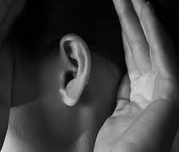
LEAN INTO HIS WHISPER
1 Kings 19
“God said “Go out and stand in front of the Lord on the mountain.” As the Lord was passing by a fierce wind tore mountains and shattered rocks ahead of the Lord. But the Lord was not in the wind. After the wind came an earthquake. But the Lord wasn’t in the earthquake. After the earthquake there was a fire. But the Lord wasn’t in the fire. And after the fire there was a quiet, whispering voice. ”

Slide 5
LEARNING TO WAIT

Slide 6
WHEN IT SEEMS QUIET

Slide 7
THE SECRET PLACE

Slide 8
If taking time to be quiet with God was something even Jesus himself did regularly, even being God’s son, then how much more do we need to take the time to tune our ears towards Him?

Slide 9
I’M LISTENING LORD…

