Slide 1
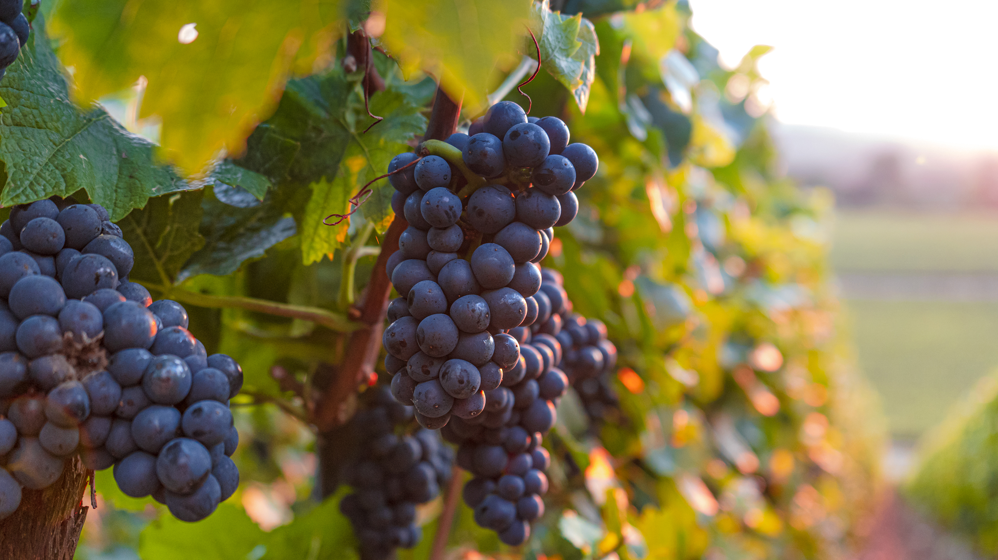
Abiding In Christ
Text: John 15:4-5

Slide 2
“Abide in Me, and I in you. As the branch cannot bear fruit of itself, unless it abides in the vine, neither can you, unless you abide in Me. I am the vine; you are the branches. He who abides in Me, and I in him, bears much fruit; for without Me you can do nothing.” John 15:4-5

Slide 3
I. Intimate Walk

Slide 4
II. Growing In Your Faith

Slide 5
III. Put Christ First

Slide 6
IV. Having a Lifestyle of Prayer

Slide 8
“For I know the thoughts that I think toward you says the LORD, thoughts of peace and not of evil, to give you a future and a hope. Then you will call upon Me and go and pray to Me, and I will listen to you. And you will seek Me and find Me, when you search for Me with all your heart.” Jeremiah 29:11-13

