Slide 1
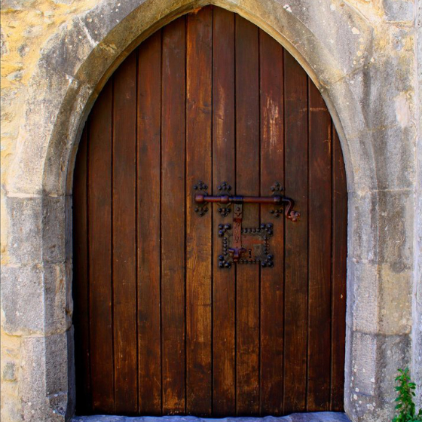
BEHIND CLOSED DOORS
Text: John 20:19-23

Slide 2
BEHIND CLOSED DOORS
We Need to Recognize and Positively Respond to the Process That Is Taking Place
Text: John 20:19-23

Slide 3
I. TIME OF ISOLATION (John 20:19)
"On the evening of that first day of the week, when the disciples were together, with the doors locked for fear of the Jewish leaders, Jesus came and stood among them and said, 'Peace be with you!’”
John 20:19

Slide 4
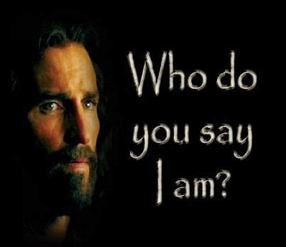
I. TIME OF ISOLATION (John 20:19)
"You are the Christ, the Son of the living God."
Matthew 16:16

Slide 5
I. TIME OF ISOLATION (John 20:19)
Jesus said,
"Peace be with you."
John 20:19,21,26

Slide 6
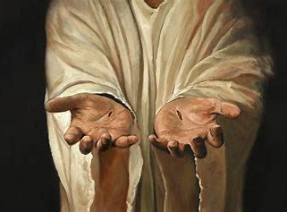
II. TIME OF IDENTIFICATION (John 20:20)
"After he said this (Peace be with you) he showed them his hands and side. The disciples were overjoyed when they saw the Lord."
John 20:20

Slide 7
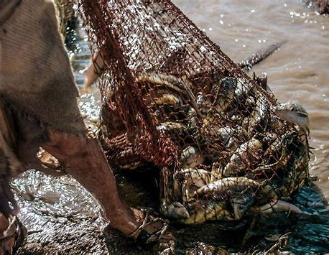
II. TIME OF IDENTIFICATION (John 20:20)
The number 153 is the numerical total for the Hebrew words
"Ani Elohim"—
I AM G-D.

Slide 8
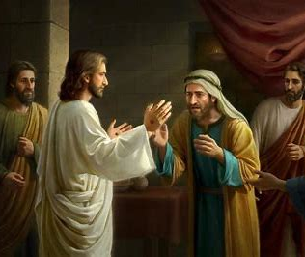
II. TIME OF IDENTIFICATION (John 20:20)
PEOPLE CAN OFTEN IDENTIFY WITH THE LIMITATIONS THAT ARE PLACED UPON THEIR LIVES
BUT
CANNOT SEE THE FREEDOM THAT THEY GAIN THROUGH THOSE LIMITATIONS.

Slide 9
II. TIME OF IDENTIFICATION (John 20:20)
". . . Unless I see the nail marks in his hands and put my finger where the nails were, and put my hand into his side,
I will not believe."
John 20:25

Slide 10
II. TIME OF IDENTIFICATION (John 20:20)
"Then he said to Thomas, "Put your finger here; see my hands. Reach out your hand and put it into my side. Stop doubting and believe.“
28. Thomas said to him, "My Lord and my God."
John 20:27,28

Slide 11
II. TIME OF IDENTIFICATION (John 20:20)
"Then Jesus told him (Thomas) ‘Because you have seen me, you have believed; blessed are those who have not seen (me and my scars) and yet have believed."
John 20:29

Slide 12
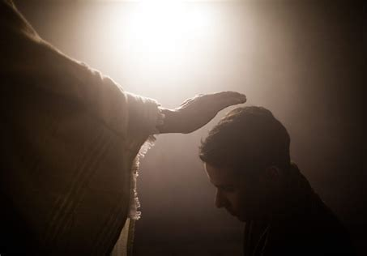
III. TIME OF IMPARTATION (John 20:21-23)
"As the Father has sent me, I am sending you."
22. And with that he breathed on them and said, Receive the Holy Spirit."
23. If you forgive anyone his sins, they are forgiven; if you do not forgive them, they are not forgiven."
John 20:21-23

Slide 13
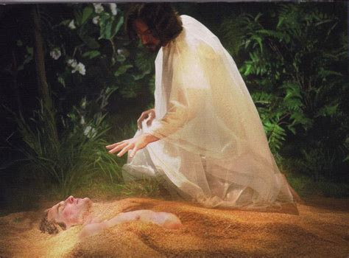
III. TIME OF IMPARTATION (John 20:21-23)
" the Lord formed the man from the dust of the ground and breathed into his nostrils the breath of life, and man became a living being."
Genesis 2:7

Slide 14
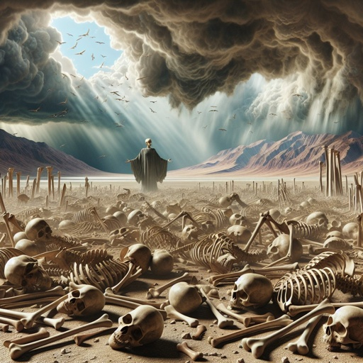
III. TIME OF IMPARTATION (John 20:21-23)
"Then he said to me, 'Prophesy to the breath; prophesy, son of man, and say to it, 'This is what the Sovereign LORD says: Come, breath, from the four winds, O breath, and breathe into these slain that they may live.
10. So I prophesied as he commanded me, and breath entered them; they came to life and stood up upon their feet - a vast army."
Ezekiel 37:9,10

Slide 15
III. TIME OF IMPARTATION (John 20:21-23)
This is what was written . . .

Slide 16
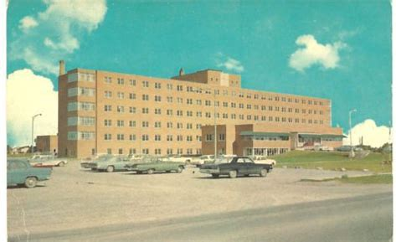
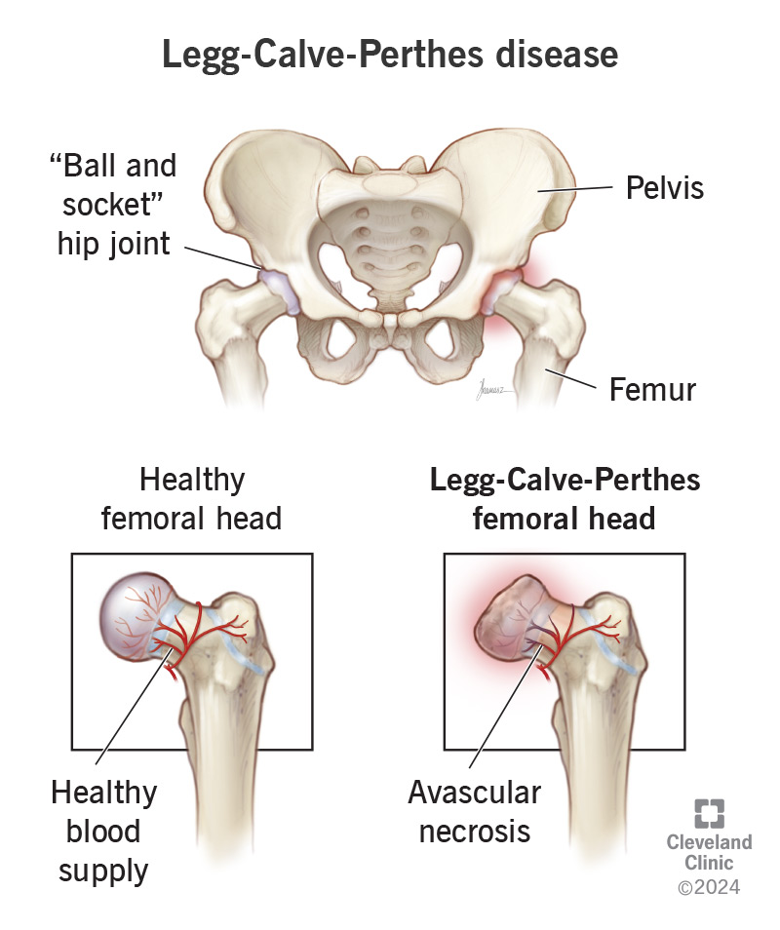
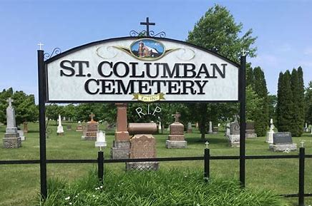
III. TIME OF IMPARTATION (John 20:21-23)
Dr. Charles Pender
(Pediatrician at Hotel Dieu in Cornwall)
He passed away Oct 14, 1981 and was buried in the St. Columban Cemetery.
R. I. P.

Slide 17
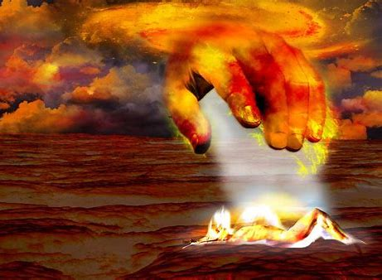
III. TIME OF IMPARTATION (John 20:21-23)
Give yourself wholeheartedly to God and let Him do what is needed in your life

