Slide 1
BLESSED ARE THE PERSECUTED
Text: Matthew 5:10-12

Slide 2
Introduction :
Proverbs 17:17; Psalm 42:1; Romans 8:23; II Timothy 3:12; Philippians 1:29; I John 3:12; Genesis 37,39; Exodus 5:21; 14:11; 16:2; 17:2; I Samuel 8:5; I Kings 18:18; Nehemiah 4; Acts 7; Acts 4:3; Acts 12:2; John 15:19,20; Romans 8:7

Slide 3
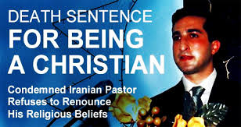
Jesus highlighted three specific areas that persecution will take place.
1. Insults (reviling)
2. Persecution
3. Evil speaking - I Peter 2:20

Slide 4
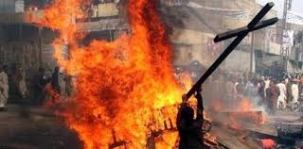
There were several areas of life which the Christians had to make a choice in What and Who they would stand for.
1. Their Christianity Disrupted Their Work
2. Their Christianity Disrupted Their Social Life
3. Their Christianity Disrupted Their Homes

Slide 5
Persecution began for many other reasons as well.
1. The Christians were accused of cannibalism.
2. The Christians were accused of immoral practises.
3. The Christians were accused of being agitators.
4. The Christians were accused of being insurrectionists.
Matthew 5:11a; Revelation 14:13; Hebrews 11:25; Acts 5:41; Romans 8:17

