Slide 1
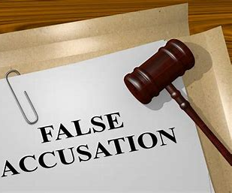
BREAKING THE CYCLE OF ACCUSATIONS
Text: Mark 2:1-3:6

Slide 2
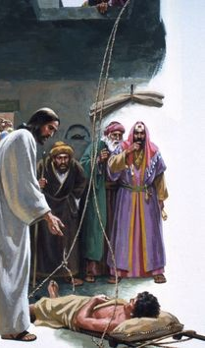
I. AN INTENSE LOOKING (Mark 2:5,12b, 16; 3:2,5a)
“When Jesus saw their faith, he said to the paralytic, ‘Son, your sins are forgiven.” Mark 2:5

Slide 3
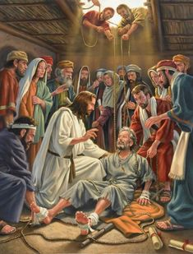
I. AN INTENSE LOOKING (Mark 2:5,12b, 16; 3:2,5a)
“He got up, took his mat and walked out in full view of them all. This amazed everyone and they praised God, saying, ‘We have never seen anything like this!”
Mark 2:12

Slide 4
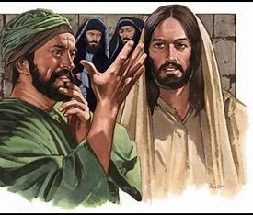
I. AN INTENSE LOOKING (Mark 2:5,12b, 16; 3:2,5a)
“Some of them were looking for a reason to accuse Jesus, so they watched him closely to see if he would heal him on the Sabbath.” Mark 3:2

Slide 5
I. AN INTENSE LOOKING (Mark 2:5,12b, 16; 3:2,5a)
“Jesus said to the man with the shriveled hand, ‘Stand up in front of everyone.” Mark 3:3

Slide 6
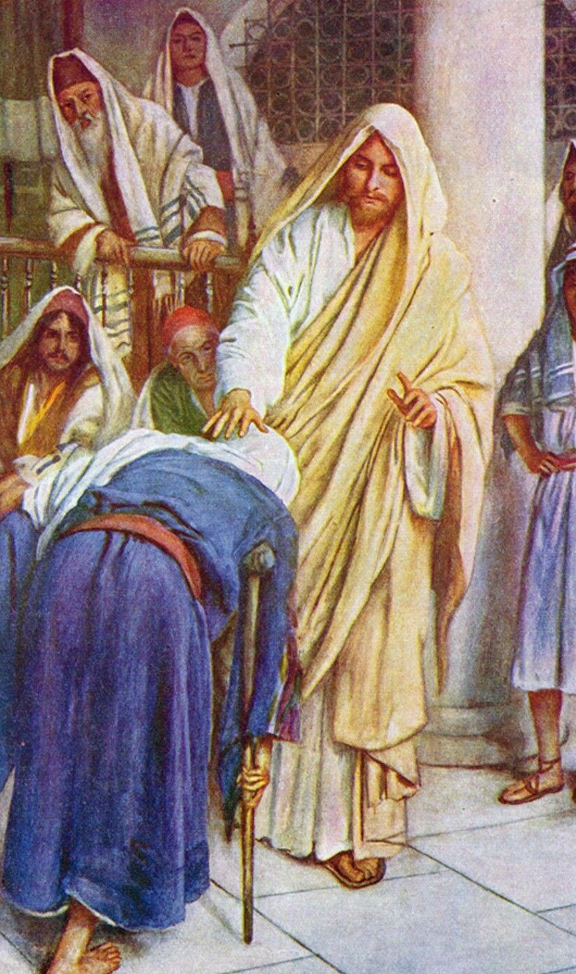
I. AN INTENSE LOOKING (Mark 2:5,12b, 16; 3:2,5a)
“There are six days for work. So come and be healed on these days, not on the Sabbath.”
Luke 13:14

Slide 7
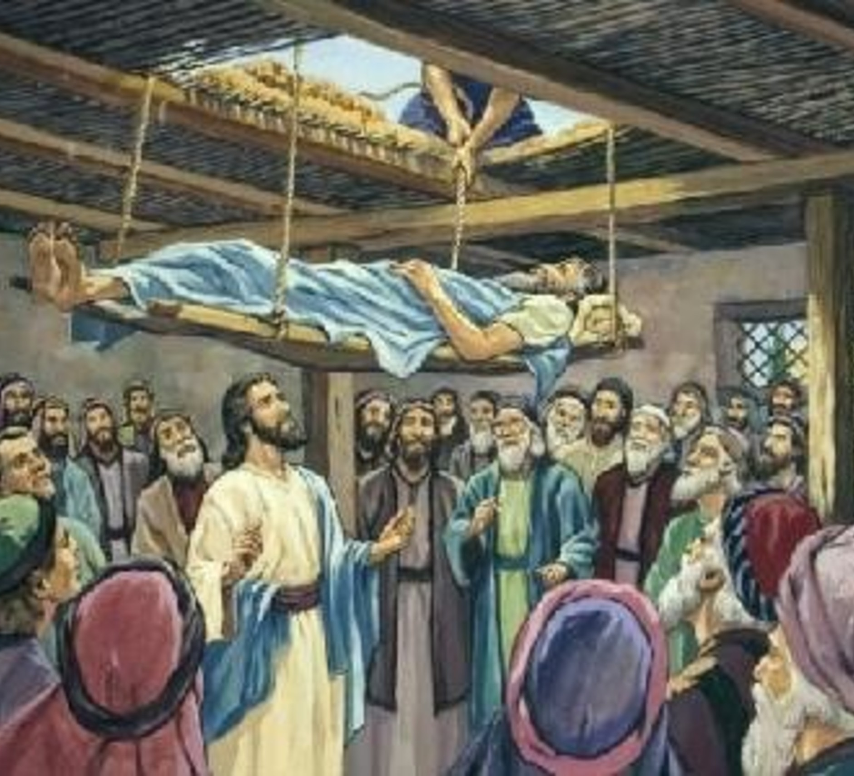
II. AN impartial loving
“The whole history of civilization is strewn with creeds and institutions which were invaluable at first, and deadly afterwards.”
Walter Bagehot
“In 12,000 Religious Quotations”
p. 364

Slide 8
II. AN impartial loving
“When Jesus saw their faith, he said to the paralytic, ‘Son, your sins are forgiven.”
Mark 2:5

Slide 9
II. AN impartial loving
“Then Jesus asked them, ‘Which is lawful on the Sabbath: to do good or to do evil, to save life or to kill?' But they remained silent."
Mark 3:4

Slide 11
III. AN immediate living
Paralytic – got up, took his mat and walked
Withered hand – He stretched it out, and his hand was completely restored

