Slide 1
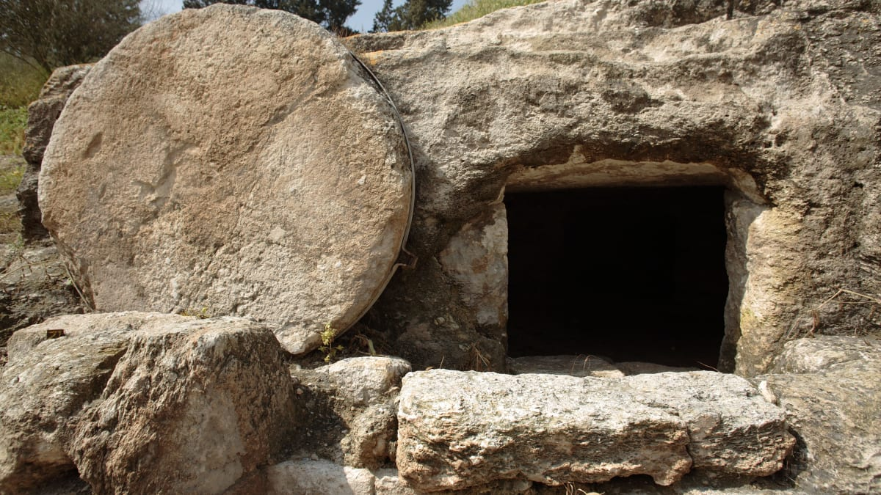
Breaking Out of Your Tomb
John 20:24-29

Slide 2
We All Have Tombs….

Slide 3
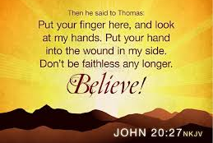
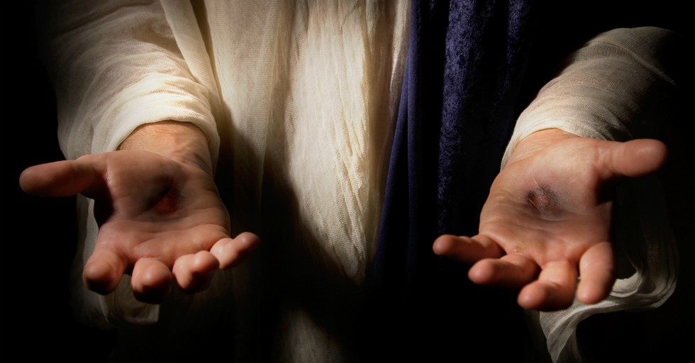
Thomas, the Disciple of Disbelief

Slide 4
What do YOU need to do to become Free of Your Tomb?

Slide 5
I. DISCOVER YOUR TOMB

Slide 6
“Examine yourselves, to see whether you are in the faith. Test yourselves. Or do you not realize this about yourselves, that Jesus Christ is in you? – unless indeed you fail to meet the test.” 2 Corinthians 13:5

Slide 7
II. BURY YOUR TOMB

Slide 8
“Forget the former things; do not dwell on the past. See, I am doing a new thing! Now it springs up; do you not perceive it? I am making a way in the wilderness and streams in the wasteland.” Isaiah 43:18-19
“Therefore, if anyone is in Christ, the: The old has gone, the new is here! All this is from God, who reconciled us to himself through Christ and gave us the ministry of reconciliation.”
2 Corinthians 5:17-18

Slide 9
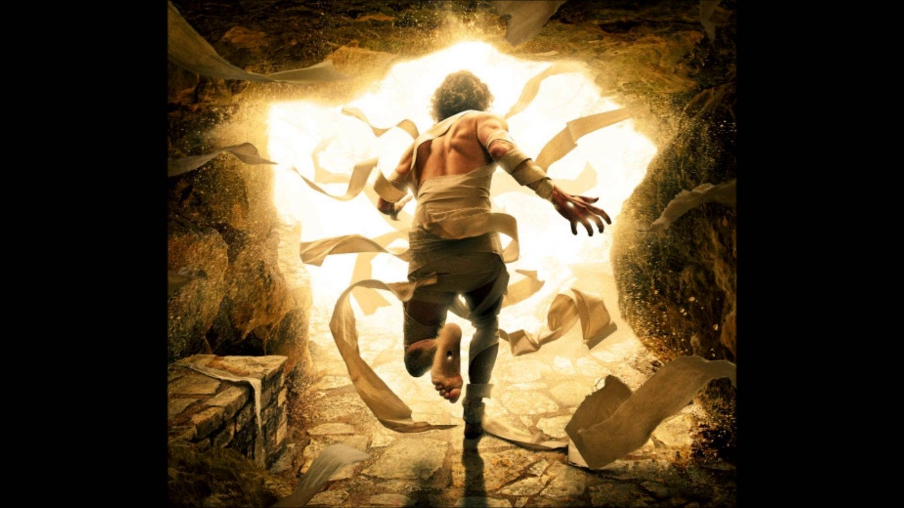
III. BREAK OUT OF YOUR TOMB WITH THE POWER OF GOD

Slide 10
“Many shall purify themselves and make themselves white and be refined, but the wicked shall act wickedly. And none of the wicked shall understand, but those who are wise shall understand.” Daniel 12:10
“And take the helmet of salvation, and the sword of the Spirit, which is the Word of God.”
Ephesians 6:17

Slide 11
God is serious about you… because He loves you!

Slide 12
1. Jesus Died

Slide 13
2. Jesus Died for OUR Sins

Slide 14
3. Jesus Defeated Death!

