Slide 1
CHALLENGES TO OUR UNDERSTANDING
Text: Job 16:1-22

Slide 2
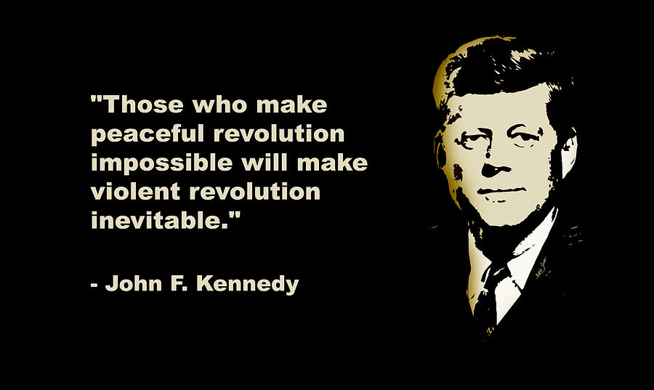

Slide 3
I. PROPER UNDERSTANDING ABOUT HIS “COMFORTERS” (Job 16:1-6)
“I have heard many things like these; you are miserable comforters, all of you!
Job 16:2

Slide 4
I. PROPER UNDERSTANDING ABOUT HIS “COMFORTERS” (Job 16:1-6)
“Will your long-winded speeches never end? What ails you that you keep on arguing?”
Job 16:3

Slide 5
I. PROPER UNDERSTANDING ABOUT HIS “COMFORTERS” (Job 16:1-6)
“Set your minds on things above, not on earthly things.”
Colossians 3:2

Slide 6
I. PROPER UNDERSTANDING ABOUT HIS “COMFORTERS” (Job 16:1-6)
“And have put on the new self, which is being renewed in knowledge in the image of its Creator.”
Colossians 3:10

Slide 7
I. PROPER UNDERSTANDING ABOUT HIS “COMFORTERS” (Job 16:1-6)
“Yet if I speak, my pain is not relieved; and if I refrain, it does not go away.”
Job 16:6

Slide 8
II. IMPROPER UNDERSTANDING ABOUT GOD (Job 16:7-14)
7. Surely, God, you have worn me out; you have devastated my entire household.
8. You have shriveled me up
9. God assails me and tears me in his anger and gnashes his teeth at me
11. God has turned me over to the ungodly and thrown me into the clutches of the wicked.
Job 16:7,8,9,11

Slide 9
II. IMPROPER UNDERSTANDING ABOUT GOD (Job 16:7-14)
12. All was well with me, but he shattered me; he seized me by the neck and crushed me. He has made me his target;
13. his archers surround me. Without pity, he pierces my kidneys and spills my gall on the ground.
14. Again and again he bursts upon me; he rushes at me like a warrior.”
Job 16:12-14

Slide 10
III. DEEP UNDERSTANDING OF HIS PAIN (Job 16:15-18)
15. “I have sewed sackcloth over my skin and buried my brow in the dust.
16. My face is red with weeping, dark shadows ring my eyes;
Job 16:15-16

Slide 11
III. DEEP UNDERSTANDING OF HIS PAIN (Job 16:15-18)
17. yet my hands have been free of violence and my prayer is pure.
18. “Earth, do not cover my blood; may my cry never be laid to rest!
Job 16:17-18

Slide 12
III. DEEP UNDERSTANDING OF HIS PAIN (Job 16:15-18)
“yet my hands have been free of violence and my prayer is pure.”
Job 16:17
The word “pain” is seldom linked with “purity.”

Slide 13
III. DEEP UNDERSTANDING OF HIS PAIN (Job 16:15-18)
Pain is a major part of God’s divine plan for our world.

Slide 14
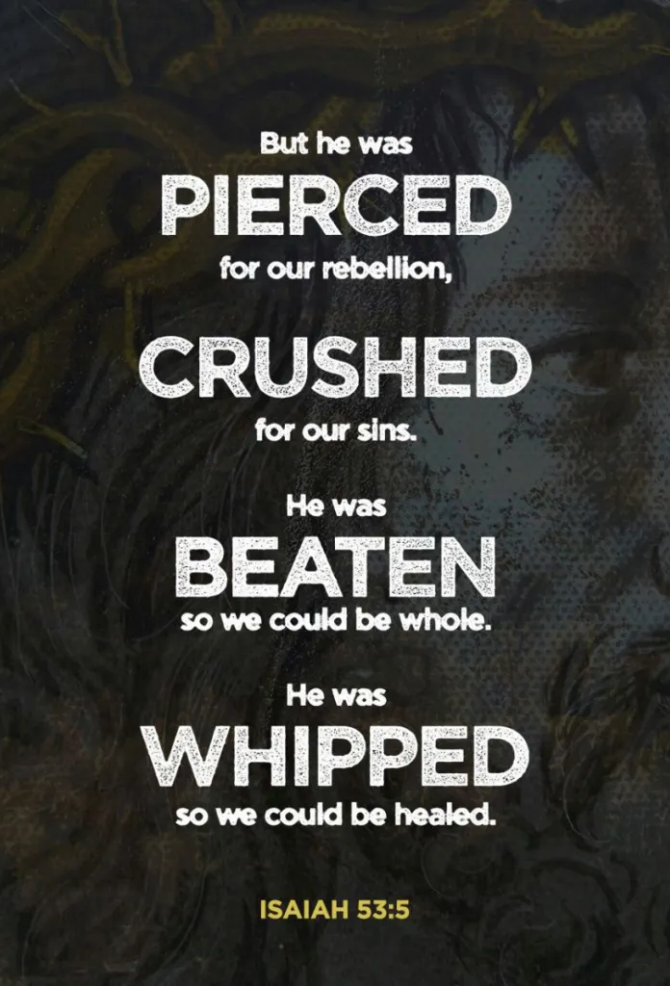
III. DEEP UNDERSTANDING OF HIS PAIN (Job 16:15-18)
Isaiah 53:1-12

Slide 15
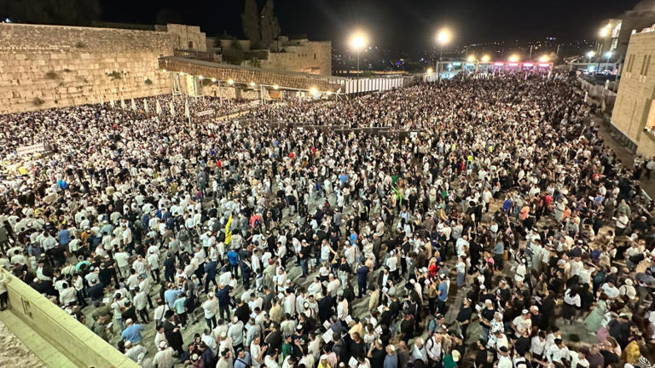
III. DEEP UNDERSTANDING OF HIS PAIN (Job 16:15-18)
Isaiah 53:1-12

Slide 16
IV. INCREDIBLE UNDERSTANDING OF ETERNITY (Job 16:19-22)
19. Even now my witness is in heaven; my advocate is on high.
20. My intercessor is my friend [or my friends treat me with scorn] as my eyes pour out tears to God;
Job 16:19-20

Slide 17
IV. INCREDIBLE UNDERSTANDING OF ETERNITY (Job 16:19-22)
21. on behalf of a man he pleads with God as one pleads for a friend.
22. “Only a few years will pass before I take the path of no return.”
Job 16:19-22

Slide 18
IV. INCREDIBLE UNDERSTANDING OF ETERNITY (Job 16:19-22)
Heaven is a POSSIBLE destiny for everyone. It’s NOT GUARANTEED to everyone.
“Anyone whose name was not found written in the book of life was thrown into the lake of fire.”
Revelation 20:15

Slide 19
IV. INCREDIBLE UNDERSTANDING OF ETERNITY (Job 16:19-22)
“But the cowardly, the unbelieving, the vile, the murderers, the sexually immoral, those who practice magic arts, the idolaters and all liars—they will be consigned to the fiery lake of burning sulfur. This is the second death.”
Revelation 21:8

Slide 20
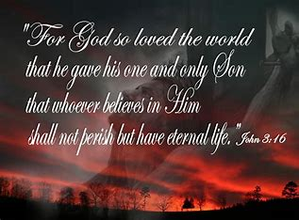
IV. INCREDIBLE UNDERSTANDING OF ETERNITY (Job 16:19-22)
John 3:16

