Slide 1
CHRIST'S GIFT OF REST
Text: Matthew 11:28-30

Slide 2
According to this Text There Are 3 Ways to Receive Christ's Gift of Rest

Slide 3
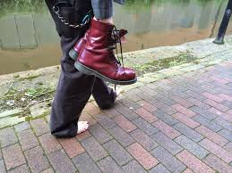
I. BY ENTERING TOWARD HIM
A. Which Has Direction - "Come Unto Me"
Isaiah 53:2b; Isaiah 55:1a, 2a; Psalm 116:7
B. Which Has A Duty - "I Will Give You Rest“ - Matthew 11:27; Hebrews 4:1; Hebrews 4:3; Hebrews 4:9

Slide 4
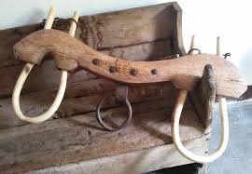
II. THROUGH EXCHANGE WITH HIM
A. Which Must Have a Determination - "Take my yoke upon you“- Matthew 16:24
B. Which Must Have A Distinction - "For my yoke is easy and my burden is light"
Matthew 11:29; John 4:32; Matthew 14; Isaiah 40:29-31

Slide 5
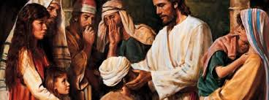
III. THROUGH EDUCATION FROM HIM
A. Which Has No Fixed Duration - "Learn"
Matthew 11:29
B. Which Has Diversity - "Learn from me, for I am gentle (meek) and humble (lowly) in heart" - Mark 10:43-45

