Slide 1
CONSIDER THE FARMER Part I
Text: Isaiah 28:23-29

Slide 2
"Woe to you who go down to Egypt for help, who rely on horses, who trust in the multitude of their chariots, and in the great strength of their horsemen, but do not look to the Holy One of Israel, or seek help from the LORD . . . 3. But the Egyptians are men and not God; their horses are flesh and not spirit . . . 6. Return to him you have so greatly revolted against, O Israelites." Isaiah 31:1,3,6

Slide 3
CONSIDER THE FARMER
I. THERE IS A TIME FOR PREPARING (Isaiah 28:23,24)
II. THERE IS A TIME FOR PLANTING (Isaiah 28:25,26)
III. THERE IS A TIME FOR PRODUCING (Isaiah 28:27,29)

Slide 4
A. A Time for Plowing
Text: Isaiah 28:23-29

Slide 5
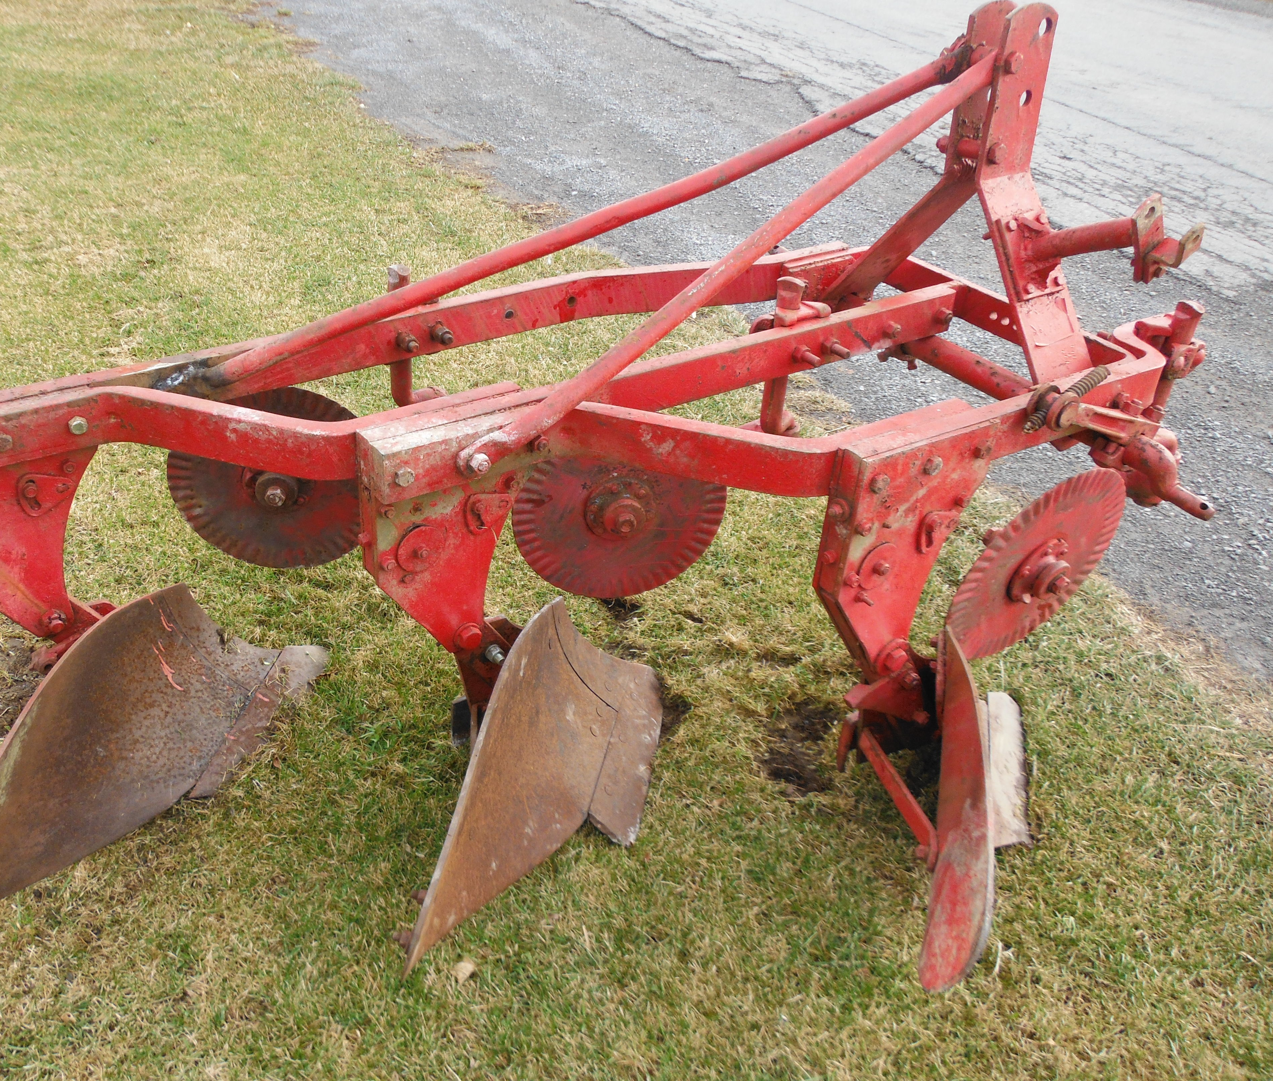
A. A Time for Plowing
Text: Isaiah 28:23-29

Slide 6
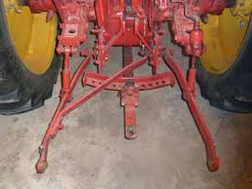
A. A Time for Plowing
Text: Isaiah 28:23-29

Slide 7
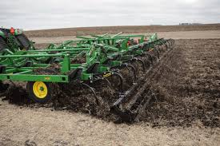
A. A Time for Plowing
Text: Isaiah 28:23-29

Slide 8
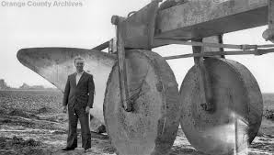
A. A Time for Plowing
Text: Isaiah 28:23-29

Slide 9
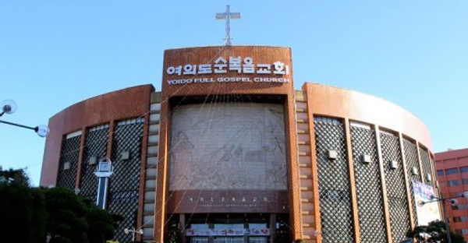
A. A Time for Plowing
Text: Isaiah 28:23-29

Slide 10
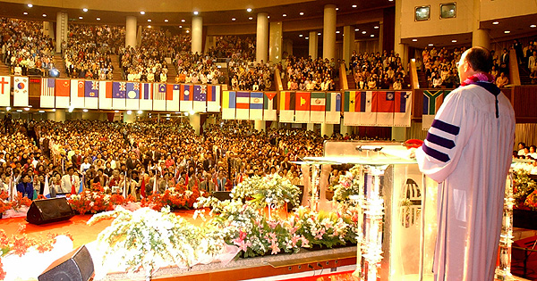
A. A Time for Plowing
Text: Isaiah 28:23-29

Slide 11
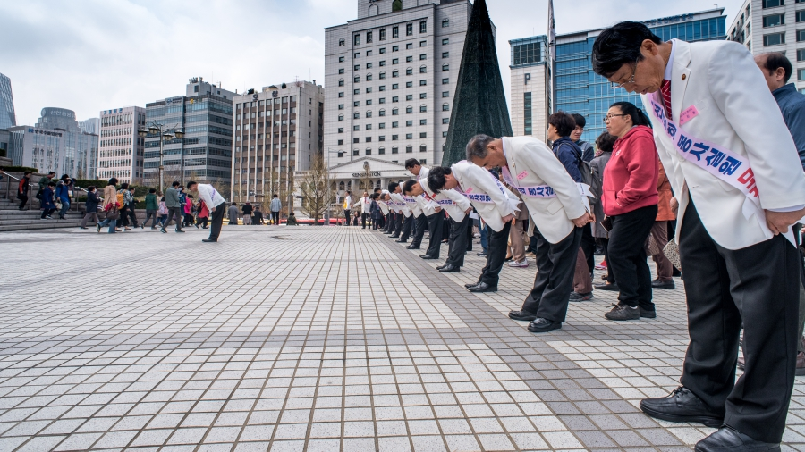
A. A Time for Plowing
Text: Isaiah 28:23-29

Slide 12
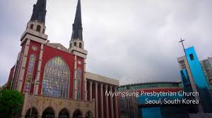
A. A Time for Plowing
Text: Isaiah 28:23-29

Slide 13
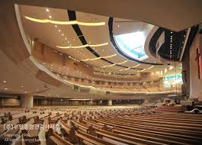
A. A Time for Plowing
Text: Isaiah 28:23-29

Slide 14
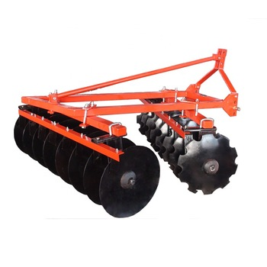
B. A Time for Discing
Text: Isaiah 28:23-29

Slide 15
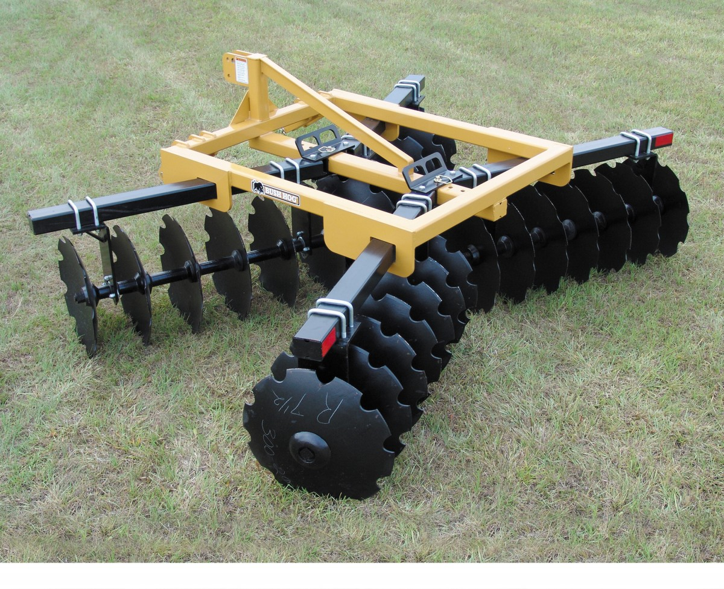
B. A Time for Discing
Text: Isaiah 28:23-29

Slide 16
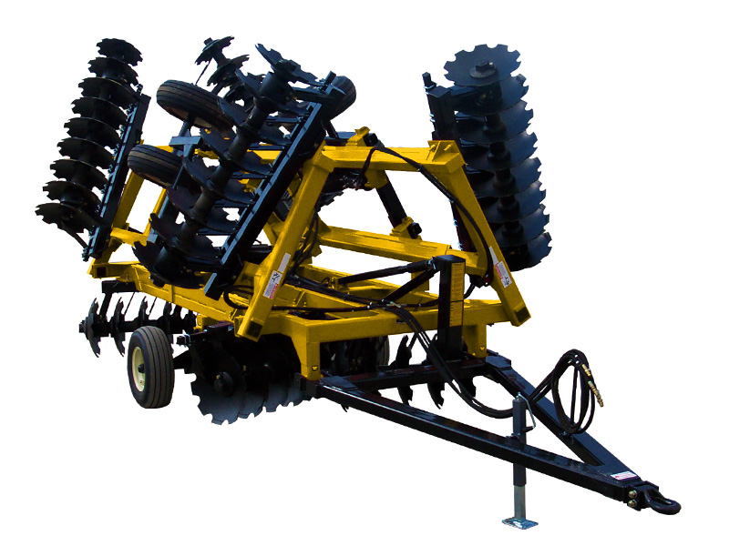
B. A Time for Discing
Text: Isaiah 28:23-29

Slide 17
B. A Time for Discing
“Ephraim is a well-trained heifer that loves to thresh; but I will place a yoke on her fair neck. I will harness Ephraim, Judah will plow, and Jacob will break the hard ground.
12. Sow for yourselves righteousness and reap the fruit of loving devotion; break up your unplowed (untilled) ground. For it is time to seek the LORD until He comes and sends righteousness upon you like rain. Hosea 10:11-12
Text: Isaiah 28:23-29

Slide 18
B. A Time for Discing
13.You have plowed wickedness and reaped injustice; you have eaten the fruit of lies. Because you have trusted in your own way and in the multitude of your mighty men . . . ”
Hosea 10:11-13
Berean Study Bible
Text: Isaiah 28:23-29

Slide 19
B. A Time for Discing
“This is what the LORD says to the people of Judah and to Jerusalem: "Break up your unplowed ground and do not sow among thorns.”
Jeremiah 4:3
Text: Isaiah 28:23-29

Slide 20
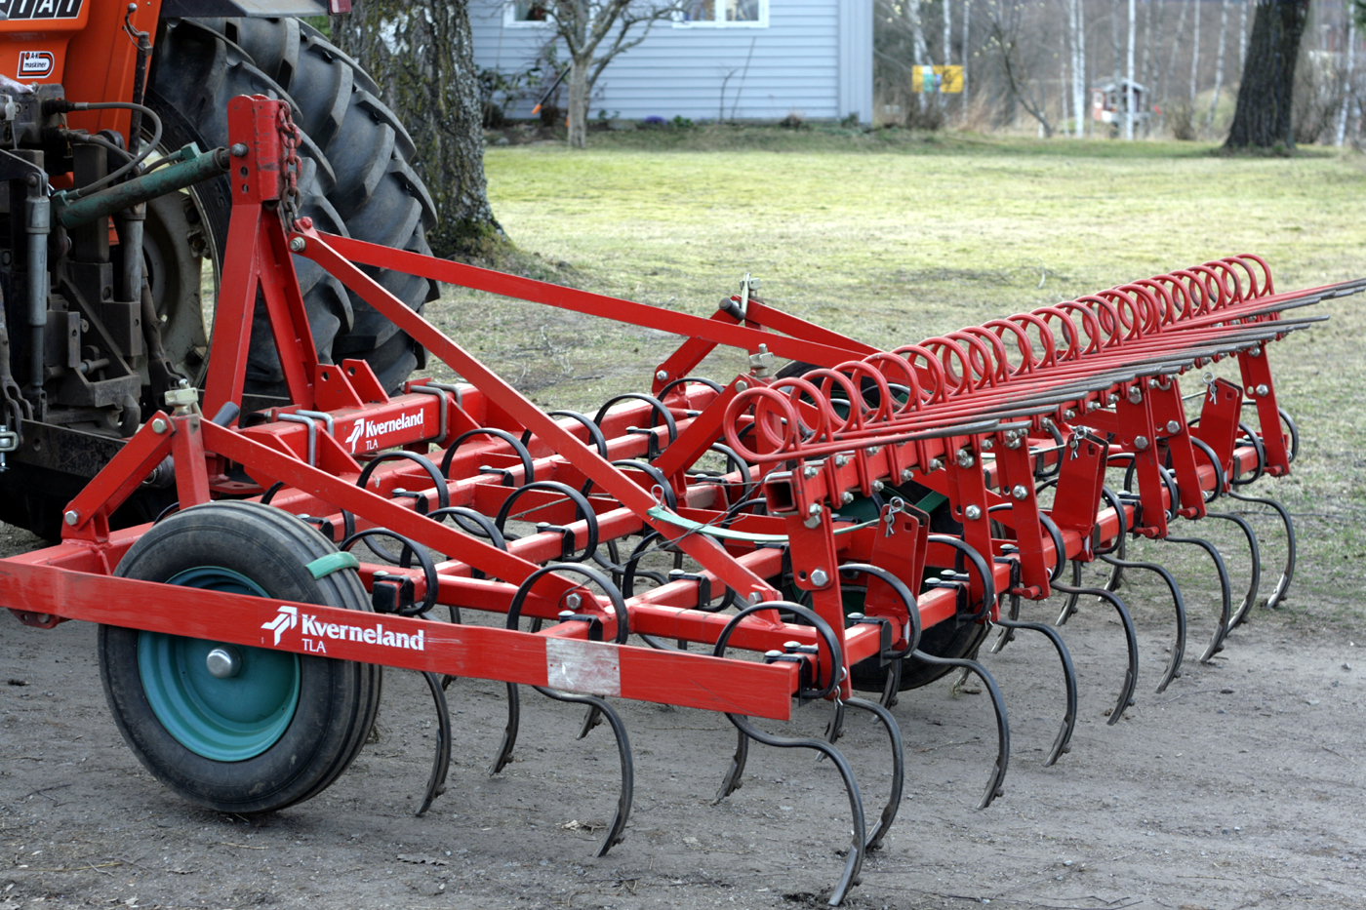
C. A Time HARROWING
Text: Isaiah 28:23-29

Slide 21
C. A Time HARROWING
“You intended to harm me, but God intended it for good to accomplish what is now being done, the saving of many lives.”
Genesis 50:20
Text: Isaiah 28:23-29

Slide 22
C. A Time HARROWING
The goal is the harvest NOT the time of preparation.
Text: Isaiah 28:23-29

Slide 23
C. A Time HARROWING
"Does he keep on breaking up and harrowing the soil?"
Isaiah 28:24
"A time to plant and a time to uproot"
Ecclesiastes 3:2
Text: Isaiah 28:23-29

