Slide 1
CONSIDER THE FARMER Part II
Text: Isaiah 28:23-29

Slide 2
CONSIDER THE FARMER
I. THERE IS A TIME FOR PREPARING (Isaiah 28:23,24)
II. THERE IS A TIME FOR PLANTING (Isaiah 28:25,26)
III. THERE IS A TIME FOR PRODUCING (Isaiah 28:27,29)

Slide 3
II. A Time for PLANTING
Text: Isaiah 28:23-29

Slide 4
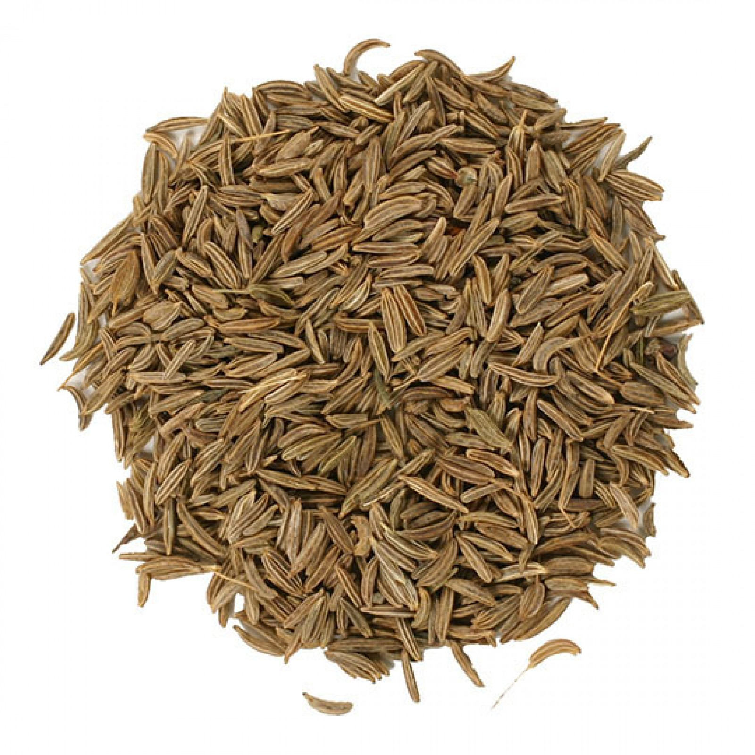
A. Selecting the right seed

Slide 5
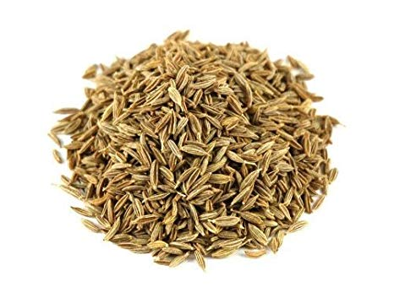
A. Selecting the right seed

Slide 6
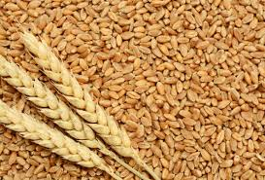
A. Selecting the right seed

Slide 7
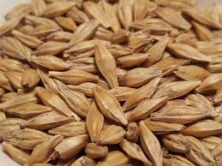
A. Selecting the right seed

Slide 8
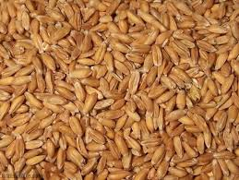
A. Selecting the right seed

Slide 9
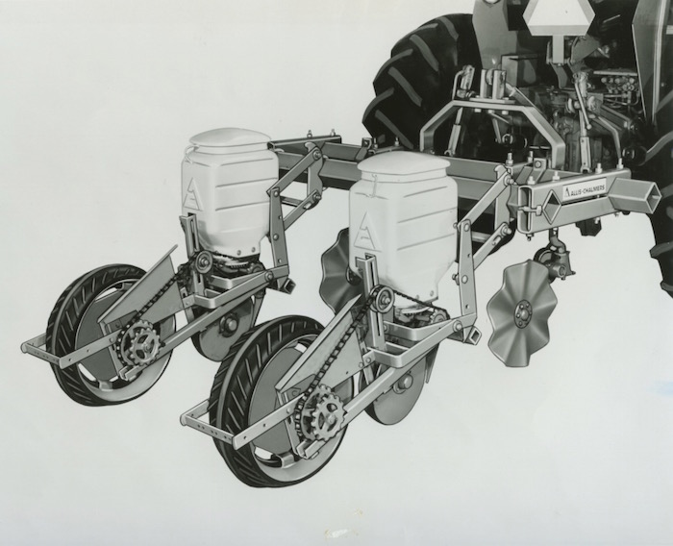
B. Selecting the correct implement

Slide 10
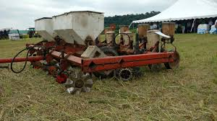
B. Selecting the correct implement

Slide 11
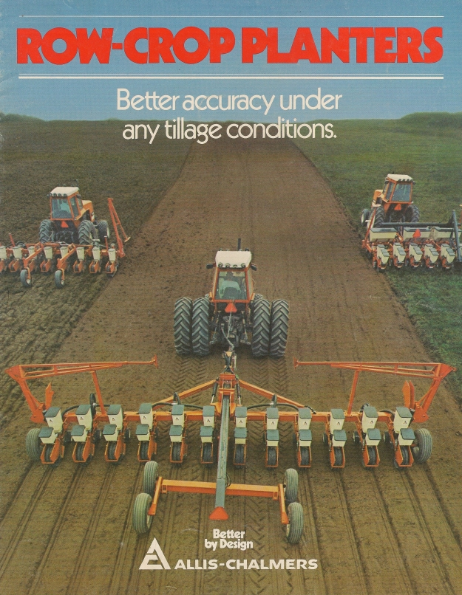
B. Selecting the correct implement

Slide 12
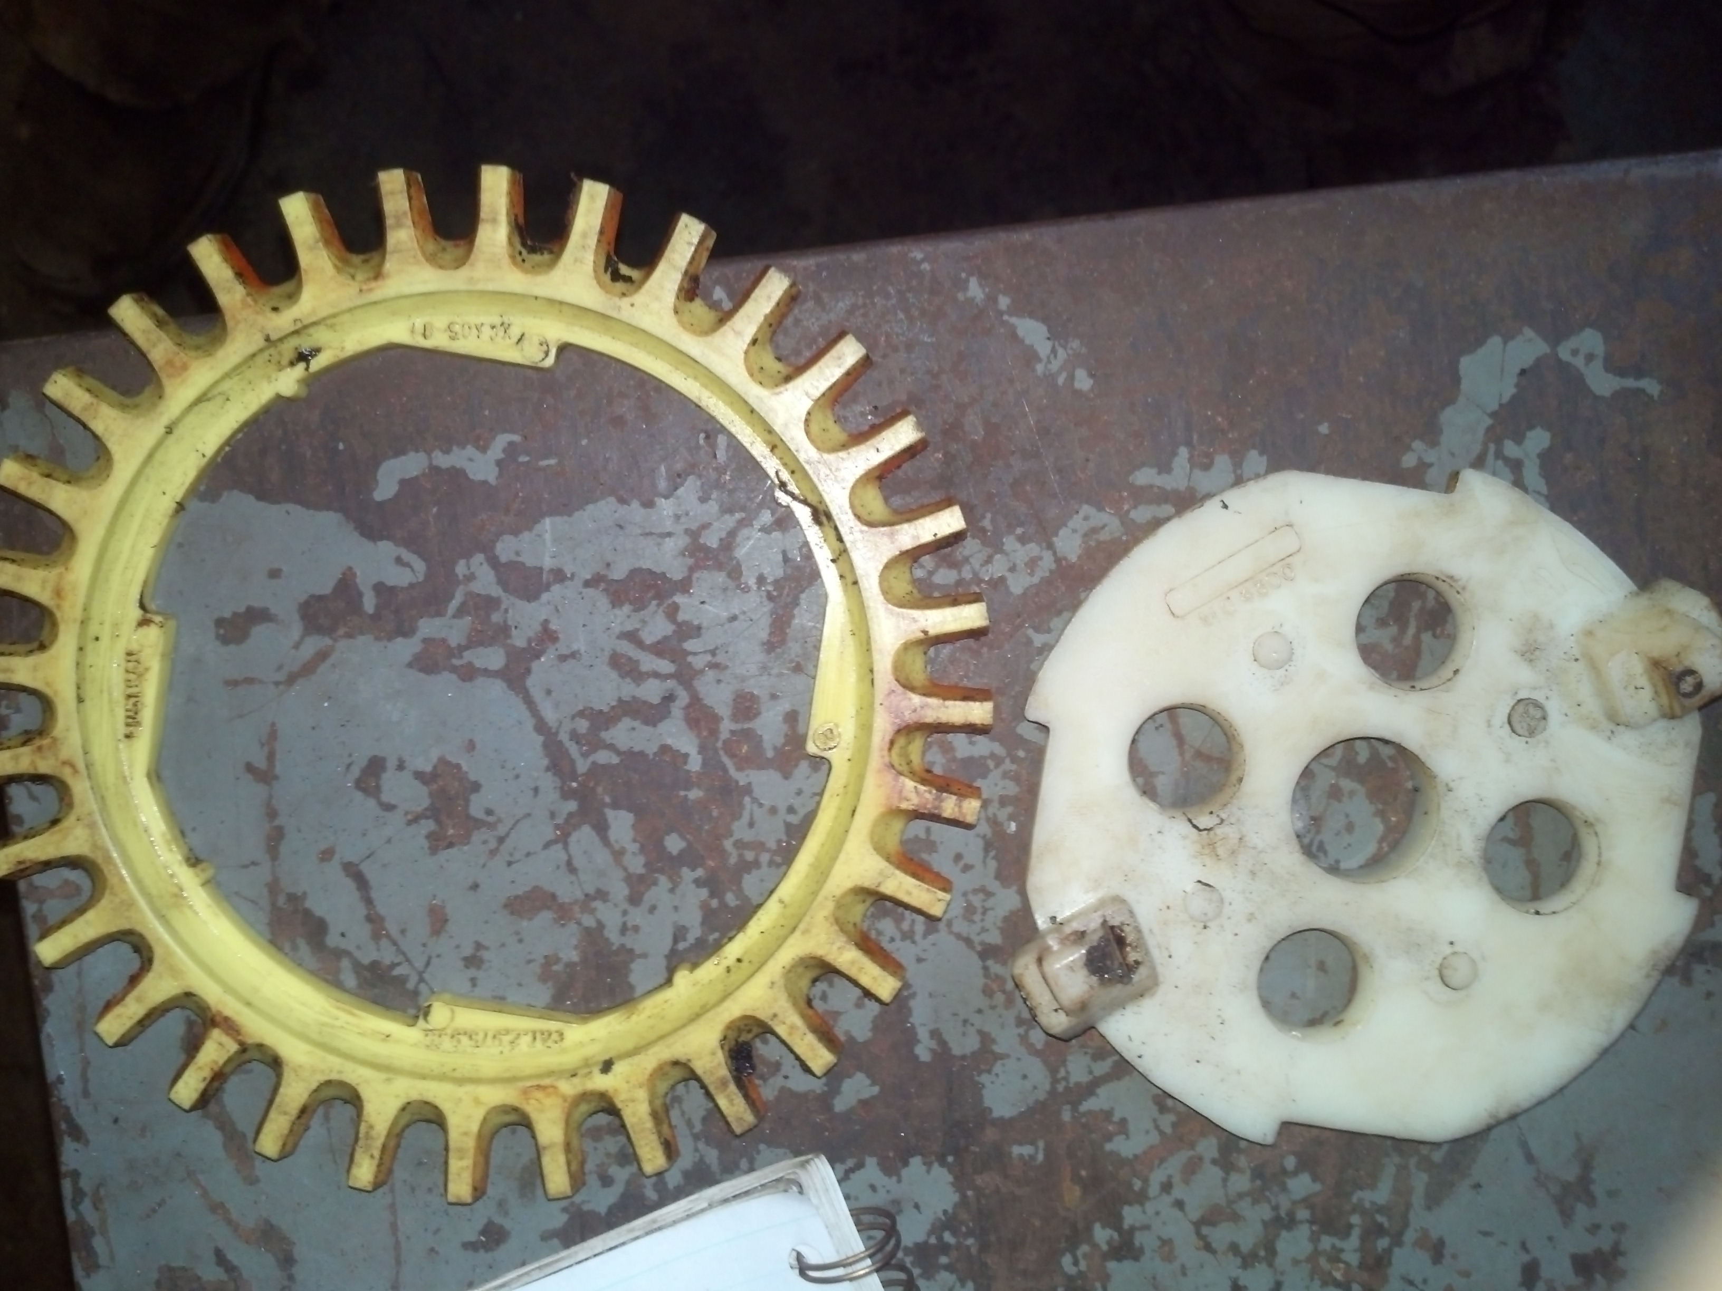
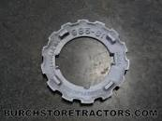
B. Selecting the correct implement

Slide 13
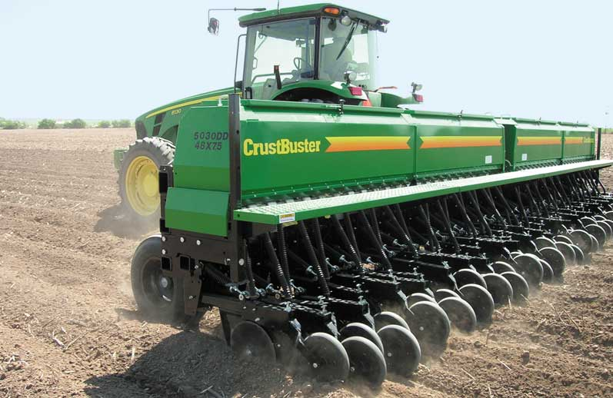
B. Selecting the correct implement

Slide 14
B. Selecting the correct implement
“His God instructs him and teaches him the right way.”
Isaiah 28:26

Slide 15
C. Selecting the correct time
“But when the time had fully come, God sent his Son . . .”
Galatians 4:4
“You see, at just the right time, when we were still powerless, Christ died for the ungodly.”
Romans 5:6

Slide 16
C. Selecting the correct time
“There is a time for everything, and a season for every activity under heaven . . .
11. He has made everything beautiful in his time . . .
Ecclesiastes 3:1, 11

Slide 17
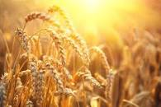
There is not only a time for preparing and planting but also a time producing .

