Slide 1
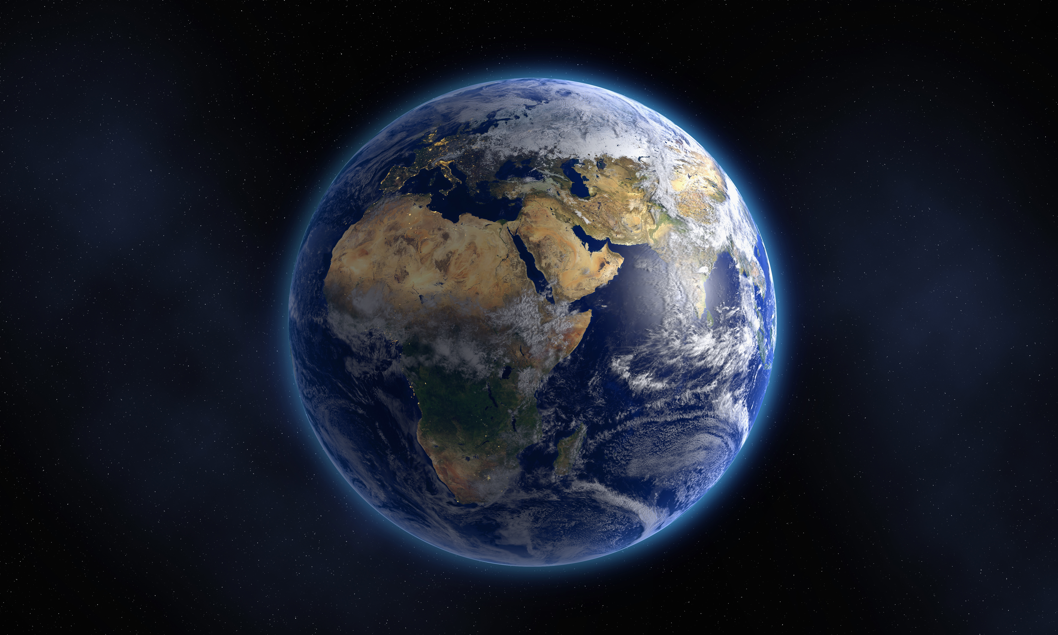
COSMIC CONFRONTATION
Text: John 1:43-51

Slide 2
However, if you do not obey the Lord your God and do not carefully follow all his commands and decrees I am giving you today, all these curses will come on you and overtake you: Deuteronomy 28:15

Slide 3
I. OPEN & CLOSED HEAVEN (John 1:43-51)
"The sky over your head will be bronze, the ground beneath you iron."
Deuteronomy 28:23

Slide 4
I. OPEN & CLOSED HEAVEN (John 1:43-51)
"If after all this you will not listen to me, I will punish you for your sins seven times over.
19. I will break down your stubborn pride and make the sky above you like iron and the ground beneath you like bronze.
20. Your strength will be spent in vain, because your soil will not yield its crops, nor will the trees of the land yield their fruit."
Leviticus 26:18-20

Slide 5
I. OPEN & CLOSED HEAVEN (John 1:43-51)
"Who can tip the water jars of the heavens . . .
38. when the dust becomes hard and the clods of the earth stick together?"
Job 38:37b-38

Slide 6
I. OPEN & CLOSED HEAVEN (John 1:43-51)
"I also withheld rain from you when the harvest was still months away. I sent rain on one town, but withheld it from another. One field had rain another had none and dried up.
8. People staggered from town to town for water but did not get enough to drink, yet you have not returned to me, says the LORD."
Amos 4:7,8

Slide 7
I. OPEN & CLOSED HEAVEN (John 1:43-51)
"He had a dream in which he saw a stairway (ladder - KJV) resting on the earth, with its top reaching to heaven, and the angels of God were ascending and descending on it.
13. There above it stood the LORD,"
Genesis 28:12,13a

Slide 8
I. OPEN & CLOSED HEAVEN (John 1:43-51)
"Surely the LORD was in this place, and I was not aware of it.
17. He was afraid and said, 'How awesome is this place! This is none other than the house of God; this is the gate of heaven."
Genesis 28:16,17

Slide 9
I. OPEN & CLOSED HEAVEN (John 1:43-51)
"His intent was that now, through the church, the manifold wisdom of God should be made known to the rulers and authorities in the heavenly realms."
Ephesians 3:10

Slide 10
I. OPEN & CLOSED HEAVEN (John 1:43-51)
"The weapons we fight with are not the weapons of this world. On the contrary, they have divine power to demolish strongholds.
5. We demolish arguments and every pretension that sets itself up against the knowledge of God and we take captive every thought to make it obedient to Christ.
6. And we will get ready to punish every act of disobedience, once your obedience is complete.“ II Corinthians 10:4-6

Slide 11
I. OPEN & CLOSED HEAVEN (John 1:43-51)
“The god of this age has blinded the minds of unbelievers, so that they cannot see the light of the gospel of the glory of Christ, who is the image of God.“
II Corinthians 4:4

Slide 12
I. OPEN & CLOSED HEAVEN (John 1:43-51)
“You, dear children, are from God and have overcome them, because the one who is in you is greater than the one who is in the world."
I John 4:4

Slide 13
II. OPEN & CLOSED HEART (Ephesians 3:10)
"Then the LORD reached out his hand and touched my mouth and said to me,
'Now I have put my words in your mouth.
10. See, today I appoint you over nations and kingdoms to uproot and tear down, to destroy and overthrow, to build and to plant."
Jeremiah 1:9,10

Slide 14
II. OPEN & CLOSED HEART (Ephesians 3:10)
OTTAWA - Politically driven (Capital Hill)
MONTREAL - Ethnically driven (Sovereignty)
KINGSTON - Intellectually driven (Queen's University)
TORONTO - Business & Commerce driven
CORNWALL - Freedom through exploring and conquering

Slide 15
II. OPEN & CLOSED HEART (Ephesians 3:10)
"I know where you live - where Satan has his throne. Yet you remain true to my name. You did not renounce your faith in me, even in the days of Antipas, my faithful witness, who was put to death in your city - where Satan lives."
Revelation 2:13

Slide 16
II. OPEN & CLOSED HEART (Ephesians 3:10)
"Finally, be strong in the Lord and in his mighty power.
11. Put on the full armor of God so that you can take your stand against the devil's schemes.
12. For our struggle is not against flesh and blood, but against the rulers, and against the authorities, against the powers of this dark world and against the spiritual forces of evil in the heavenly realms.
Ephesians 6:13

Slide 17
II. OPEN & CLOSED HEART (Ephesians 3:10)
13. Therefore put on the whole armor, of God, so that when the day of evil comes, you may be able to stand your ground, and after you have done everything, to stand."
Ephesians 6:13

