Slide 1
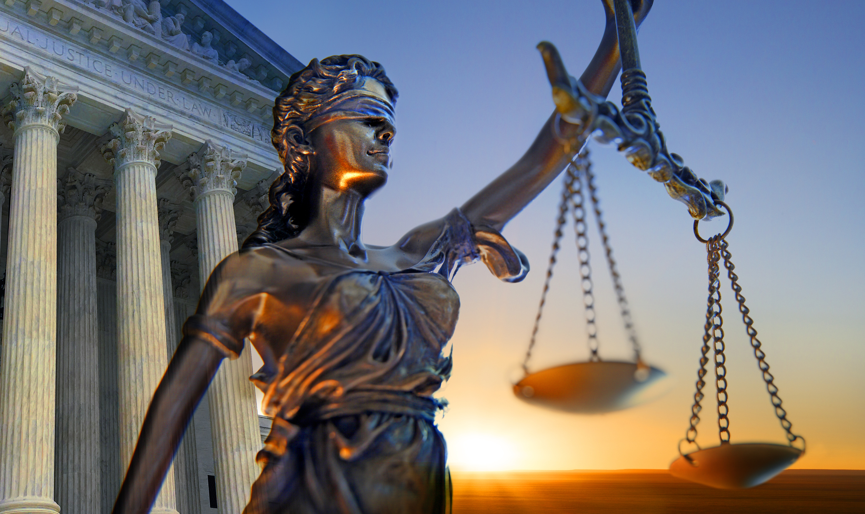
Crying out Against (God’s?) Injustice
Text: Job 7:11-21

Slide 2
“Why should innocent people suffer inequities, undeserved treatment, and hate crimes? It is not fair, and it is not right. I propose that injustice becomes a trauma when either the magnitude or accumulative experiences exceed the capacity to cope.” Lori S Katz - PhD “Injustice Trauma: Individual and Collective Distress”

Slide 3
“For as often as I speak (cry), whether I cry out against injustice or proclaim devastation, the word of Jehovah is turned against me into matter of reproach and derision continually. 9. But if I say, “I will not mention his word or speak anymore in his name,” his word is in my heart like a fire, a fire shut up in my bones. I am weary of holding it in; indeed, I cannot.” Jeremiah 20:8,9 1769 Blayney Bible Translation

Slide 4
I. HIS COMPLAINT TOWARD GOD (Job 7:11-16) “I cannot keep from speaking. I must express my anguish. My bitter soul must complain.” Job 7:11 New Living Translation

Slide 5
I. HIS COMPLAINT TOWARD GOD (Job 7:11-16) When I asked Jesus Christ to become the Saviour and Lord of my life my SPIRITUAL DNA began to override my BIOLOGICAL DNA

Slide 6
I. HIS COMPLAINT TOWARD GOD (Job 7:11-16) “It is better to remain silent at the risk of being thought a fool, than to talk and remove all doubt of it.” Maurice Switzer “Mrs. Goose. Her Book” Published 1907

Slide 7
I. HIS COMPLAINT TOWARD GOD (Job 7:11-16) “A wicked person listens to deceitful lips; a liar pays attention to a destructive tongue.” Proverbs 17:4

Slide 8
I. HIS COMPLAINT TOWARD GOD (Job 7:11-16) “Even fools are thought wise if they keep silent, and discerning if they hold their tongues.” Proverbs 17:28

Slide 9
I. HIS COMPLAINT TOWARD GOD (Job 7:11-16) “Therefore, as such is my hard lot, I will at least have the melancholy satisfaction of venting my sorrow in words.” “Jamieson-Fausset-Brown Bible Commentary” Job 7:11

Slide 10
I. HIS COMPLAINT TOWARD GOD (Job 7:11-16) “I despise my life; I would not live forever. Let me alone; my days have no meaning.” Job 7:16

Slide 11
I. HIS COMPLAINT TOWARD GOD (Job 7:11-16) “THINGS WHICH THE EYE HAS NOT SEEN AND THE EAR HAS NOT HEARD, AND WHICH HAVE NOT ENTERED THE HEART OF MAN, ALL THAT GOD HAS PREPARED FOR THOSE WHO LOVE HIM [who hold Him in affectionate reverence, who obey Him, and who gratefully recognize the benefits that He has bestowed].” I Corinthians 2:9 Amplified Bible

Slide 12
II. HIS CONTEMPLATION TOWARD GOD (Job 7:17-21) “What is mankind that you make so much of them, that you give them so much attention, 18. that you examine them every morning and test them every moment?” Job 7:17-18

Slide 13
II. HIS CONTEMPLATION TOWARD GOD (Job 7:17-21) “If I have sinned, what have I done to you, you who see everything we do? Why have you made me your target? Have I become a burden to you?” Job 7:20

Slide 14
II. HIS CONTEMPLATION TOWARD GOD (Job 7:17-21) Asking the wrong question undoubtably leads to a wrong answer!

Slide 15
II. HIS CONTEMPLATION TOWARD GOD (Job 7:17-21) “Why do you not pardon my offenses and forgive my sins?” Job 7:21a

