Slide 1
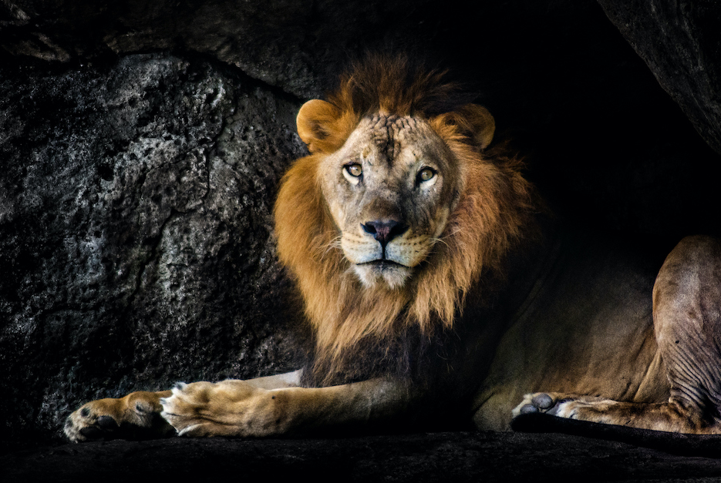
CONSISTENT FAITH
DANIEL 6:1-28

Slide 2
I. A CONSISTENT FAITH WILL BE TESTED
THE SAINT IS CULTIVATED
THE SAVIOUR IS CELEBRATED
THE SINNER IS CONVICTED

Slide 3
II. A CONSISTENT FAITH WILL TESTIFY
IT TESTIFIES TO ITS FOES
IT TESTIFIES TO ITS FRIENDS
IT TESTIFIES TO ITS FOCUS

Slide 4
III. A CONSISTENT FAITH WILL TRIUMPH
VICTORY OVER EVERY ADVERSITY
“All things are possible to him that believes”
Mark 9:23

Slide 5
III. A CONSISTENT FAITH WILL TRIUMPH
2. VICTORY OVER EVERY ADVERSARY

Slide 6
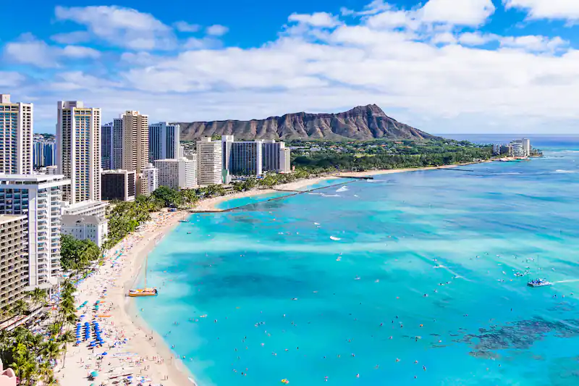
MIKE DAVISON

Slide 7
ARE YOU A CONSISTENT CHRISTIAN?
DO YOU LIVE EVERY DAY TO THE GLORY OF GOD?

