Slide 1
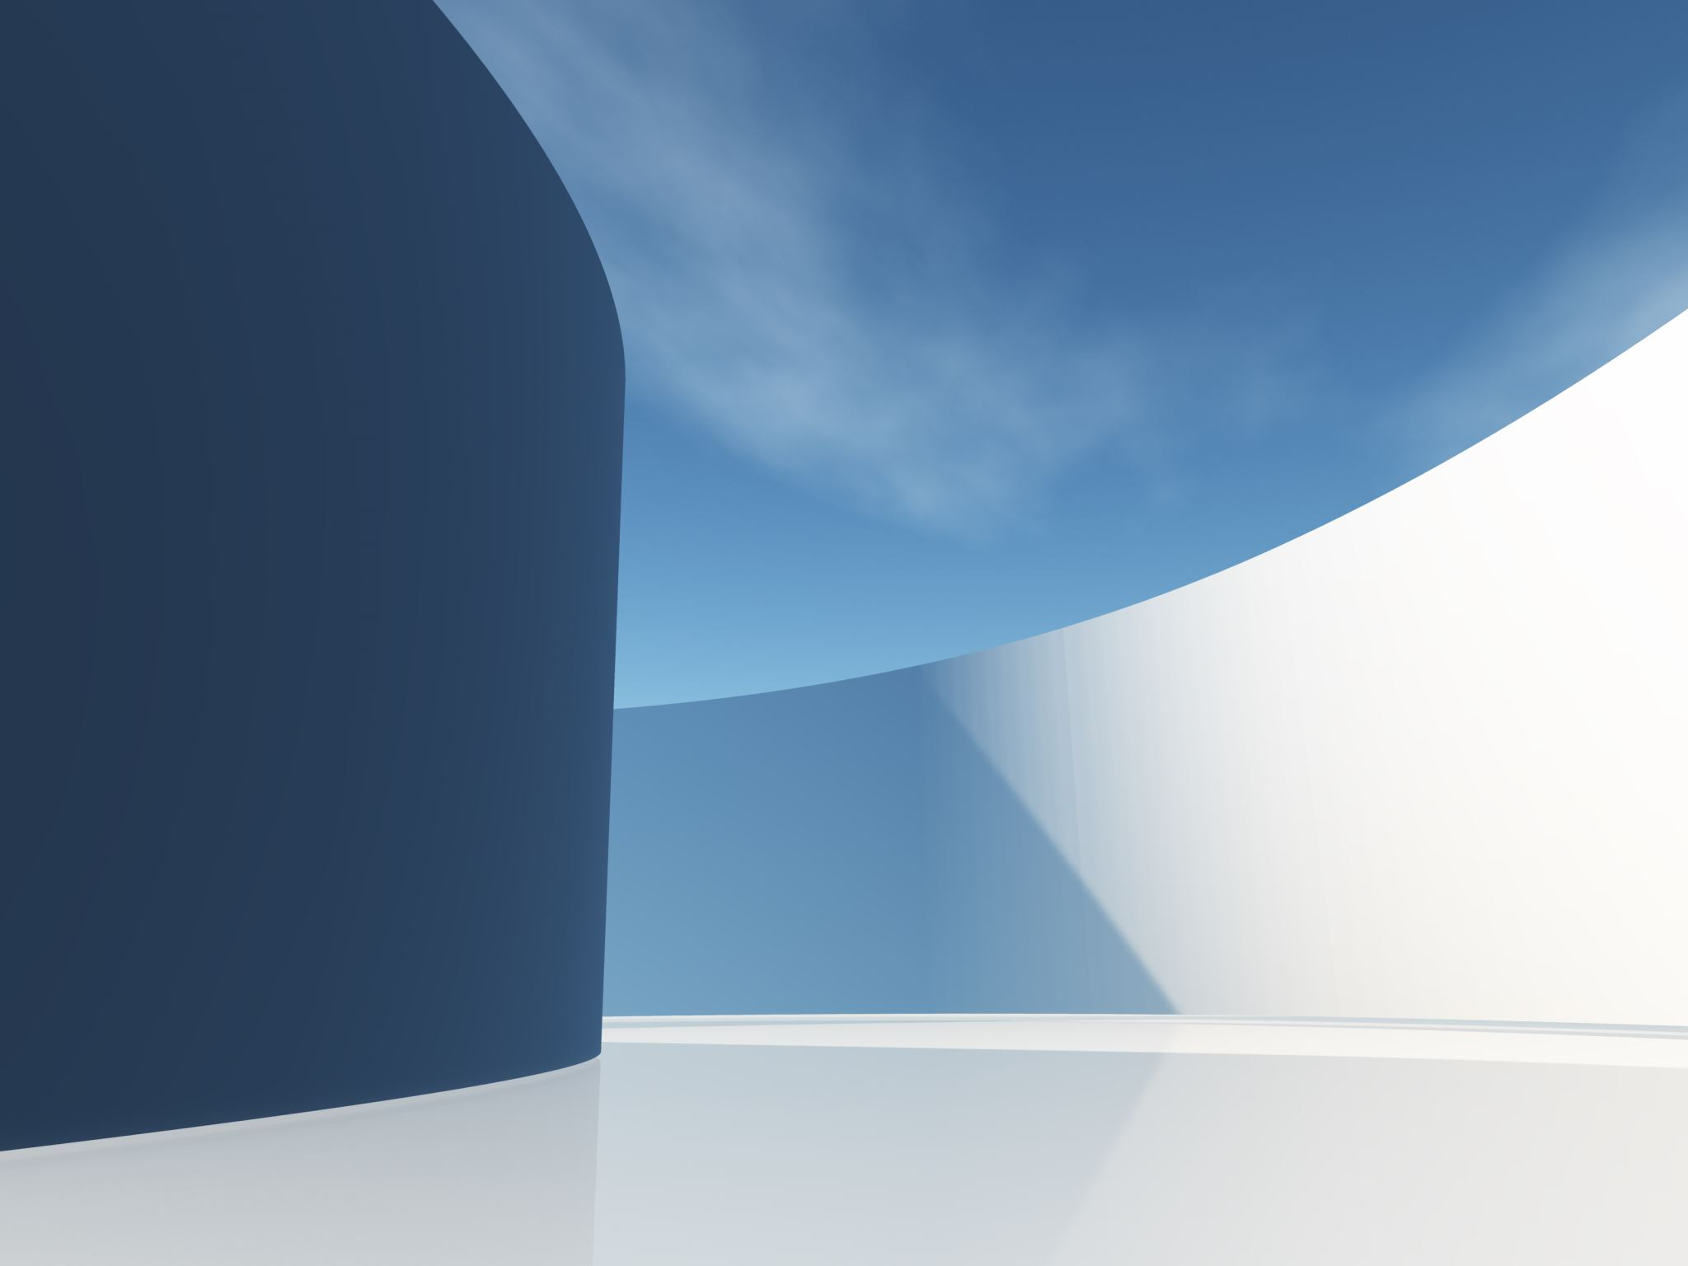
DELAYED, YET DEFINITE
Text: Daniel 10:10-13

Slide 2
“A hand touched me and set me trembling on my hands and knees.
11. He said, “Daniel, you who are highly esteemed, consider carefully the words I am about to speak to you, and stand up, for I have now been sent to you.” And when he said this to me, I stood up trembling.

Slide 3
12. Then he continued, “Do not be afraid, Daniel. Since the first day that you set your mind to gain understanding and to humble yourself before your God, your words were heard, and I have come in response to them.
13. But the prince of the Persian kingdom resisted me twenty-one days. Then Michael, one of the chief princes, came to help me, because I was detained there with the king of Persia . . .

Slide 4
18. Again the one who looked like a man touched me and gave me strength.
Daniel 10:10-13,18

Slide 5
18. Again the one who looked like a man touched me and gave me strength.
Daniel 10:10-13,18

Slide 6
I. GOD’S INCLINED EAR (10:12)
“I waited patiently for the LORD; he turned to me and heard my cry.”
Psalm 40:1

Slide 7
I. GOD’S INCLINED EAR (10:12)
“In my distress I called to the LORD; I cried to my God for help. From his temple he heard my voice; my cry came before him, into his ears.”
Psalms 18:6

Slide 8
II. GOD’S OUTSTRETCHED HAND (10:13)
"I waited patiently for the LORD; he turned to me and heard my cry.
2. He lifted me out of the slimy pit, out of the mud and mire; he set my feet on a rock and gave me a firm place to stand.
3. He put a new song in my mouth, a hymn of praise to our God. Many will see and fear and put their trust in the LORD. "
Psalm 40:1-3

Slide 9
II. GOD’S OUTSTRETCHED HAND (10:13)
“In my distress I called to the LORD;
I cried to my God for help.
From his temple he heard my voice;
my cry came before him, into his ears. . .
9. He parted the heavens and came down;
dark clouds were under his feet . . . Psalms 18:6,9

Slide 10
II. GOD’S OUTSTRETCHED HAND (10:13)
16. He reached down from on high and took hold of me; he drew me out of deep waters.
17. He rescued me from my powerful enemy,
from my foes, who were too strong for me.”
Psalms 18:16-17

Slide 11
II. GOD’S OUTSTRETCHED HAND (10:13)
“But the prince of the Persian kingdom resisted me twenty-one days.”
Daniel 10:13
“for twenty-one days the mighty Evil Spirit who overrules the kingdom of Persia blocked my way ..."

Slide 12
II. GOD’S OUTSTRETCHED HAND (10:13)
“Then Michael, one of the top officers of the heavenly army, came to help me, so that I was able to break through these spirit rulers of Persia."
Daniel 10:13

Slide 13
III. GOD’S ULTIMATE PLAN
“Wait for the LORD; be strong and take heart and wait for the LORD.”
Psalm 27:14

Slide 14
III. GOD’S ULTIMATE PLAN
“Be still before the LORD and wait patiently for him; do not fret when men succeed in their ways,
when they carry out their wicked schemes.”
Psalm 37:7

Slide 15
III. GOD’S ULTIMATE PLAN
“For the revelation awaits an appointed time; it speaks of the end and will not prove false. Though it linger, wait for it; it will certainly come and will not delay.
Habakkuk 2:3

Slide 16
III. GOD’S ULTIMATE PLAN
"being fully persuaded that God had power to do what he had promised."
Romans 4:21

Slide 17
III. GOD’S ULTIMATE PLAN
"being fully persuaded that God had power to do what he had promised."
Romans 4:21

Slide 18
CONCLUSION:
1. God Hears Our Prayers
“The eyes of the LORD are on the righteous and his ears are attentive to their cry;"
Psalm 34:15

Slide 19
CONCLUSION:
2. God Acts upon Our Prayers
“The righteous cry out, and the LORD hears them; he delivers them from all their troubles."
Psalm 34:17

Slide 20
CONCLUSION:
3. Sometimes Our Prayers Are Hindered by the Adversary
“For our struggle is not against flesh and blood, but against the rulers, against the authorities, against the powers of this dark world and against the spiritual forces of evil in the heavenly realms.”
Ephesians 6:12

Slide 21
CONCLUSION:
4. God Has Promised an Ultimate Victory
“...and on this rock I will build my church, and the gates of Hades will not overcome it.”
Matthew 16:18

Slide 22
CONCLUSION:
5. Waiting Is Often in Our Best Interest
"But they that wait upon the LORD shall renew their strength; they shall mount up with wings as eagles; they shall run, and not be weary; and they shall walk, and not faint."
Isaiah 40:31

