Slide 1
DISPLAYING AN ATTITUDE OF FULL GRATITUDE
I Thessalonians 5:17, 18

Slide 2
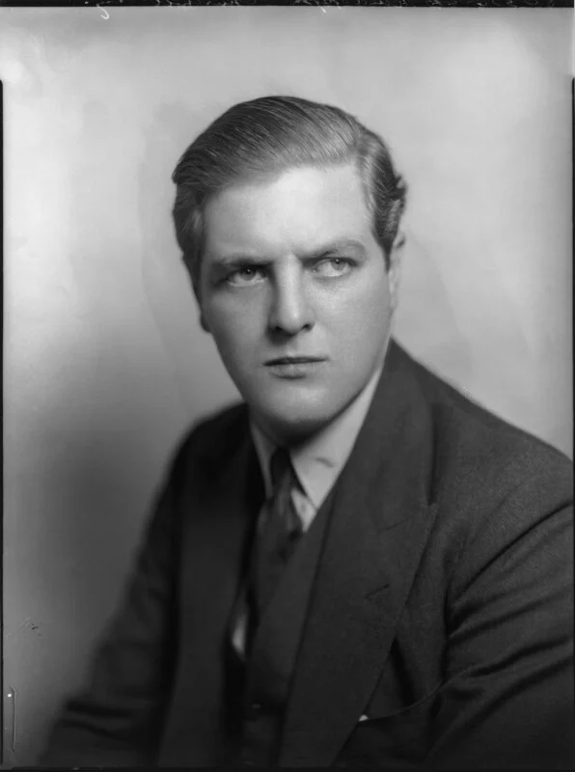
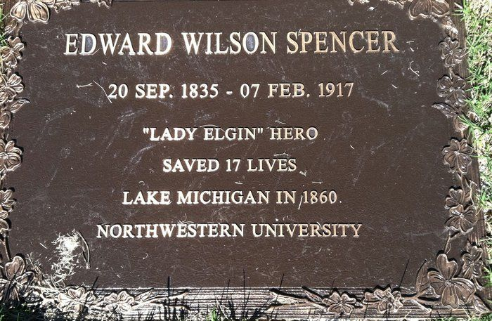
Edward Spencer did not give up…

Slide 3
1) IN OUR BLESSINGS: Being thankful when things are going well.
“Every good thing given and every perfect gift is from above, coming down from the Father of lights, with
whom there is no variation or shifting of shadows”
- James 1:17

Slide 4
EXPRESSIONS….
FAILING TO HAVE AN ATTITUDE OF GRATITUDE IS ACTUALLY INGRATITUDE

Slide 5
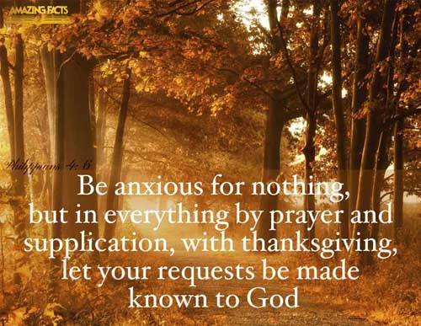
2) IN OUR PRAYERS: Being thankful as we bring our requests to God.
One of the keys to an effective prayer life is understanding that prayer is to be entered into with an attitude of gratitude.
- Philippians 4:6

Slide 6
Don’t worry or fret… God’s got under control!!!

Slide 7
3) IN OUR WORSHIP: Being thankful as we connect with God.
Colossians:
“…singing with thankfulness in your hearts to God”

Slide 8
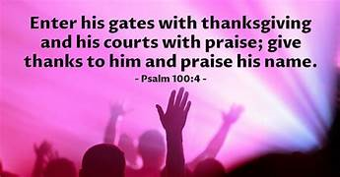
PSALM OF ASCENSION:
Being thankful leads into a more personal and heart stretching area of praise.
So, enter His gates with thanksgiving, which leads us into His inner courts with praise.

Slide 9
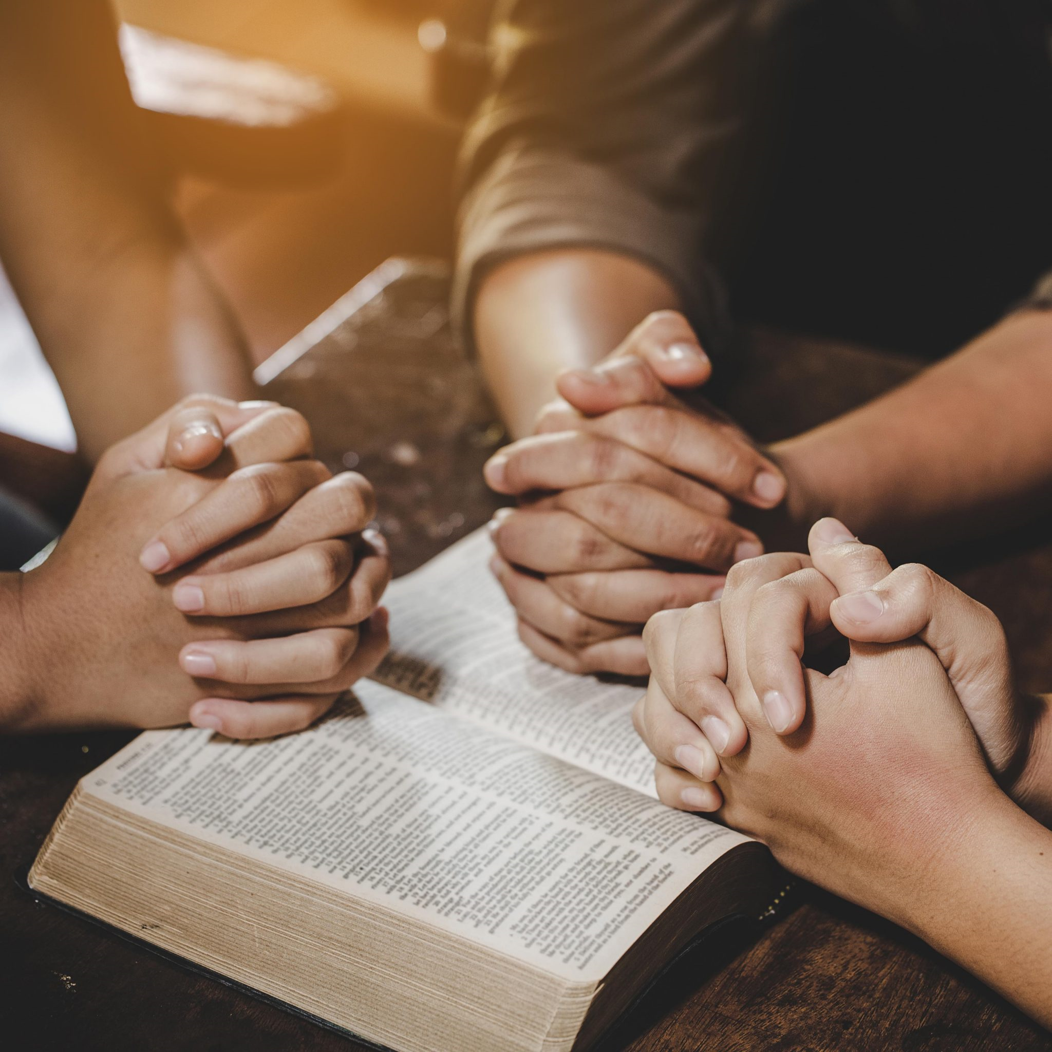
4) IN OUR FELLOWSHIP: Being thankful for the other believers God has brought into our lives.
PSALM 100:4

Slide 10
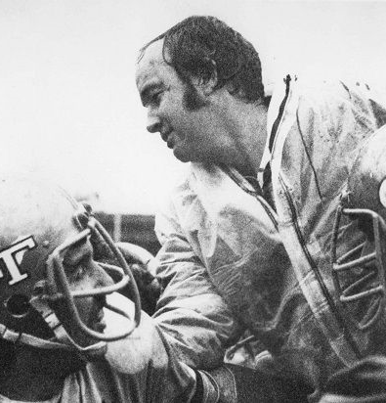
UCLA Football coach Pepper Rodgers…

Slide 11
5) IN OUR SUFFERING: Being thankful in every circumstance…

Slide 12
Someone was listening…..

Slide 13
Perspective changes….

Slide 14
Bad report card….

Slide 15
Paul and Silas praised God….

Slide 16
Peter and John refused to be silent…

Slide 17
REJOICE…
The Key is
that they learned the secret of having an attitude of gratitude.

Slide 18
Give thanks with a heart displaying an attitude of gratitude!!!

