Slide 1
THE SERMON ON THE MOUNT SERIES “DIVORCE - FROM A HARDENED HEART”
Text:
Matthew 5:31–32

Slide 2
How is the Church to deal with Divorce and how can we help people who have gone through it?
Text:
Matthew 5:31–32

Slide 3
“It has been said, ‘Anyone who divorces his wife must give her a certificate of divorce.’ 32. But I tell you that anyone who divorces his wife, except for marital unfaithfulness, causes her to become an adulteress, and anyone who marries the divorced woman commits adultery.” Matthew 5:31,32

Slide 4
“God desired that man have a suitable helper so he took a rib from Adam and made Eve for him!” Genesis 2:20
I. THE ORIGINAL INTENT FOR MARRIAGE (Genesis 2:20-24)

Slide 5
“For this reason a man will leave his father and mother and be united to his wife, and they will become one flesh.” Genesis 2:24
I. THE ORIGINAL INTENT FOR MARRIAGE (Genesis 2:20-24)

Slide 6
The words “Cleave (united) to” carries “the idea of firm, permanent attachment, as in gluing.”

Slide 7
II. THE STATE OF MARRIAGE DURING THE TIME OF MOSES (Deuteronomy 24:1-4)

Slide 8
II. THE STATE OF MARRIAGE DURING THE TIME OF MOSES (Deuteronomy 24:1-4)
“‘I hate divorce’ says the LORD God of Israel, ‘and I hate a man’s covering himself with violence as well as with his garment,’ says the LORD Almighty. So guard yourself in your spirit, and do not break faith.”
Malachi 2:16

Slide 9
III. THE STATE OF MARRIAGE DURING THE TIME OF JESUS AND TODAY (Matthew 19:1-9)

Slide 10
III. THE STATE OF MARRIAGE DURING THE TIME OF JESUS AND TODAY (Matthew 19:1-9)
“Some Pharisees came to him to test him. They asked,
Is it lawful for a man to divorce his wife for any and every reason?”
4. “Haven’t you read,” he replied, “that at the beginning the Creator ‘made them male and female,’
5. and said, ‘For this reason a man will leave his father and mother and be united to his wife, and the two will become one flesh’?
6. So they are no longer two, but one. Therefore what God has joined together, let man not separate.”
7. “Why then,” they asked, “did Moses command that a man give his wife a certificate of divorce and send her away?”

Slide 11
III. THE STATE OF MARRIAGE DURING THE TIME OF JESUS AND TODAY (Matthew 19:1-9)
8. Jesus replied, “Moses permitted you to divorce your wives because your hearts were hard. But it was not this way from the beginning.
9. I tell you that anyone who divorces his wife, except for marital unfaithfulness, and marries another woman commits adultery.”
10. The disciples said to him, “If this is the situation between a husband and wife, it is better not to marry.”
Matthew 19:3-10

Slide 12
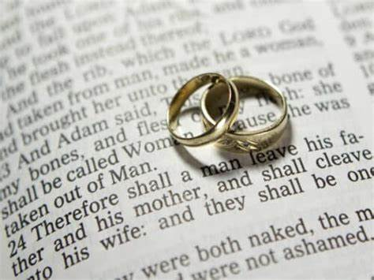
IV. GOD’S TRUE INTENT FOR MARRIAGE (Matthew 5:31-32)
WHAT GOD HAS JOINED TOGETHER, LET NO MAN SEPARATE!”
Matthew 19:6

