Slide 1
Elements of Truth
Text: Job 4:1-21

Slide 2
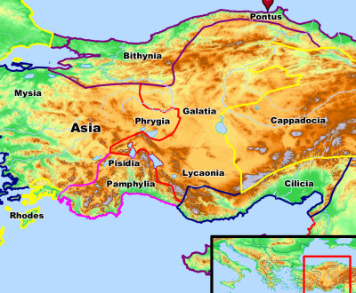

Slide 3
“For it is time for judgment to begin with the household of God; and if it begins with us first, what will be the outcome for those who do not obey the gospel of God? 18. AND IF IT IS WITH DIFFICULTY THAT THE RIGHTEOUS IS SAVED, WHAT WILL BECOME OF THE GODLESS MAN AND THE SINNER? I Peter 4:18-19 NASB 1995

Slide 4
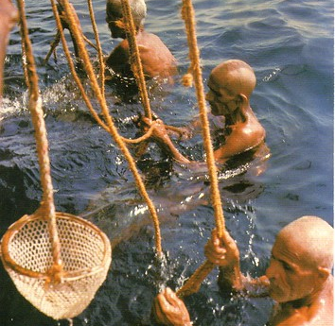
You may have to risk your life to gain the riches of God’s Word.
Diving for precious pearls in Bahrain

Slide 5
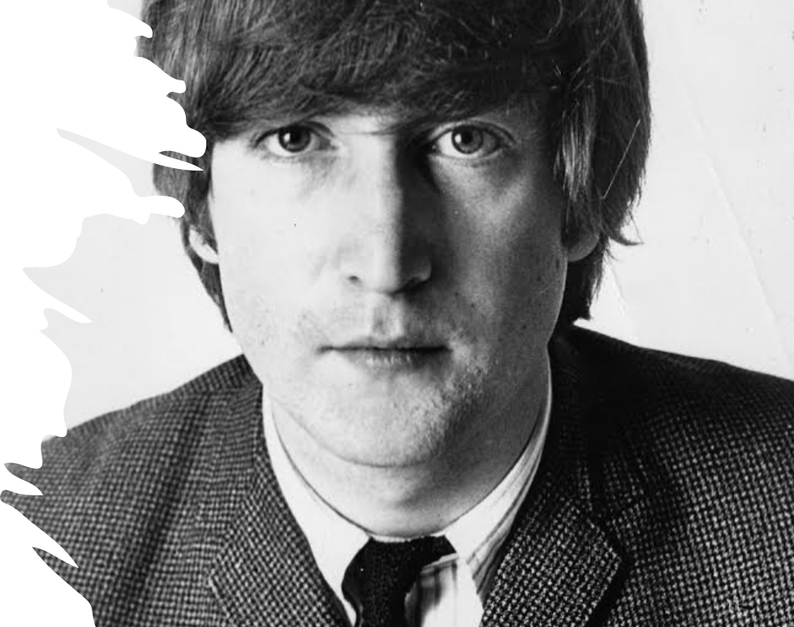
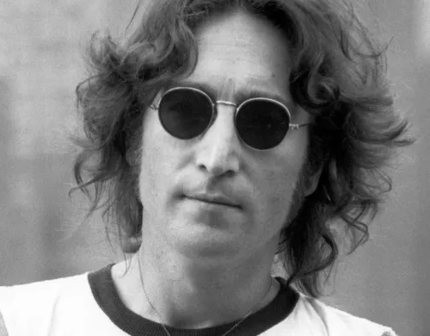
I. CHARGES AGAINST JOB (Job 4:1-6)
Yesterday (March 4/66 was in the infamous day that John Lennon said in an interview with the London Evening Standard in 1966 that “The Beatles” band was more popular then Jesus.

Slide 6
I. CHARGES AGAINST JOB (Job 4:1-6)
“If someone ventures a word with you, will you be impatient? But who can keep from speaking?”
Job 4:2
“Think how you have instructed so many . . . Your words have supported those who stumbled”
Job 4:3,4

Slide 7
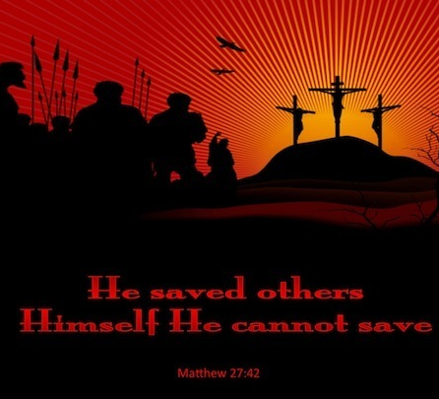
I. CHARGES AGAINST JOB (Job 4:1-6)
“He saved others . . . but he can’t save himself.” (Matthew 27:42).

Slide 8
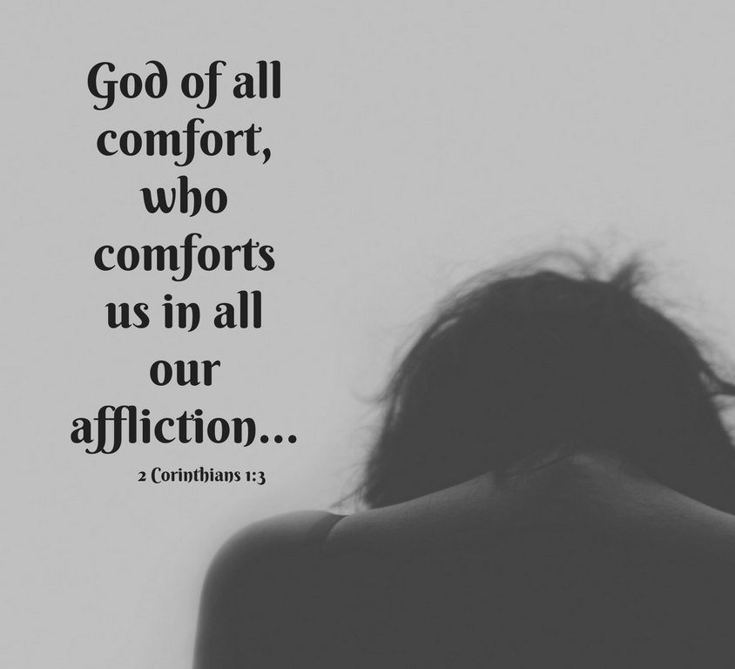
I. CHARGES AGAINST JOB (Job 4:1-6)

Slide 9
I. CHARGES AGAINST JOB (Job 4:1-6)

Slide 10
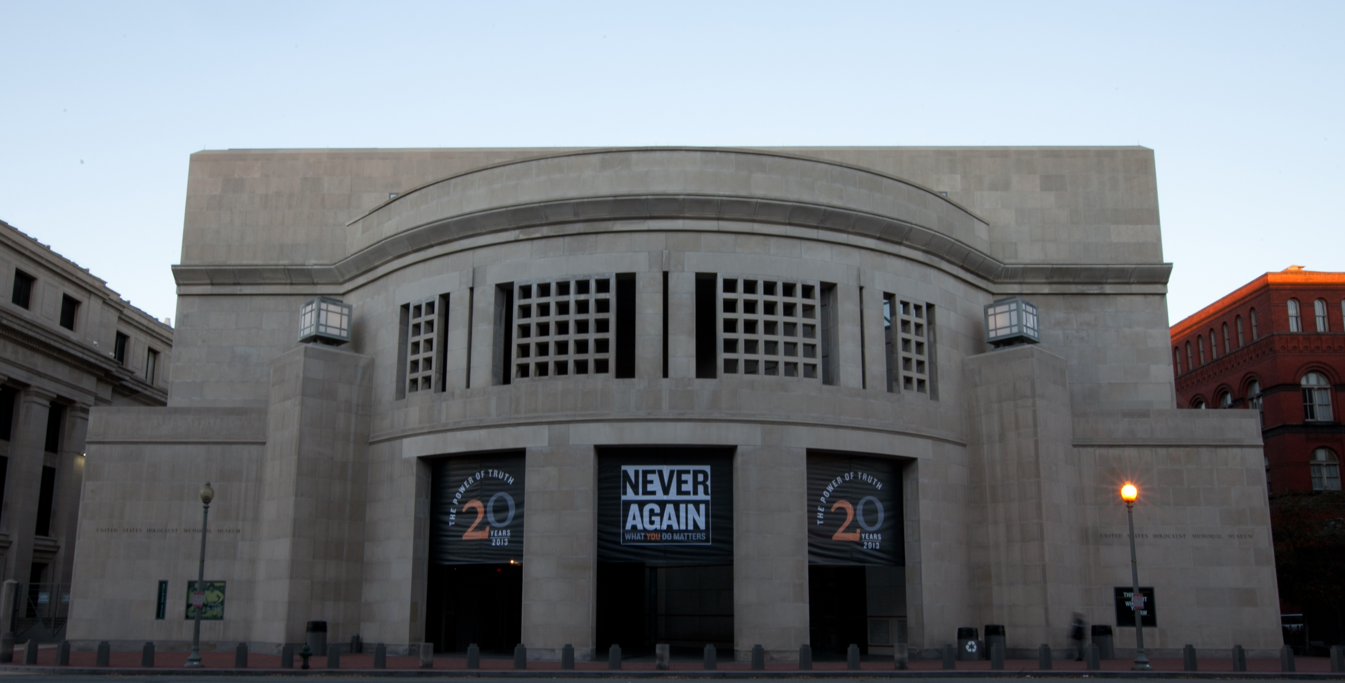
II. COMPARISON TO THE UNRIGHTEOUS (Job 4:7-16)

Slide 11
II. COMPARISON TO THE UNRIGHTEOUS (Job 4:7-16)

Slide 12
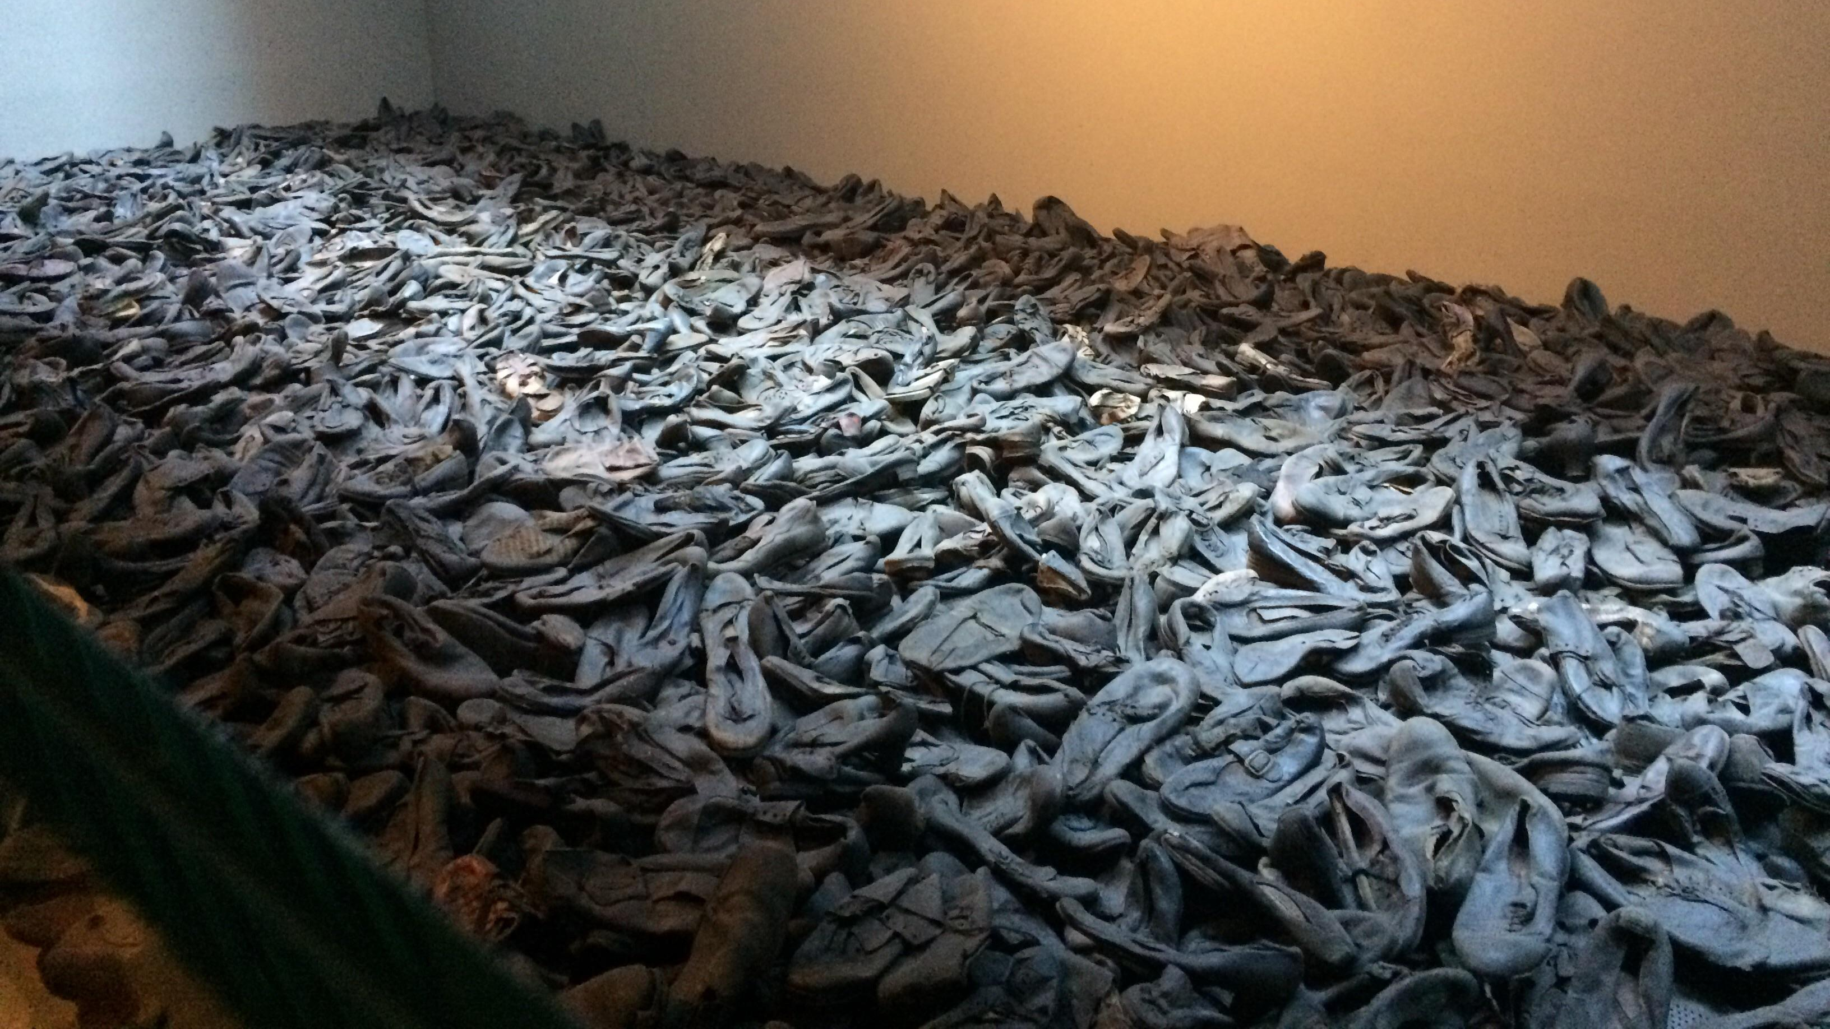
II. COMPARISON TO THE UNRIGHTEOUS (Job 4:7-16)

Slide 13
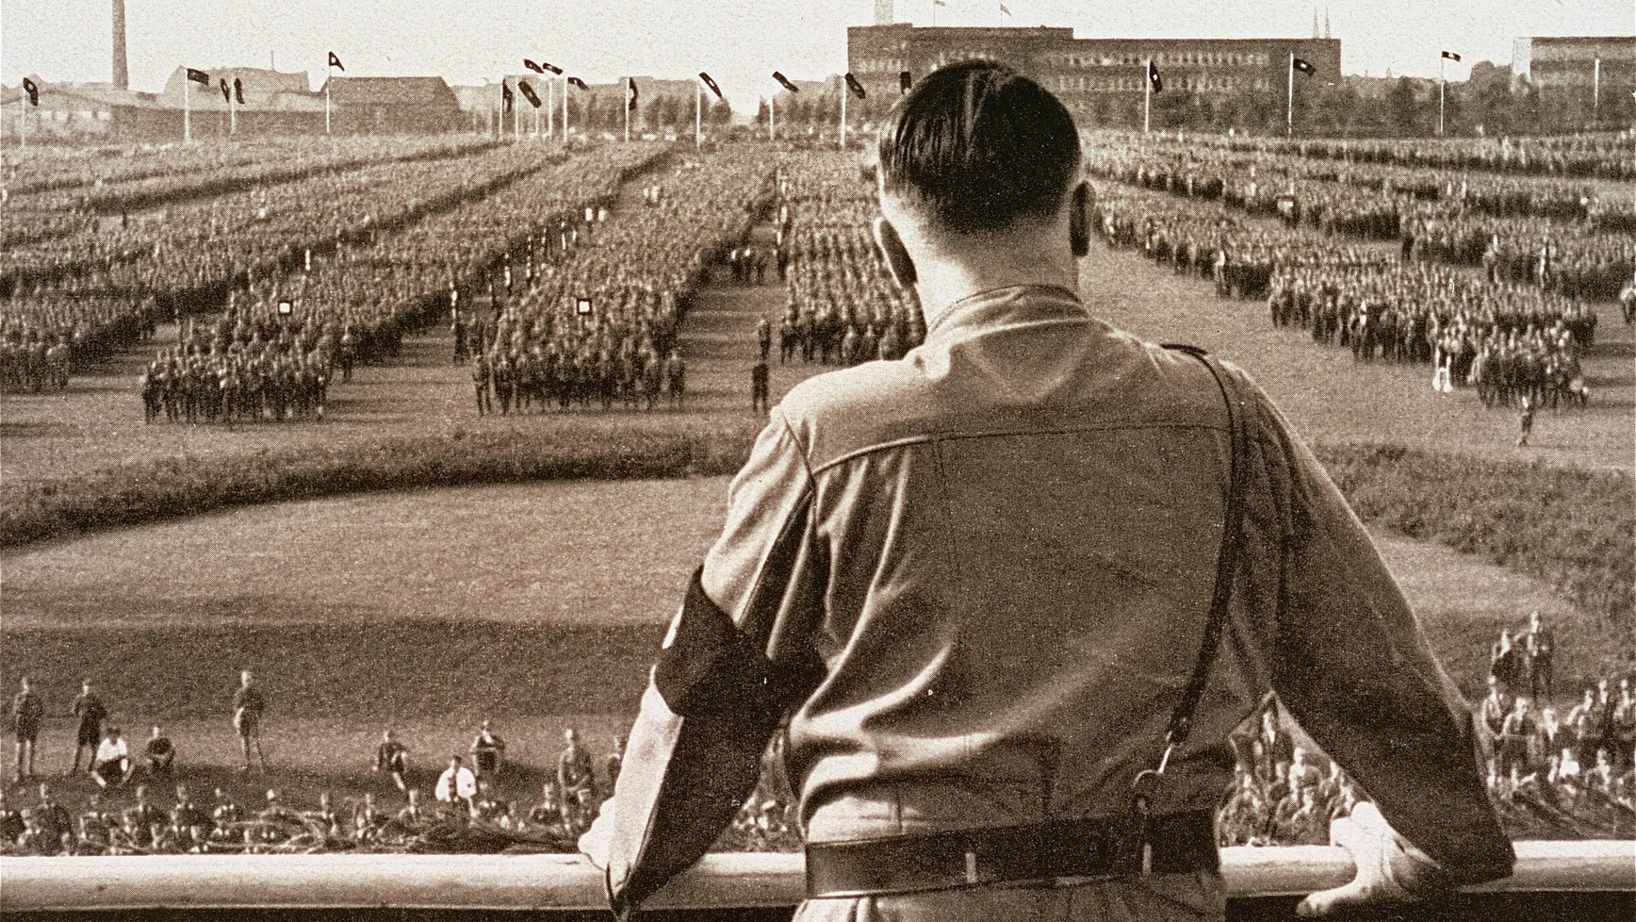
II. COMPARISON TO THE UNRIGHTEOUS (Job 4:7-16)

Slide 14
II. COMPARISON TO THE UNRIGHTEOUS (Job 4:7-16)
“Consider now: Who, being innocent, has ever perished? Where were the upright ever destroyed?”
Job 4:7

Slide 15
II. COMPARISON TO THE UNRIGHTEOUS (Job 4:7-16)
The Church has been blind sided by leaders like Demas
“because he loved this world” II Timothy 4:10).

Slide 16
II. COMPARISON TO THE UNRIGHTEOUS (Job 4:7-16)
“They went on stoning Stephen as he called on the Lord and said, “Lord Jesus, receive my spirit!”
Acts 7:59

Slide 17
II. COMPARISON TO THE UNRIGHTEOUS (Job 4:7-16)
“For I am already being poured out as a drink offering, and the time of my departure has come. I have fought the good fight, I have finished the course, I have kept the faith;
II Timothy 4:7

Slide 18
II. COMPARISON TO THE UNRIGHTEOUS (Job 4:7-16)
“in the future there is laid up for me the crown of righteousness, which the Lord, the righteous Judge, will award to me on that day; and not only to me, but also to all who have loved His appearing.”
II Timothy 4:8

Slide 19
II. COMPARISON TO THE UNRIGHTEOUS (Job 4:7-16)
“The righteous man perishes, and no man takes it to heart; And devout men are taken away, while no one understands. For the righteous man is taken away from evil,”
Isaiah 57:1

Slide 20
II. COMPARISON TO THE UNRIGHTEOUS (Job 4:7-16)

Slide 21
II. COMPARISON TO THE UNRIGHTEOUS (Job 4:7-16)
“A word was secretly brought to me, my ears caught a whisper of it.
13. Amid disquieting dreams in the night, when deep sleep falls on people,
14. fear and trembling seized me and made all my bones shake.
Job 4:12-14

Slide 22
II. COMPARISON TO THE UNRIGHTEOUS (Job 4:7-16)
“A spirit glided past my face, and the hair on my body stood on end.
16. It stopped, but I could not tell what it was.”
Job 4:15-16

Slide 23
III. CRUSHING THE STRONGMAN (Job 4:17-21)
“Can even a strong man be more pure than his Maker?
Job 4:17

Slide 24
III. CRUSHING THE STRONGMAN (Job 4:17-21)
“Eliphaz’s final image of man’s precarious existence is that he is like a tent held up by a single rope.”
“Job an Introduction and Commentary”
Francis I. Anderson
p. 115

Slide 25
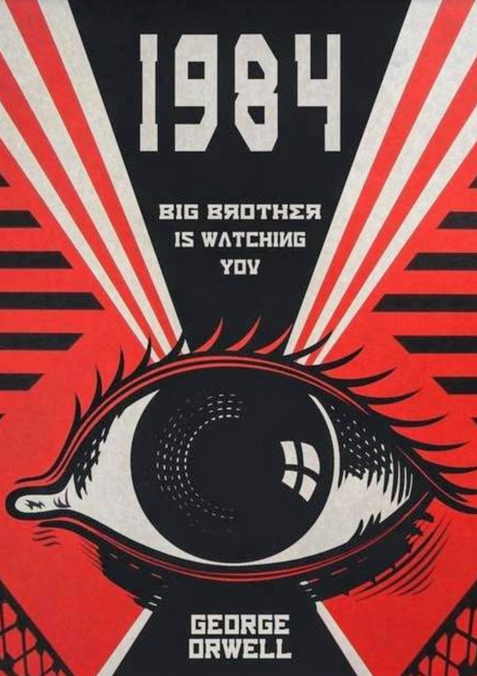
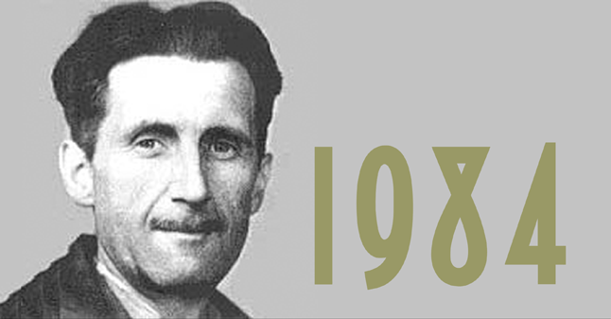
III. CRUSHING THE STRONGMAN (Job 4:17-21)
“Orwellian is an adjective describing a situation, idea, or societal condition that George Orwell identified as being destructive to the welfare of a free and open society. It denotes an attitude and a brutal policy of draconian control by propaganda, surveillance, disinformation, denial of truth (doublethink), and manipulation of the past, including the "unperson"—a person whose past atrocity is idealised from the public record and memory, practiced by modern repressive governments.”

Slide 26
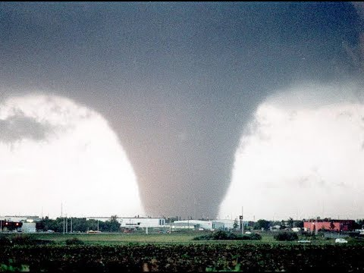
III. CRUSHING THE STRONGMAN (Job 4:17-21)

Slide 27
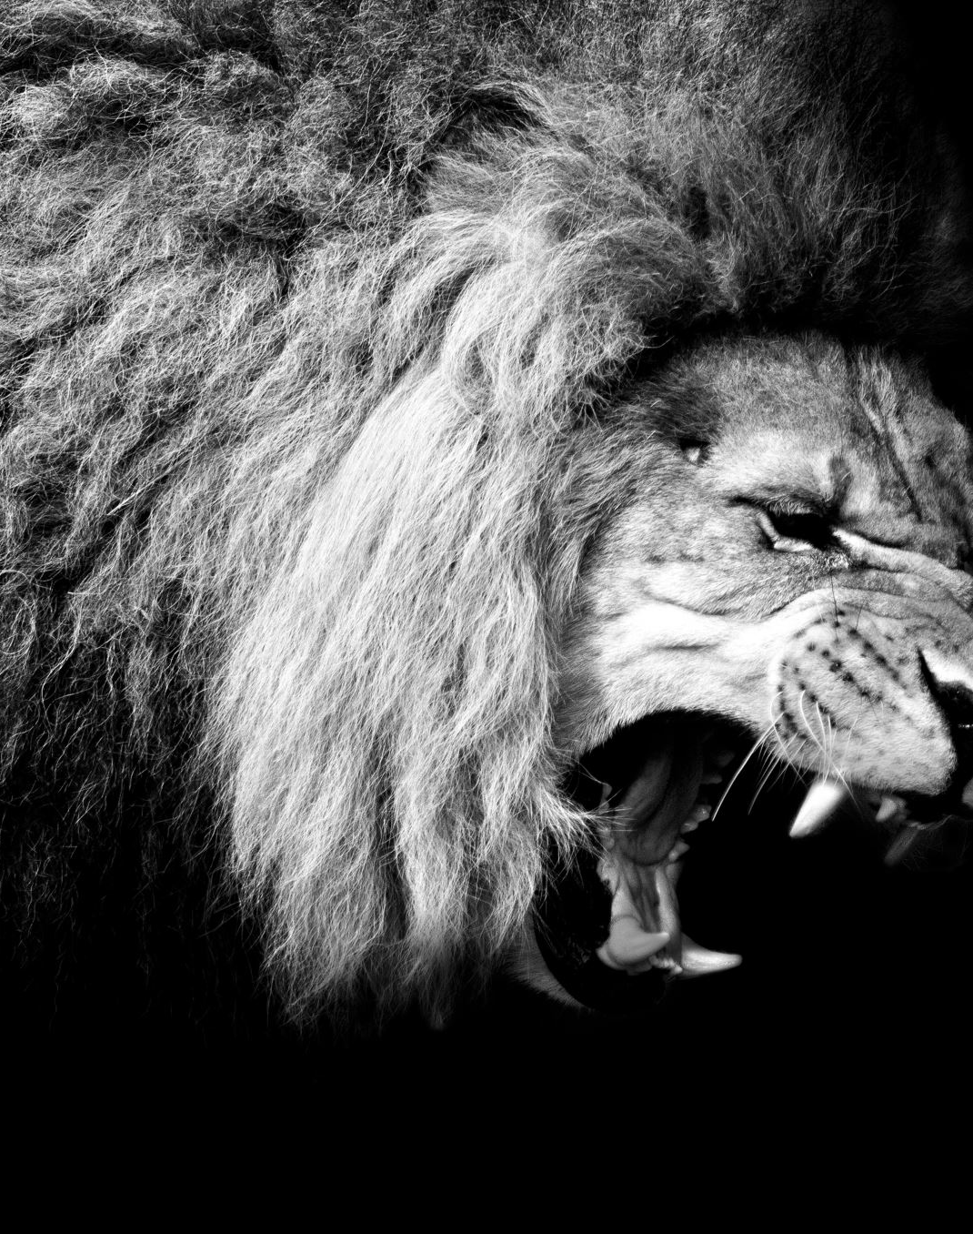
III. CRUSHING THE STRONGMAN (Job 4:17-21)
“The lions may roar and growl, yet the teeth of the great lions are broken.”
Job 4:10

