Slide 1
Encounter
Luke 19:1-10

Slide 2
Jesus entered Jericho and was passing through. A man was there by the name of Zacchaeus; he was a chief tax collector and was wealthy. He wanted to see who Jesus was, but because he was short, he could not see over the crowd. So, he ran ahead and climbed a sycamore-fig tree to see him, since Jesus was coming that way.

Slide 3
When Jesus reached the spot, he looked up and said to him, “Zacchaeus, come down immediately. I must stay at your house today.” So, he came down at once and welcomed him gladly. All the people saw this and began to mutter, “He has gone to be the guest of a sinner.”

Slide 4
But Zacchaeus stood up and said to the Lord, “Look, Lord! Here and now I give half of my possessions to the poor, and if I have cheated anybody out of anything, I will pay back four times the amount.” Jesus said to him, “Today salvation has come to this house, because this man, too, is a son of Abraham. For the Son of Man came to seek and to save the lost.” Luke 19:1-10

Slide 5
I. THE SEEKING SINNER ENCOUNTER A) HIS PROMINENCE
1. A MAN OF POSITION
2. A MAN OF POWER

Slide 6
I. THE SEEKING SINNER ENCOUNTER
B) HIS PREOCCUPATION
C) HIS DESIRE

Slide 7
I. THE SEEKING SINNER ENCOUNTER
D) HIS DESPERATE NEED

Slide 8
I. THE SEEKING SINNER ENCOUNTER E) HIS PROBLEM
1. THE CROWD
2. HIS CONDITION

Slide 9
I. THE SEEKING SINNER ENCOUNTER
F) HIS PERSISTENCE

Slide 10
II. THE SEEKING SAVIOUR ENCOUNTER
A) JESUS CAME TO HIM
B) JESUS CONSIDERED HIM
“But because of his great love for us, God, who is rich in mercy, made us alive with Christ even when we were dead in transgressions—it is by grace you have been saved.”
Ephesians 2:4-5

Slide 11
II. THE SEEKING SAVIOUR ENCOUNTER C) JESUS CALLED HIM
1. AN URGENT CALL
2. AN UNMISTAKABLE CALL

Slide 12
III. THE SPECTACULAR SALVATION ENCOUNTER
A) ZACCHAEUS RECEIVED THE SAVIOUR
1. OBEDIENCE
2. OPEN HEART
3. OBVIOUS JOY

Slide 13
III. THE SPECTACULAR SALVATION ENCOUNTER
B) ZACCHAEUS REPENTED OF HIS SINS
There Was Confession –
“If we confess our sins, he is faithful and just and will forgive us our sins and purify us from all unrighteousness.”
1 John 1:9
2. There Was a Change –
Therefore, if anyone is in Christ, the new creation has come: The old has gone, the new is here!
2 Corinthians 5:17

Slide 14
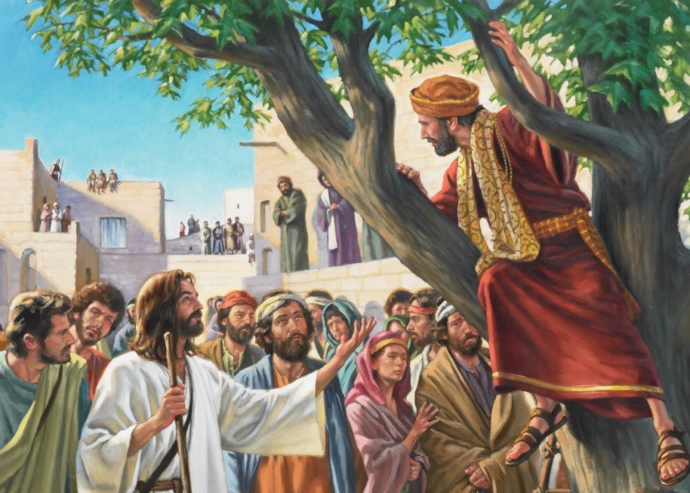
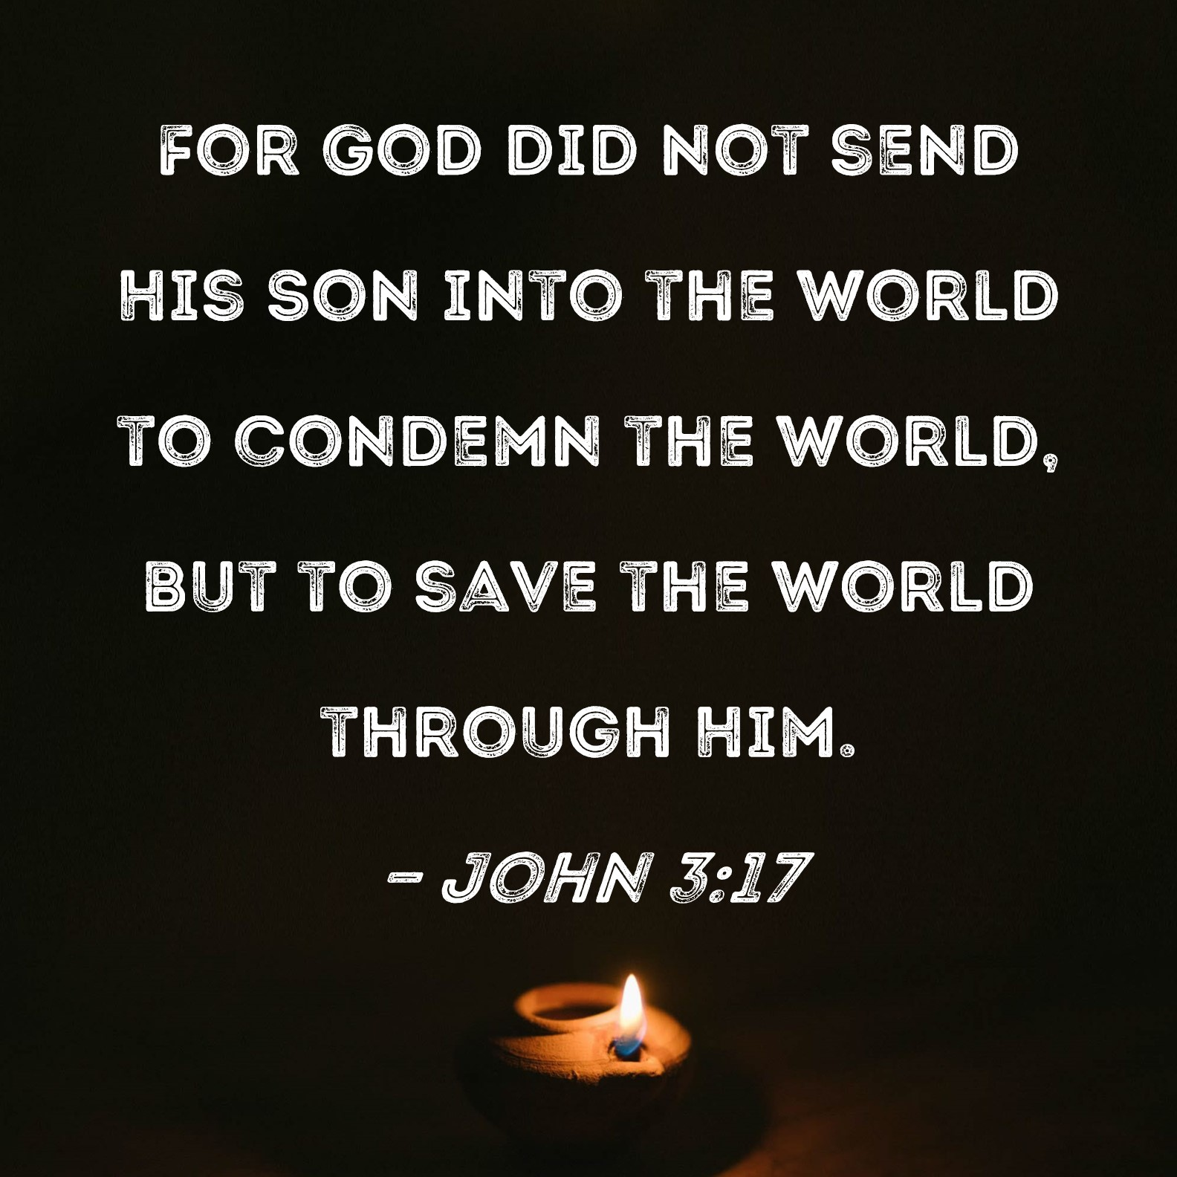
III. THE SPECTACULAR SALVATION ENCOUNTER
C) ZACCHAEUS WAS REDEEMED WITH A GREAT SALVATION
THE MERCY OF CHRIST
2. THE MISSION OF CHRIST

Slide 15
ARE YOU LONGING FOR A TRUE ENCOUNTER?

