Slide 1
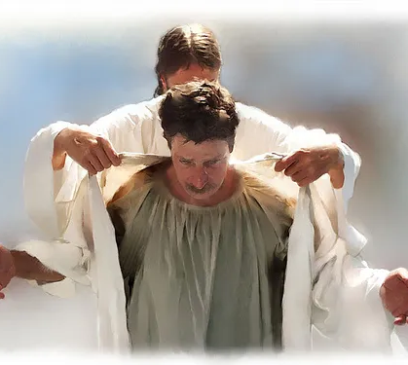
FALLING UPON THE ROCK
Text: Luke 20:18

Slide 2
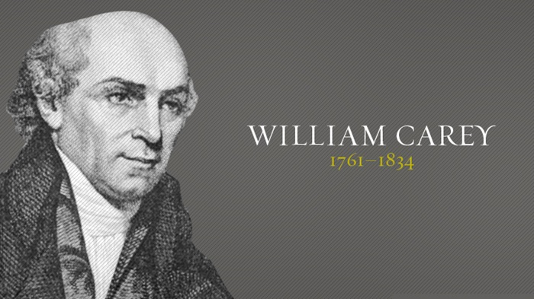

Slide 3
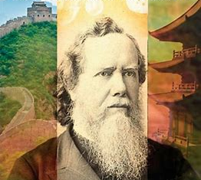
Hudson Taylor Missionary to China
“Dear friends,
I am the
little servant
of an
illustrious Master.”

Slide 4
How Does True Humility Show Itself?

Slide 5
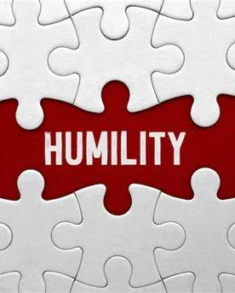
I. IN OUR GRIEVANCES
A “grievance” is (according to Funk & Wagnal’s Dictionary) “a feeling of resentment arising from a sense of having been wronged.”

Slide 6
II. IN OUR GROWTH
Joseph - Genesis 32; 50:20;
Gideon - Judges 6,7;
Manasseh gave birth to Josiah –
II Kings 22,23

Slide 7
II. IN OUR GROWTH
“Do nothing out of selfish ambition or vain conceit, but in humility consider others better than yourselves.
Philippians 2:3

Slide 8
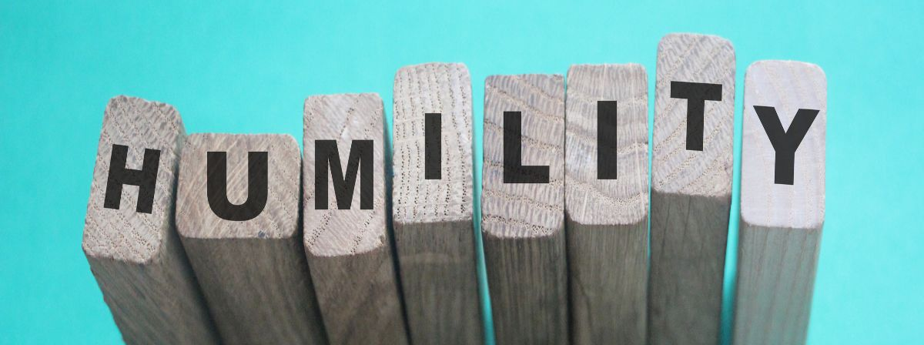
II. IN OUR GROWTH
“My grace is sufficient for you, for my power is made perfect in weakness.”
II Corinthians 12:9

Slide 9
II. IN OUR GROWTH
“But Mary treasured up all these things and pondered them in her heart.”
Luke 2:19

Slide 10
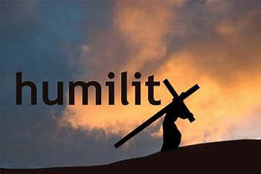
II. IN OUR GROWTH
“And being found in appearance as a man, he humbled himself and became obedient to death—even death on a cross!”
Philippians 2:8

Slide 11
II. IN OUR GROWTH
“Let us fix our eyes on Jesus, the author and perfecter of our faith, who for the joy set before him endured the cross, scorning its shame, and sat down at the right hand of the throne of God.”
Hebrews 12:2

Slide 12
II. IN OUR GROWTH
“I am the least of the apostles.” 1 Corinthians 15:9
“I am the very least of all the saints.” Ephesians 3:8
“I am the foremost of sinners. “ I Timothy 1:15

Slide 13
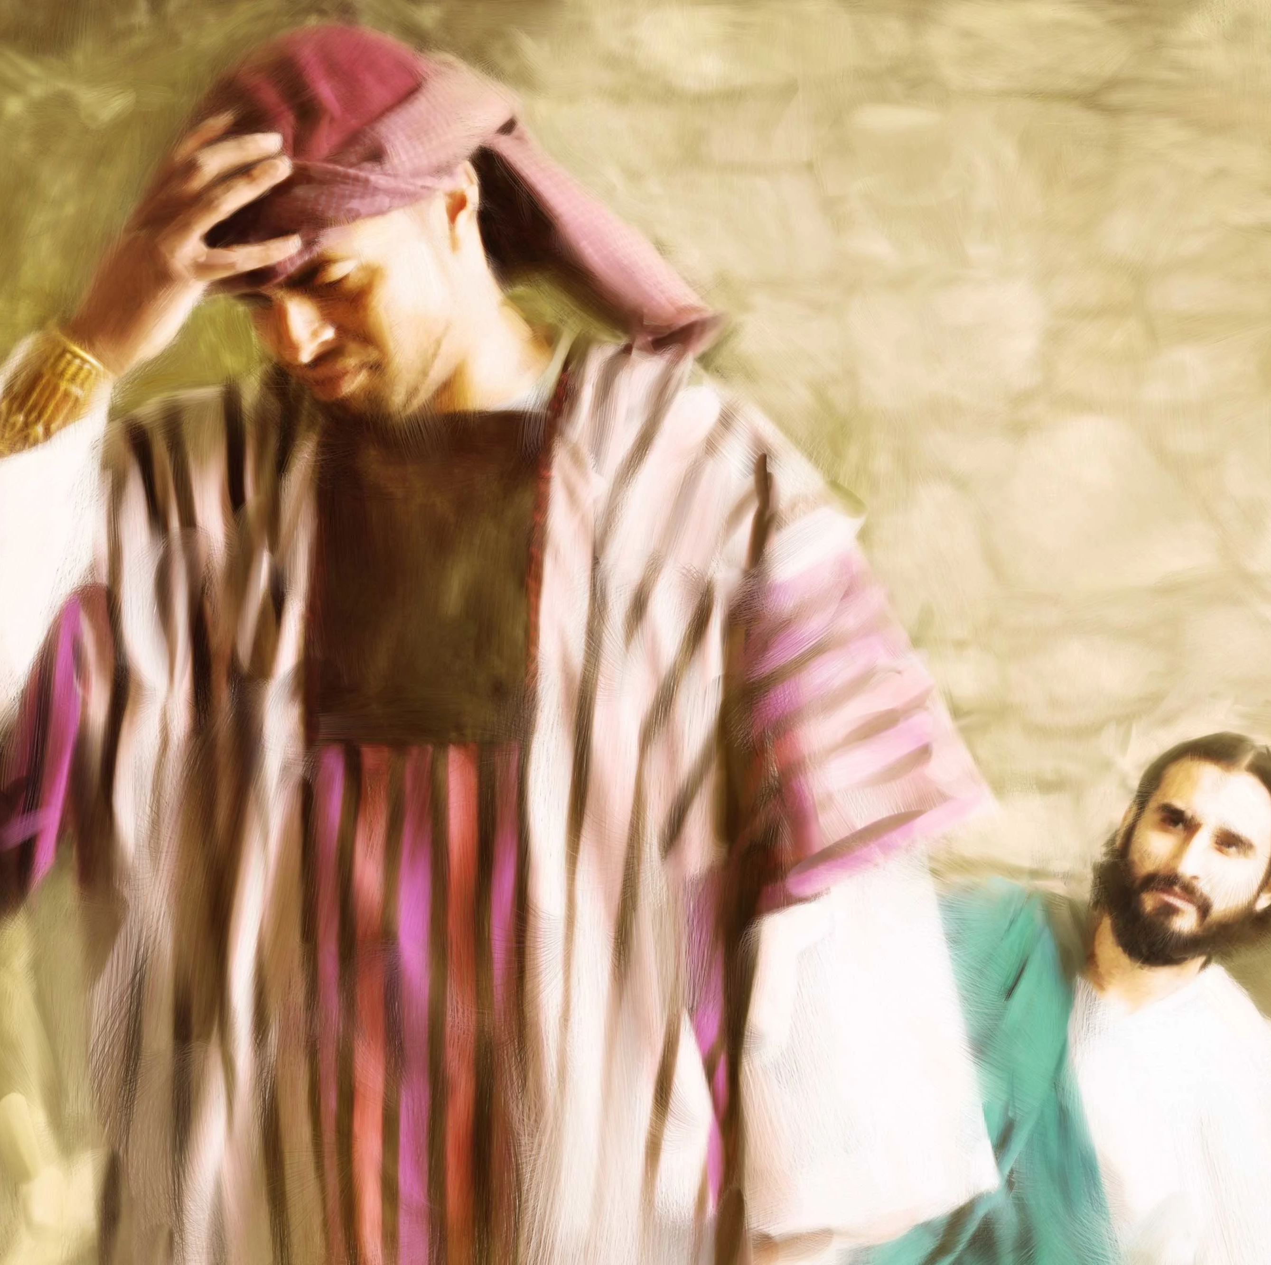
III. IN OUR GIVING
“When it comes to giving, some people will stop at nothing.”
Jimmy Carter

Slide 14
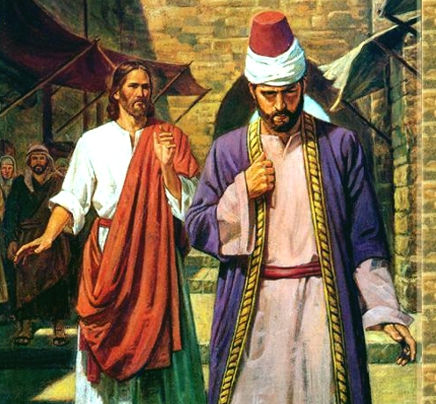
III. IN OUR GIVING
“We’d all like a reputation for generosity, and we’d all like to buy it cheap.”

Slide 15
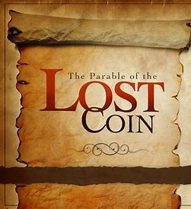
III. IN OUR GIVING
In Matthew, Mark, and Luke, 1 of 6 verses deals with money. Of the 29 parables Christ told, 16 deal with a person and his money.

Slide 16
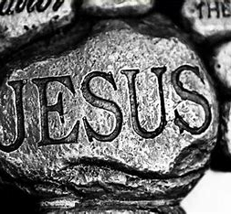
Let us
fall upon the Rock
of our Salvation.
In doing so
(yet not for that purpose) we shall avoid having
the Rock fall upon us.

