Slide 1
FALSE ACCUSATIONS
Job 5:1-27

Slide 2
I. WHAT WAS JOB FALSELY ACCUSED OF (Job 5:1-7)?
A. Calling upon God’s Deaf Ear –
“Call if you will, but who will answer you? To which of the holy ones will you turn?”
Job 5:1

Slide 3
I. WHAT WAS JOB FALSELY ACCUSED OF (Job 5:1-7)?
A. Calling upon God’s Deaf Ear –
“This man was blameless and upright, he feared God and shunned evil.”
Job 1:1

Slide 4
I. WHAT WAS JOB FALSELY ACCUSED OF (Job 5:1-7)?
A. Calling upon God’s Deaf Ear –
“Every good and perfect gift is from above, coming down from the Father of the heavenly lights, who does not change like shifting shadows.”
James 1:17

Slide 5
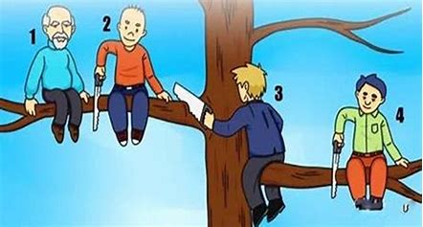
I. WHAT WAS JOB FALSELY ACCUSED OF (Job 5:1-7)?
B. Being Resentful, Foolish and Envious (Job 5:2,3)
“Resentment kills a fool, and envy slays the simple.
3. I myself have seen a fool taking root, but suddenly his house was cursed.”
Job 5:2,3

Slide 6
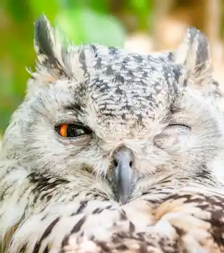
I. WHAT WAS JOB FALSELY ACCUSED OF (Job 5:1-7)?
C. Being Crafty (Job 5:13)
“He catches the wise in their craftiness, and the schemes of the wily are swept away.”
Job 5:13

Slide 7
II. WHAT DOES GOD RESCUE US FROM (Job 5:18-24)?
A. Sickness (Job 5:18)
“For he wounds, but he also binds up; he injures, but his hands also heal.”
Job 5:18

Slide 8
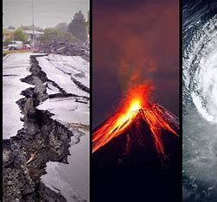
II. WHAT DOES GOD RESCUE US FROM (Job 5:18-24)?
B. Calamities (Job 5:19)
“From six calamities he will rescue you; in seven no harm will touch you.”
Job 5:19

Slide 9
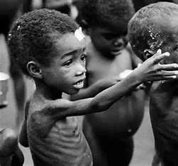
II. WHAT DOES GOD RESCUE US FROM (Job 5:18-24)?
C. Famines (Job 5:20)
“In famine he will deliver you from death,”
Job 5:20a

Slide 10
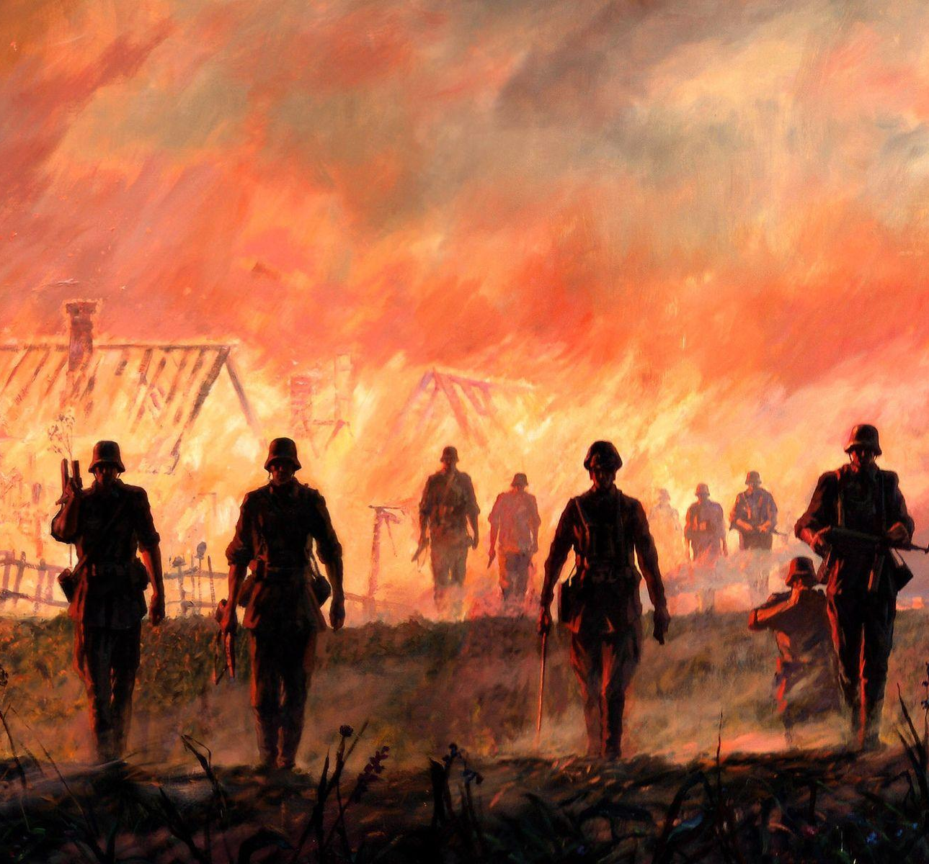
II. WHAT DOES GOD RESCUE US FROM (Job 5:18-24)?
D. War and Battles (Job 5:20)
“and in battle from the stroke of the sword.”
Job 5:20b

Slide 11
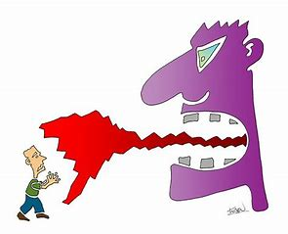
II. WHAT DOES GOD RESCUE US FROM (Job 5:18-24)?
E. The Lash of the Tongue (Job 5:21)
“You will be protected from the lash of the tongue.” Job 5:21

Slide 12
II. WHAT DOES GOD RESCUE US FROM (Job 5:18-24)?
E. The Lash of the Tongue (Job 5:21)
“Those who consider themselves religious and yet do not keep a tight rein on their tongues deceive themselves, and their religion is worthless.” James 1:26

Slide 13
II. WHAT DOES GOD RESCUE US FROM (Job 5:18-24)?
E. The Lash of the Tongue (Job 5:21)
“The tongue also is a fire, a world of evil among the parts of the body. It corrupts the whole body, sets the whole course of one’s life on fire, and is itself set on fire by hell.” James 3:6

Slide 14
II. WHAT DOES GOD RESCUE US FROM (Job 5:18-24)?
F. Fear of Wild Animals (Job 5:22)
“. . . and need not fear the wild animals.”
Job 5:22b

Slide 15
II. WHAT DOES GOD RESCUE US FROM (Job 5:18-24)?
G. Death Itself (Job 5:20a,24)
“he will deliver you from death,” Job 5:20a

