Slide 1
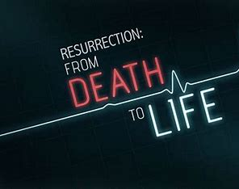
FROM DEATH TO DELIGHT
Text: Luke 7:11-17

Slide 2
Lets focus for a few moments on the woman who lost her son. This woman walked through at least three stages of change.
Text: Luke 7:11-17

Slide 3
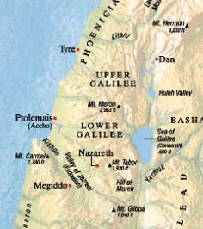
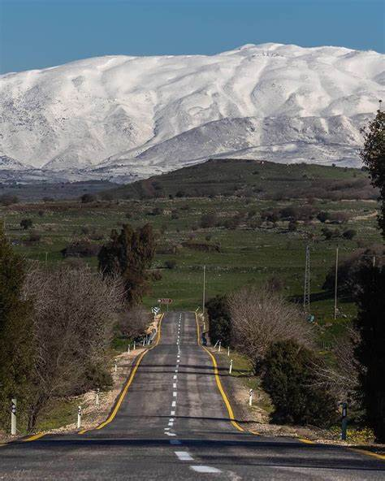
I. Death (Luke 7:11,12)
Majestic Mount Hermon – 9232 ft

Slide 4
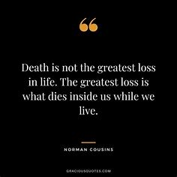
“When we encounter death, we face an irreversible, unalterable situation that we are powerless to change. Even though “death has been swallowed up in victory,” the loss of a loved one can be devastating and grief can be overwhelming.” Gary R. Collins “Christian Counseling” p. 345

Slide 5
II. Despair “When the Lord saw her, his heart went out to her and he said, ‘Don’t cry.’” Luke 7:13

Slide 6
II. Despair She had probably already experienced many other effects in the grieving process - shock, numbness, denial, emptiness, guilt, anger, forgetfulness, loneliness, and even collapsing. “These symptoms of grief come in waves, and rarely are they all present at the same time.” C. S. Lewis “A Grief Observed” p. 66,67

Slide 7
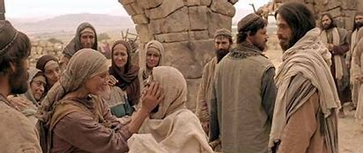
III. Delight “Young man, I say to you, get up!” 15. The dead man sat up and began to talk, and Jesus gave him back to his mother.” Luke 7:14,15

Slide 8
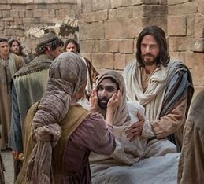
III. Delight “They were filled with awe and praised God. ‘A great prophet has appeared among us,’ they said. ‘God has come to help his people.’ 17. This news about Jesus spread throughout Judea and the surrounding country.” Luke 7:16,17

Slide 9
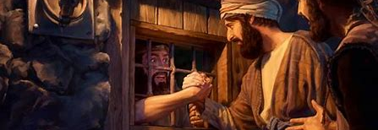
III. Delight “Go back and report to John what you have seen and heard: the blind receive their sight, the lame walk, those who have leprosy are cured, the deaf hear, the dead are raised, and the good news is preached to the poor.” Luke 7:22

Slide 10
FROM DEATH TO DELIGHT

