Slide 1
GENTLE VOICES SPEAK LOUDLY
Text: I Kings 19:1-18

Slide 2
“A gentle answer turns away wrath.” Proverbs 15:1

Slide 3
I. A LESSON IN ANTIQUITY
“Horeb” means “consecration

Slide 4
I. A LESSON IN ANTIQUITY
“Three times I pleaded with the Lord to take it away from me.
9. But he said to me, “My grace is sufficient for you, for my power is made perfect in weakness.” Therefore I will boast all the more gladly about my weaknesses, so that Christ’s power may rest on me.

Slide 5
I. A LESSON IN ANTIQUITY
10. That is why, for Christ’s sake, I delight in weaknesses, in insults, in hardships, in persecutions, in difficulties. For when I am weak, then I am strong.”
I Corinthians 12:8-10

Slide 6
I. A LESSON IN ANTIQUITY
“What are you doing here, Elijah?”
I Kings 19:9

Slide 7
I. A LESSON IN ANTIQUITY
“. . . but the LORD was not in the wind.”
I Kings 19:11
“. . . but the LORD was not in the earthquake.”
I Kings 19:11
“. . . but the LORD was not in the fire.”
I Kings 19:12

Slide 8
I. A LESSON IN ANTIQUITY
“When Elijah heard it, he pulled his cloak (mantel) over his face and went out and stood at the mouth of the cave, then the voice said to him, ‘What are you doing here, Elijah?”
I Kings 19:13

Slide 9
I. A LESSON IN ANTIQUITY
“The LORD said to him, ‘Go back the way you came, and go to the desert of Damacus. When you get there, anoint Hazael king over Aram.”
I Kings 19:15

Slide 10
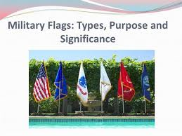
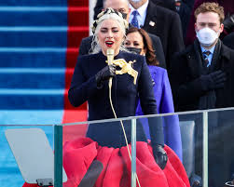
II. A MODERN LESSON the inauguration of Robert F. Biden Jr.
z

Slide 11
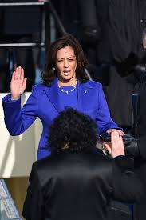
II. A MODERN LESSON the inauguration of Robert F. Biden Jr.
“one nation Under God, indivisible with Liberty & Justice for all.”
z
“So Help Me God.”

Slide 12
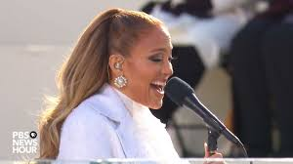
II. A MODERN LESSON the inauguration of Robert F. Biden Jr.
“This Land is Your Land, This Land is My Land” and
“God Bless America.”
z

Slide 13
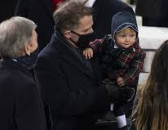
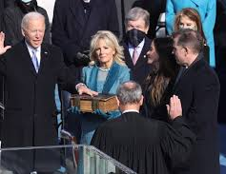
II. A MODERN LESSON the inauguration of Robert F. Biden Jr.
Little Beau Biden Jr. carried out twice
z

Slide 14
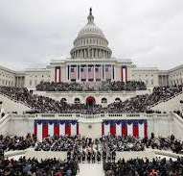
II. A MODERN LESSON the inauguration of Robert F. Biden Jr.
“Ladies and Gentlemen please be seated” followed by 2 minutes of silence
z
Then it happened - AGAIN.
A baby cried twice.

Slide 15
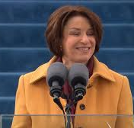
II. A MODERN LESSON the inauguration of Robert F. Biden Jr.
The 20th Amendment states that the “terms of the President and Vice President shall end
at noon
on the 20th day of January.”
Since 1937 the Oath of Office has taken place at noon EST on January 20th on the first day of the first term
z

Slide 16
“Democracy Dies in Darkness.”
The USA now has a president for all Americans
Go with truth not lies
Power and profit bring about an uncivil war
This new administration will do their best to remove resentment, lawlessness and disease.
It’s no longer going to be “the example of our power but our power from our example.”
Facts will no longer be manipulated and manufactured.

Slide 17
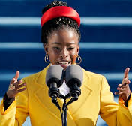
II. A MODERN LESSON the inauguration of Robert F. Biden Jr.
Poet
Amanda Gorman
z
“the pen is mightier than the sword.”

Slide 18
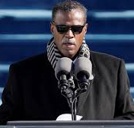
II. A MODERN LESSON the inauguration of Robert F. Biden Jr.
Rev. Dr. Sylvester Beaman
Bethel African Methodist Episcopal Church in Wilmington, Delaware
z
Benediction Prayer
unity is the path forward

Slide 19
II. A MODERN LESSON the inauguration of Robert F. Biden Jr.
The baby’s gentle voice cries loudly.
z

