Slide 1
GIVING - FROM A HIDDEN HEART Text: Matthew 6:1-4

Slide 2
I. THREE POSSIBILITIES EXIST TO EXPOSE WHAT IS GOING ON IN OUR HEARTS WHEN WE GIVE
A. Seeking the Praise of People (Matthew 6:1,2)
“Let your light shine before men, that they may see your good deeds and praise your Father in heaven.” Matthew 5:16

Slide 3
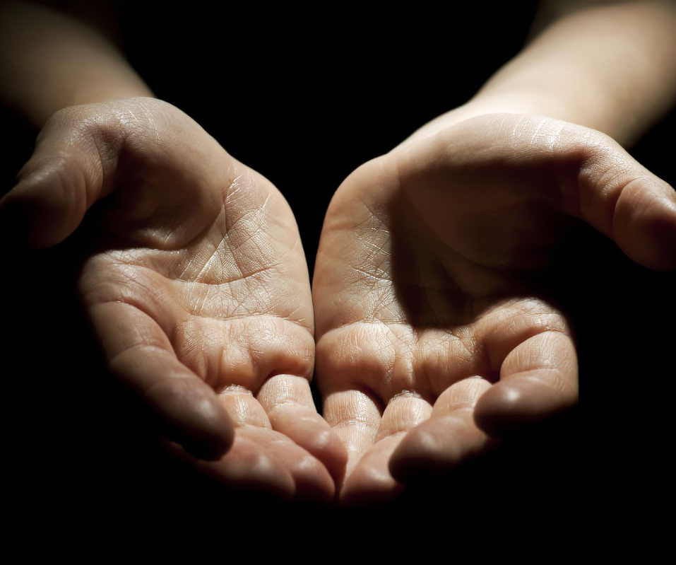
I. THREE POSSIBILITIES EXIST TO EXPOSE WHAT IS GOING ON IN OUR HEARTS WHEN WE GIVE
A. Seeking the Praise of People (Matthew 6:1,2)
“There will always be poor people in the land. Therefore, I command you to be openhanded toward your brothers and toward the poor and needy in your land.”
Deuteronomy 15:11

Slide 4
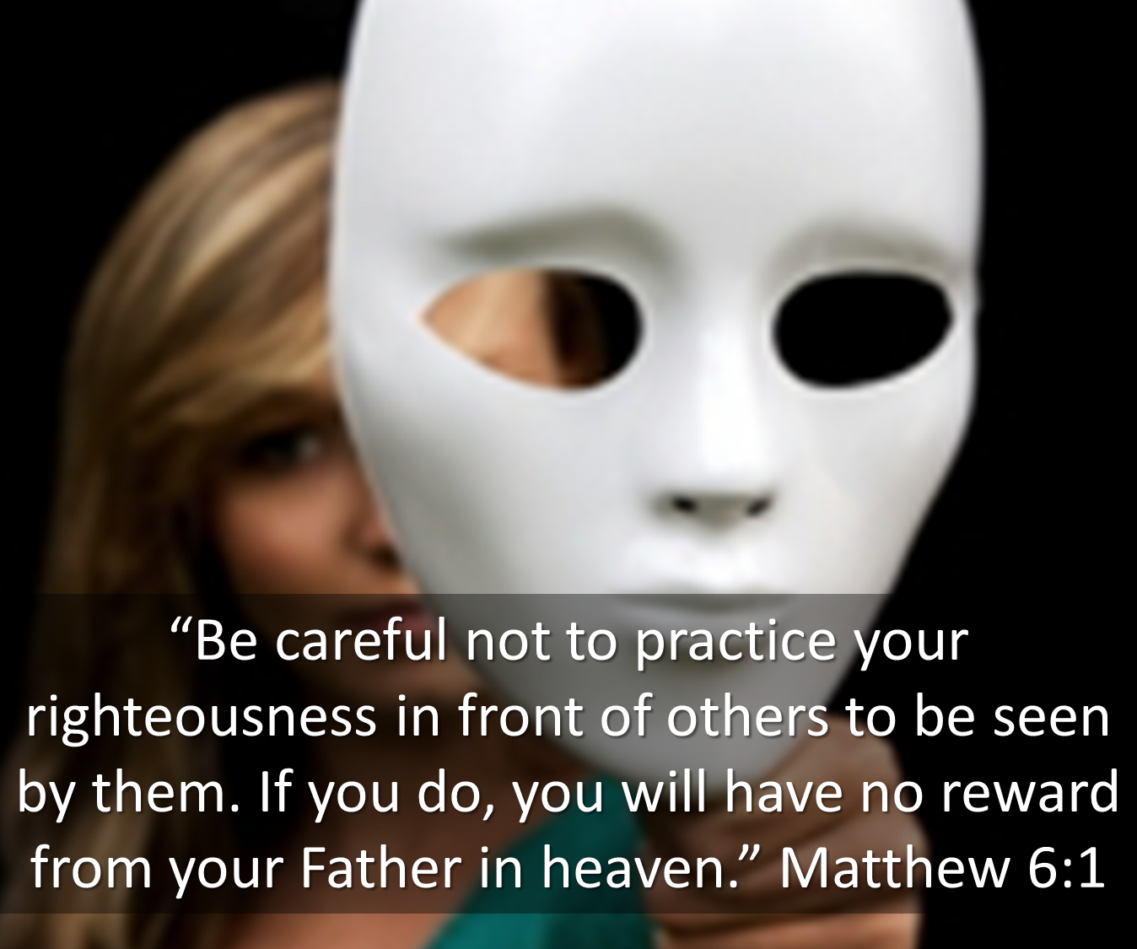
I. THREE POSSIBILITIES EXIST TO EXPOSE WHAT IS GOING ON IN OUR HEARTS WHEN WE GIVE
A. Seeking the Praise of People (Matthew 6:1,2)
“So when you give to the needy, do not announce it with trumpets, as the hypocrites do in the synagogues and on the streets, to be honored by men.” Matthew 6:2

Slide 5
I. THREE POSSIBILITIES EXIST TO EXPOSE WHAT IS GOING ON IN OUR HEARTS WHEN WE GIVE
A. Seeking the Praise of People (Matthew 6:1,2)
“they loved praise from men more than praise from God” John 12:43

Slide 6
I. THREE POSSIBILITIES EXIST TO EXPOSE WHAT IS GOING ON IN OUR HEARTS WHEN WE GIVE
A. Seeking the Praise of People (Matthew 6:1,2)
“Everything they do is for show. On their arms they wear extra wide prayer boxes with Scripture verses inside, and they wear extra long tassels on their robes.
6. And how they love to sit at the head table at banquets and in the most prominent seats in the synagogue!
7. They enjoy the attention they get on the streets, and they enjoy being called ‘rabbi.’”
Matthew 23:5-7 (NLT)

Slide 7
I. THREE POSSIBILITIES EXIST TO EXPOSE WHAT IS GOING ON IN OUR HEARTS WHEN WE GIVE
B. Preserving Anonymity Yet Quietly Congratulating Ourselves (Matthew 6:3)
“But when you give to the needy, do not let your left hand know what your right hand is doing” Matthew 6:3

Slide 8
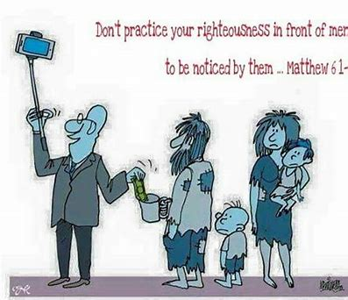
I. THREE POSSIBILITIES EXIST TO EXPOSE WHAT IS GOING ON IN OUR HEARTS WHEN WE GIVE
B. Preserving Anonymity Yet Quietly Congratulating Ourselves (Matthew 6:3)
“But when you give to the needy, do not let your left hand know what your right hand is doing” Matthew 6:3

Slide 9
I. THREE POSSIBILITIES EXIST TO EXPOSE WHAT IS GOING ON IN OUR HEARTS WHEN WE GIVE
C. Desiring God’s Approval Alone (Matthew 6:4)
True followers of Christ live out their lives authentically before an audience of ONE.

Slide 10
II. HOW CAN I TELL IF MY MOTIVES ARE RIGHT?
A. I Will Give Spontaneously Balanced with God’s Wisdom
“If anyone has material possessions and sees his brother in need but has no pity on him, how can the love of God be in him?” 1 John 3:17

Slide 11
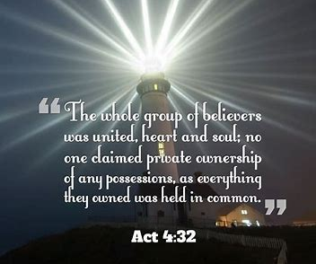
II. HOW CAN I TELL IF MY MOTIVES ARE RIGHT?
I Will Give Spontaneously Balanced with God’s Wisdom
“There were no needy persons among them.” Acts 4:34

Slide 12
II. HOW CAN I TELL IF MY MOTIVES ARE RIGHT?
B. I Will Give Secretly and Enjoy the Moment

Slide 13
II. HOW CAN I TELL IF MY MOTIVES ARE RIGHT?
C. I Will Give with NO Thought of Reward

