Slide 1
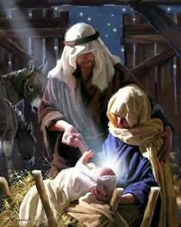
GOD IS WITH US
Texts: Isaiah 7:14; Matthew 1:23 Matthew 28:18-20; John 14:16-18

Slide 2
GOD IS WITH US
"Therefore the Lord himself will give you a sign: The virgin will be with child and give birth to a son, and will call him Immanuel."
Isaiah 7:14
"The virgin will be with child and will give birth to a son, and will call him Immanuel - which means God with us."
Matthew 1:23

Slide 3
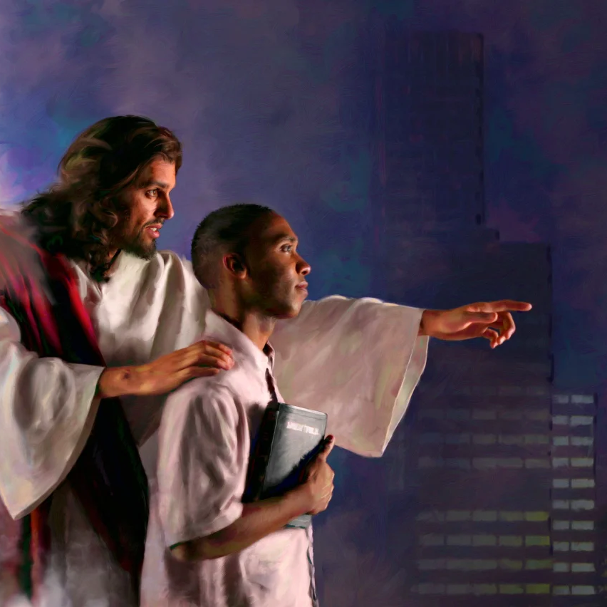
GOD IS WITH US
“All authority in heaven and on earth has been given to me.
19. Therefore go and make disciples of all nations, baptizing them in the name of the Father and of the Son and of the Holy Spirit,
20. and teaching them to obey everything I have commanded you. And surely I am with you always, to the very end of the age.”
Matthew 28:18-20

Slide 4
A flag is the sign of identity and of conquering
The Progressive Pride Flag

Slide 5
A flag is the sign of identity and of conquering
The Palestinian Flag

Slide 6
A flag is the sign of identity and of conquering
Israel’s Flag

Slide 7
A flag is the sign of identity and of conquering
The Christian Flag

Slide 8
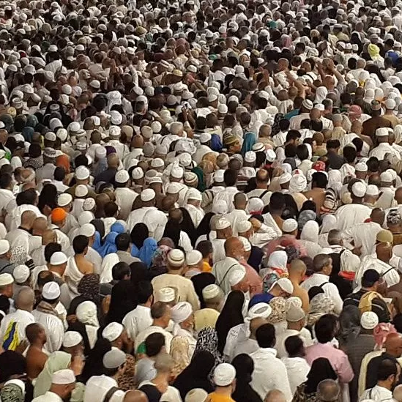
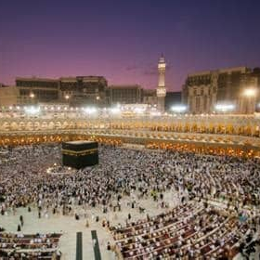
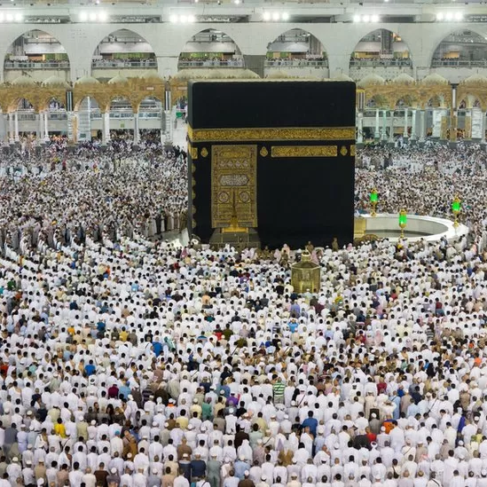
The Ka’Bah
The Umrah pilgrimage in Mecca, Saudi Arabia

Slide 9
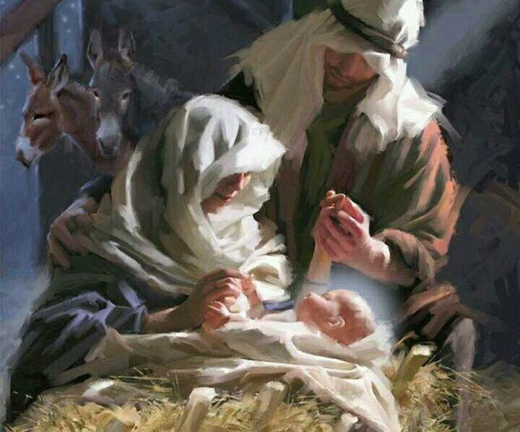
The One and Only God
He clearly demonstrated He wanted
to be with us through His incarnation

Slide 10
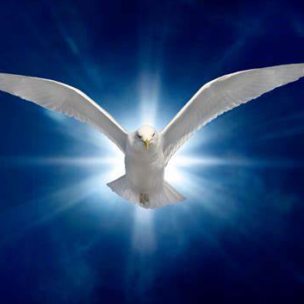
The One and Only God
"I will ask the Father and he will give you another Counselor to be with you forever.
17. The Spirit of truth. The world cannot accept him, because it neither sees him nor knows him. But you know him, for he lives with you and will be in you,
18. I will not leave you as orphans; I will come to you."
John 14:16-18

