Slide 1
THE BOOK OF JOB God’s Fullness During Trying Times
Text: Job 9

Slide 2
“Some trust in chariots and some in horses, but we trust in the name of the Lord our God.” Psalm 20:7

Slide 3
What Did Job See in God That Kept Him from Turning Toward Someone Else in His Days of Trouble and Torment?

Slide 4
I. HE SAW A GOD THAT IS ALL – KNOWING
“A fool has said in his heart that there is no God.”
Psalm 14:1; cf. Psalm 53:1

Slide 5
I. HE SAW A GOD THAT IS ALL – KNOWING
“Therefore hell hath enlarged herself, and opened her mouth without measure: and their glory, and their multitude, and their pomp, and he that rejoiceth, shall descend into it.”
Isaiah 5:14 (KJV)

Slide 6
I. HE SAW A GOD THAT IS ALL – KNOWING
“Indeed, I know that this is true. But how can mere mortals prove their innocence before God?
3. Though they wished to dispute with him, they could not answer him one time out of a thousand.
Job 9:2-3

Slide 7
I. HE SAW A GOD THAT IS ALL – KNOWING
“4. His wisdom is profound . . .
14. “How then can I dispute with him? How can I find words to argue with him?
Job 9:4,14

Slide 8
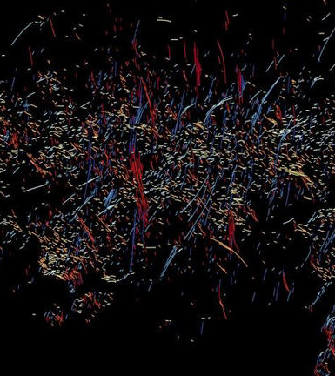
II. HE SAW A GOD THAT IS ALL - POWERFUL
“He moves mountains without their knowing it and overturns them in his anger.
6 He shakes the earth from its place and makes its pillars tremble
10. He performs wonders that cannot be fathomed, miracles that cannot be counted . . .
19. If it is a matter of strength, he is mighty!
Job 9:5,6,10,19
Radio observations of the Milky Way's center, including hundreds of newly discovered filaments (the smaller, yellowish lines and dots)

Slide 9
II. HE SAW A GOD THAT IS ALL - POWERFUL
OUR GOD IS SO BIG
SO STRONG AND SO MIGHTY
THERE’S NOTHING
OUR GOD CANNOT DO
FOR YOU (2 x’s)
THE MOUNTAINS ARE HIS
THE RIVERS ARE HIS
THE STARS SHOW HIS HANDIWORK TOO
Children’s Song
Radio observations of the Milky Way's center, including hundreds of newly discovered filaments (the smaller, yellowish lines and dots)

Slide 10
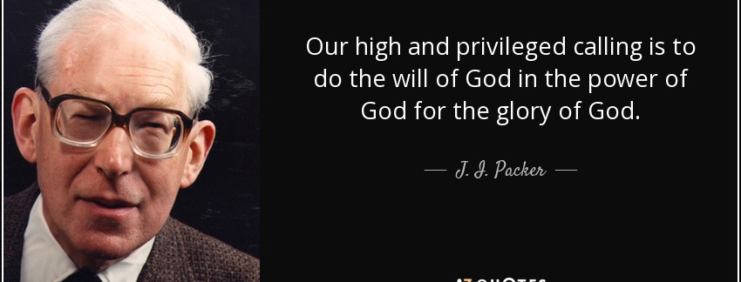
II. HE SAW A GOD THAT IS ALL - POWERFUL

Slide 11
III. HE SAW A GOD THAT IS ALL - PRESENT
“When he passes me, I cannot see him; when he goes by, I cannot perceive him.
12. If he snatches away, who can stop him? Who can say to him, ‘What are you doing?’ . . .
24. When a land falls into the hands of the wicked, he blindfolds its judges. If it is not he, then who is it?
Job 9:11,12.24

Slide 12
III. HE SAW A GOD THAT IS ALL - PRESENT
“Where can I go from your Spirit? Where can I flee from your presence?
8. If I go up to the heavens, you are there; if I make my bed in the depths, you are there.
9. If I rise on the wings of the dawn, if I settle on the far side of the sea,
10. even there your hand will guide me, your right hand will hold me fast.”
Psalm 139:7-10

Slide 13
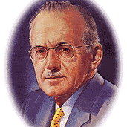
III. HE SAW A GOD THAT IS ALL - PRESENT
"whoever will listen will hear the speaking heaven. This is definitely not the hour when men take kindly to an exhortation to listen, for listening is not today a part of popular religion. We are at the opposite end of the pole from there. Religion has accepted the monstrous heresy that noise, size, activity and bluster make a man dear to God."
A.W. Tozer

