Slide 1
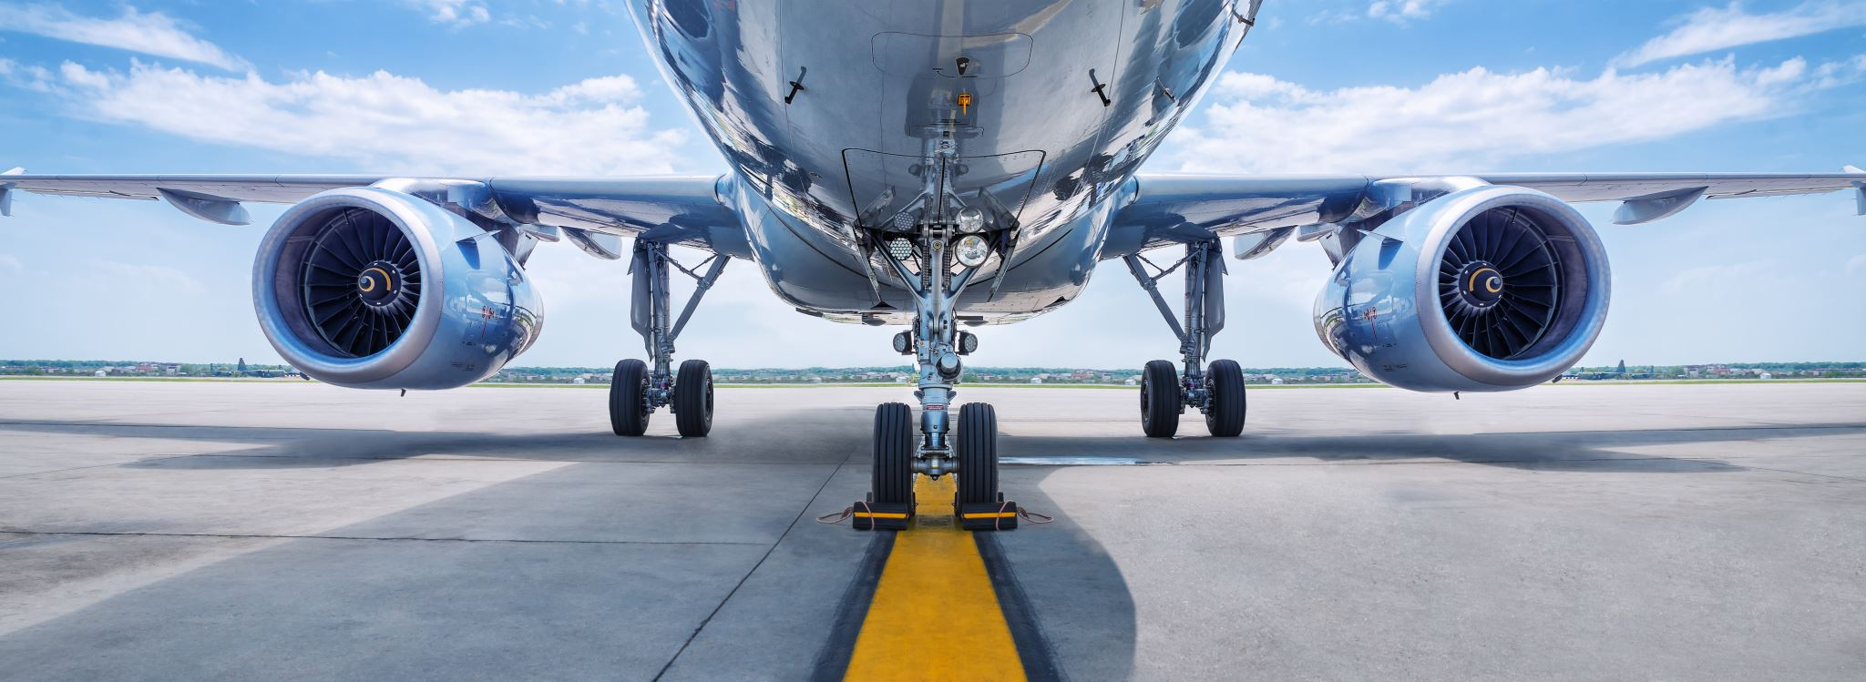
Get Right For The Flight
Matthew 24:42-44 & 25

Slide 2
prepare

Slide 3
The rapture

Slide 4
I'd Rather Have Jesus Jim Reeves I'd rather have Jesus than silver or gold I'd rather be His than have riches untold I'd rather have Jesus than houses or land I'd rather be led by His nail-pierced hand Than to be the king of a vast domain And be held in sin's dread sway I'd rather have Jesus than anything This world affords today I'd rather have Jesus than worldly applause I'd rather be faithful to His dear cause I'd rather have Jesus than worldwide fame Yes, I'd rather be true to His holy name Than to be the king of a vast domain And be held in sin's dread sway I'd rather have Jesus than anything This world affords today

Slide 5
I. It will be sudden
A) In The Blink of An Eye
B) No Time To Prepare

Slide 6
I. It will be sudden
C) Don’t Count On Another Day
D) Split Second of Time

Slide 7
II. It will be shocking

Slide 8
Iii. It will be satisfying

Slide 9
iv. It will be sad

Slide 10
1.Surrender your heart

Slide 11
2. Submit your life

Slide 12
3.Repent from sin

Slide 13
Expecting him….

