Slide 1
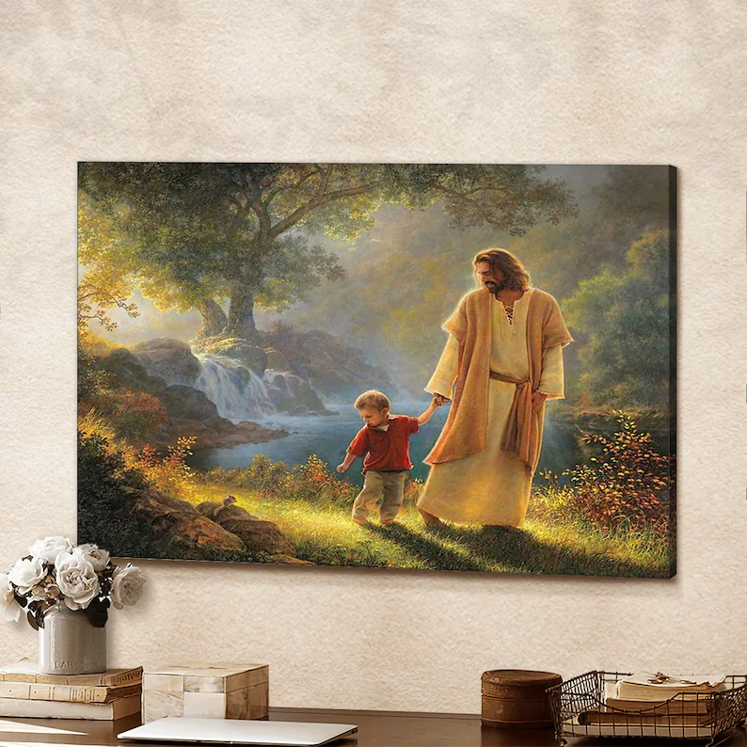
HAVE YOU MET MY JESUS Part 3
Text: John 1:1

Slide 2
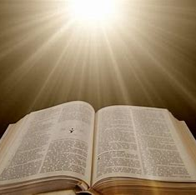
I. HE UNVEILS THE WORD OF GOD (John 1:1)
“In the beginning was the Word, and the Word was with God, and the Word (logos) was God.
2. He was with God in the beginning.
3. Through him all things were made; without him nothing was made that has been made.
4. In him was life, and that life was the light of men.
5. The light shines in the darkness, but the darkness has not understood it.” John 1:1-5

Slide 3
I. HE UNVEILS THE WORD OF GOD (John 1:1)
“Concerning this salvation, the prophets, who spoke of the grace that was to come to you, searched intently and with the greatest care,
11. trying to find out the time and circumstances to which the Spirit of Christ in them was pointing when he predicted the sufferings of Christ (the Messiah) and the glories that would follow.
I Peter 1:10-11

Slide 4
I. HE UNVEILS THE WORD OF GOD (John 1:1)
“12. It was revealed to them that they were not serving themselves but you, when they spoke of the things that have now been told you by those who have preached the gospel to you by the Holy Spirit sent from heaven. Even angels long to look into these things.”
I Peter 1:12

Slide 5
I. HE UNVEILS THE WORD OF GOD (John 1:1)
“In the past God spoke to our forefathers through the prophets at many times and in various ways,
2. but in these last days he has spoken to us by his Son, . . .”
Hebrews 1:1,2

Slide 6
I. HE UNVEILS THE WORD OF GOD (John 1:1)
“Surely you have heard about the administration of God’s grace that was given to me for you,
3. that is, the mystery made known to me by revelation, as I have already written briefly.
4. In reading this, then, you will be able to understand my insight into the mystery of Christ,
5. which was not made known to men in other generations as it has now been revealed by the Spirit to God’s holy apostles and prophets.
Ephesians 3:2-5

Slide 7
I. HE UNVEILS THE WORD OF GOD (John 1:1)
“6. This mystery is that through the gospel the Gentiles are heirs together with Israel, members together of one body, and sharers together in the promise in Christ Jesus.
7. I became a servant of this gospel by the gift of God’s grace given me through the working of his power.
8. Although I am less than the least of all God’s people, this grace was given me: to preach to the Gentiles the unsearchable riches of Christ,
9. and to make plain to everyone the administration of this mystery, which for ages past was kept hidden in God, who created all things.”
Ephesians 3:6-9

Slide 8
I. HE UNVEILS THE WORD OF GOD (John 1:1)
“We are not like Moses, who would put a veil over his face to keep the Israelites from gazing at it while the radiance was fading away.
14. But their minds were made dull, for to this day the same veil remains when the old covenant is read. It has not been removed, because only in Christ is it taken away.
15. Even to this day when Moses is read, a veil covers their hearts.
II Corinthians 3:13-15

Slide 9
I. HE UNVEILS THE WORD OF GOD (John 1:1)
“16. But whenever anyone turns to the Lord, the veil is taken away.
17. Now the Lord is the Spirit, and where the Spirit of the Lord is, there is freedom.
18. And we, who with unveiled faces all reflect the Lord’s glory, are being transformed into his likeness with ever-increasing glory, which comes from the Lord, who is the Spirit.”
II Corinthians 3:16-18

Slide 10
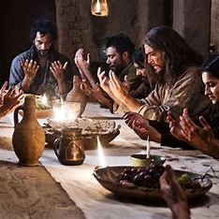
II. HE EMBRACES THE WILL OF GOD (Matthew 26:39-44)
“My prayer is not for them alone. I pray also for those who will believe in me through their message,
21. that all of them may be one, Father, just as you are in me and I am in you. May they also be in us so that the world may believe that you have sent me.
22. I have given them the glory that you gave me, that they may be one as we are one:
23. I in them and you in me. May they be brought to complete unity to let the world know that you sent me and have loved them even as you have loved me.” John 17:20-23

Slide 11
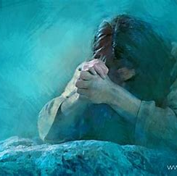
II. HE EMBRACES THE WILL OF GOD (Matthew 26:39-44)
“My Father, if it is possible, may this cup be taken from me. Yet not as I will, but as you will.”
40. Then he returned to his disciples and found them sleeping. Could you men not keep watch with me for one hour?” he asked Peter.
41. Watch and pray so that you will not fall into temptation. The spirit is willing, but the body is weak.”
Matthew 26:39-41

Slide 12
II. HE EMBRACES THE WILL OF GOD (Matthew 26:39-44)
“He went away a second time and prayed, My Father, if it is not possible for this cup to be taken away unless I drink it, may your will be done.”
43. When he came back, he again found them sleeping, because their eyes were heavy.
44. So he left them and went away once more and prayed the third time, saying the same thing.”
Matthew 26:42-44

Slide 13
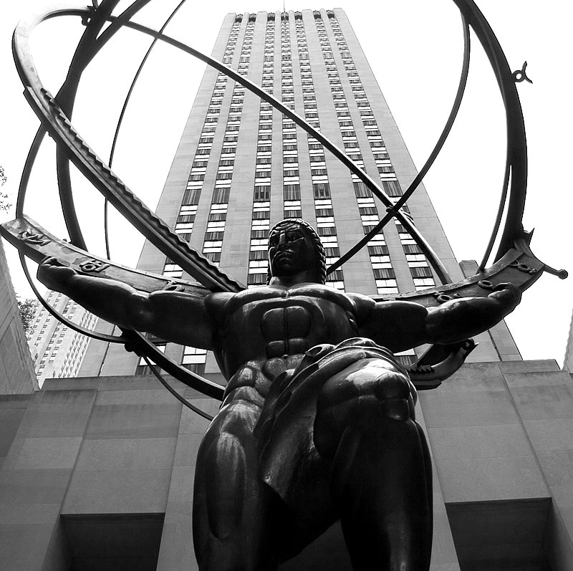
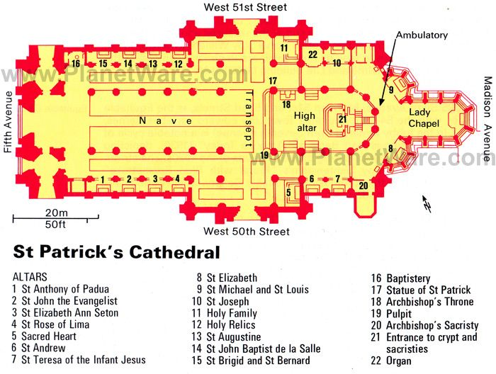
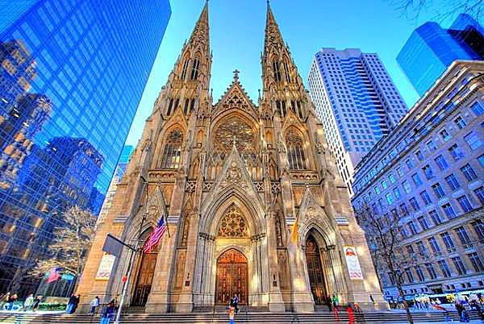
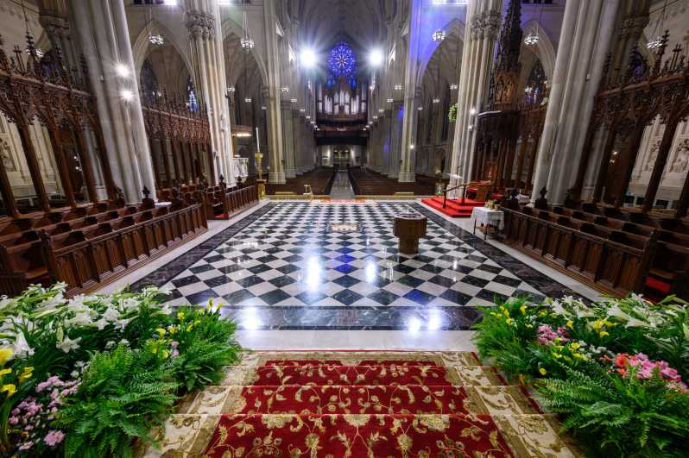
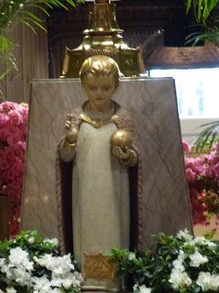
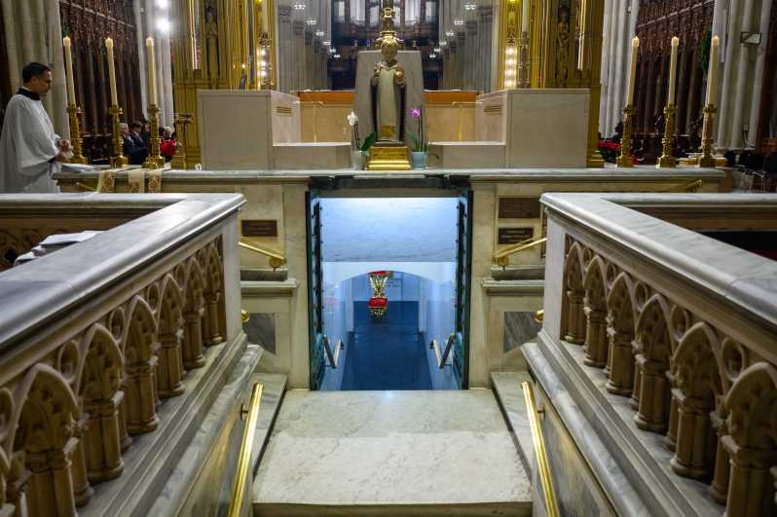
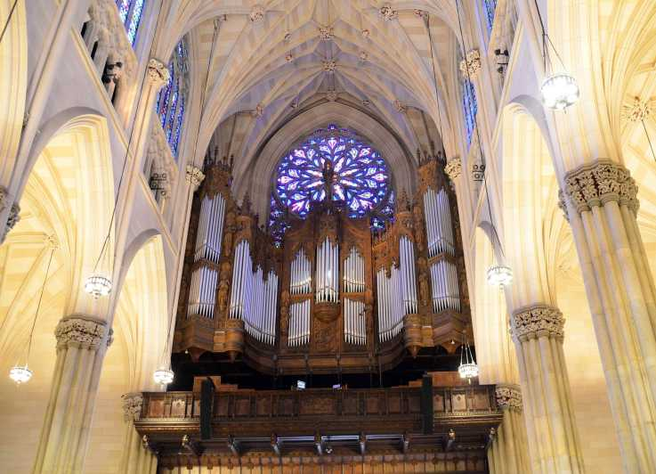
II. HE EMBRACES THE WILL OF GOD (Matthew 26:39-44)

Slide 14
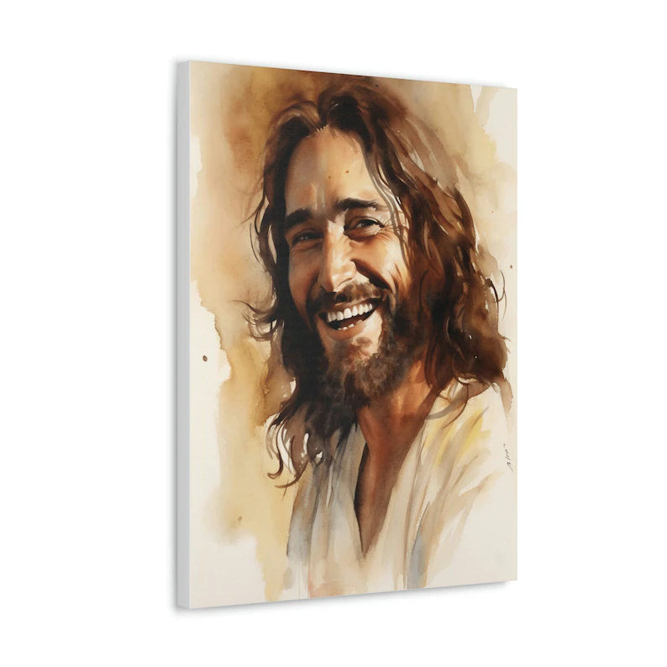
III. HE DEMONSTRATES THE WISDOM OF GOD (I Corinthians 1:20-25)
“. . . to the only wise God be glory forever through Jesus Christ! Amen.”
Romans 16:27

Slide 15
III. HE DEMONSTRATES THE WISDOM OF GOD (I Corinthians 1:20-25)

Slide 16
III. HE DEMONSTRATES THE WISDOM OF GOD (I Corinthians 1:20-25)
“Where is the wise man? Where is the scholar? Where is the philosopher of this age? Has not God made foolish the wisdom of the world?
21. For since in the wisdom of God the world through its wisdom did not know him, God was pleased through the foolishness of what was preached to save those who believe.
22. Jews demand miraculous signs and Greeks look for wisdom,
I Corinthians 1:20-22

Slide 17
III. HE DEMONSTRATES THE WISDOM OF GOD (I Corinthians 1:20-25)
23. but we preach Christ crucified: a stumbling block to Jews and foolishness to Gentiles.
24. but to those whom God has called, both Jews and Greeks, Christ the power of God and the wisdom of God.
25. For the foolishness of God is wiser than man’s wisdom, and the weakness of God is stronger than man’s strength.”
I Corinthians 1:23-25

Slide 18
III. HE DEMONSTRATES THE WISDOM OF GOD (I Corinthians 1:20-25)
“His intent was that now, through the church, the manifold wisdom of God should be made known to the rulers and authorities in the heavenly realms,
11. according to his eternal purpose which he accomplished in Christ Jesus our Lord.”
Ephesians 3:10.11

Slide 19
III. HE DEMONSTRATES THE WISDOM OF GOD (I Corinthians 1:20-25)
“My purpose is that they may be encouraged in heart and united in love, so that they may have the full riches of complete understanding, in order that they may know the mystery of God, namely, Christ,
3. in whom are hidden all the treasures of wisdom and knowledge.
4. I tell you this so that no one may deceive you by fine-sounding arguments.” Colossians 2:2-4

