Slide 1
HE DID IT ALL FOR US
ROMANS 5:6-11

Slide 2
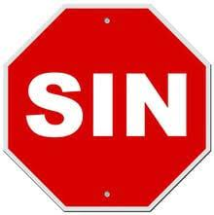
I. The sinners pitiful condition
(a) The sinner is a weak man

Slide 3

I. The sinners pitiful condition
(b) The sinner is a wicked man

Slide 4
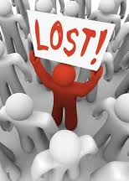
I. The sinners pitiful condition
(c) The sinner is a wayward man

Slide 5

I. The sinners pitiful condition
(d) The sinner is a warlike man

Slide 6

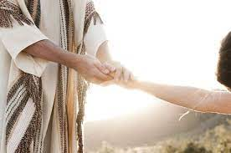
ii. The savioUrs priceless compassion

Slide 7
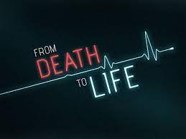
iii. The precious conversion

Slide 8
Hebrews 10:11-14
“DAY AFTER DAY EVERY PRIEST STANDS AND PERFORMS HIS RELIGIOUS DUTIES; AGAIN AND AGAIN HE OFFERS THE SAME SACRIFICES, WHICH CAN NEVER TAKE AWAY SINS.
BUT WHEN THE PRIEST HAD OFFERED FOR ALL TIME ONE SACRIFICE FOR SINS, HE SAT DOWN AT THE RIGHT HAND OF GOD, AND SINCE THAT TIME HE WAITS FOR HIS ENEMIES TO BE MADE HIS FOOTSTOOL. FOR BY ONE SACRIFICE HE HAS MADE PERFECT FOREVER THOSE WHO ARE BEING MADE HOLY.”

Slide 9
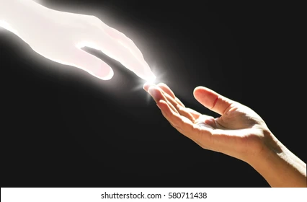
Our blessings are far greater than the mind could ever begin to comprehend. where do you stand with God this morning?

