Slide 1
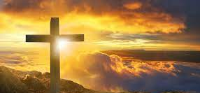
HOLY LIVING
ROMANS 12:1-2

Slide 2
I. THE WORSHIP OF GOD
“If you love me, keep my commands. And I will ask the Father, and he will give you another advocate to help you and be with you forever— the Spirit of truth. The world cannot accept him because it neither sees Him nor knows Him. But you know Him, for He lives with you and will be in you. I will not leave you as orphans; I will come to you. Before long, the world will not see me anymore, but you will see me. Because I live, you also will live. On that day you will realize that I am in my Father, and you are in me, and I am in you. Whoever has my commands and keeps them is the one who loves me. The one who loves me will be loved by my Father, and I too will love them and show myself to them.”
John 14:15 - 21

Slide 3
I. THE WORSHIP OF GOD
1) THE CAUSE
2) THE CONSECRATION

Slide 4
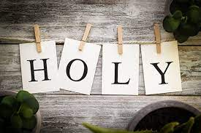
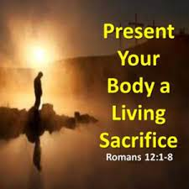
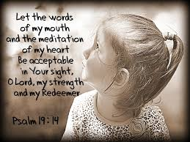
I. THE WORSHIP OF GOD
3) THE
CONDITIONS

Slide 5
II. THE WISDOM OF GOD
1. SHUNNING THE MOLD
2. SHAPING THE MIND

Slide 6
3 TYPES OF PEOPLE AT CHURCH…..

Slide 7
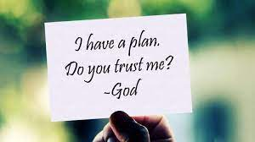
III. THE WILL OF GOD
A DESCRIPTION OF GOD’S WILL
2. A DEMONSTRATION
OF GOD’S WILL

Slide 8
ARE YOU LIVING A HOLY LIFE?

