Slide 1
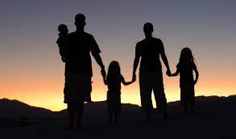
HOUSEHOLD SALVATION
Text: Acts 16:16-34

Slide 2
I. A FOUNDATION WILL NEED TO BE SET (Acts 16:25)

Slide 3
“Pray also for me, that whenever I open my mouth, words may be given me so that I will fearlessly make known the mystery of the gospel, 20. For which I am an ambassador in chains. Pray that I may declare it fearlessly, as I should.” Ephesians 6:19,20

Slide 4
II. A JAIL WILL NEED TO BE SHAKEN Acts 16:26-28

Slide 5
“So if the Son sets you free, you will be free indeed.” John 8:36

Slide 6
“Don’t harm yourself! We are all here!” Acts 16:28

Slide 7
III. A LIGHT WILL NEED TO BE SHONE Acts 16:29

Slide 8
IV. A TRUTH WILL NEED TO BE SIMPLIFIED (Acts 16:31-34)

Slide 9
“Believe (cling to) in (on) the Lord Jesus, and you will be saved - you and your household.” Acts 16:31

