Slide 1
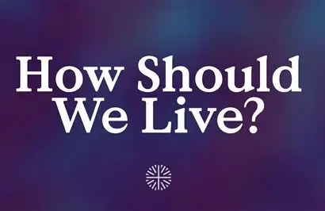
Text: Galatians 2:20

Slide 2
I. WE MUST DIE WITH CHRIST (Galatians 2:20a)
“I have been crucified with Christ . . .” Galatians 2:20a
Notes:
Being crucified with Christ is a concept in Christian theology that refers to the believer's identification with the death and resurrection of Jesus. It signifies dying to one's old self and sinful nature, and living a new life through faith in Christ. This transformation involves embracing the sacrificial love of Christ, leading a life of obedience to God's will, and experiencing spiritual renewal and freedom.

Slide 3
I. WE MUST DIE WITH CHRIST (Galatians 2:20a)
Paul used the Greek word “synestaurōmai” (scenestaromay) is a verb used only once in the Bible by Paul. It is in the Perfect Tense meaning “a past action with issuing a lasting result.”
Notes:
Being crucified with Christ is a concept in Christian theology that refers to the believer's identification with the death and resurrection of Jesus. It signifies dying to one's old self and sinful nature, and living a new life through faith in Christ. This transformation involves embracing the sacrificial love of Christ, leading a life of obedience to God's will, and experiencing spiritual renewal and freedom.

Slide 4
I. WE MUST DIE WITH CHRIST (Galatians 2:20a)
“Christ redeemed us from the curse of the law by becoming a curse for us. For it is written “Cursed is everyone who is hung on a pole.”
Galatians 3:13; cf. Deuteronomy 21:23
Notes:
Being crucified with Christ is a concept in Christian theology that refers to the believer's identification with the death and resurrection of Jesus. It signifies dying to one's old self and sinful nature, and living a new life through faith in Christ. This transformation involves embracing the sacrificial love of Christ, leading a life of obedience to God's will, and experiencing spiritual renewal and freedom.

Slide 5
I. WE MUST DIE WITH CHRIST (Galatians 2:20a)
1). Painful
2). Humiliating
3). Sorrowful
4). Dethroning
Notes:
Being crucified with Christ is a concept in Christian theology that refers to the believer's identification with the death and resurrection of Jesus. It signifies dying to one's old self and sinful nature, and living a new life through faith in Christ. This transformation involves embracing the sacrificial love of Christ, leading a life of obedience to God's will, and experiencing spiritual renewal and freedom.

Slide 6
I. WE MUST DIE WITH CHRIST (Galatians 2:20a)
The victim of crucifixion was said to have died a thousand deaths.
There was not a more vivid means of describing death in Paul’s day than that of crucifixion.
Notes:
Being crucified with Christ is a concept in Christian theology that refers to the believer's identification with the death and resurrection of Jesus. It signifies dying to one's old self and sinful nature, and living a new life through faith in Christ. This transformation involves embracing the sacrificial love of Christ, leading a life of obedience to God's will, and experiencing spiritual renewal and freedom.

Slide 7
II. WE MUST LIVE BY CHRIST (Galatians 2:20b) “And I no longer live, but Christ lives in me.” Galatians 2:20b
Notes:
Being crucified with Christ is a concept in Christian theology that refers to the believer's identification with the death and resurrection of Jesus. It signifies dying to one's old self and sinful nature, and living a new life through faith in Christ. This transformation involves embracing the sacrificial love of Christ, leading a life of obedience to God's will, and experiencing spiritual renewal and freedom.

Slide 8
II. WE MUST LIVE BY CHRIST (Galatians 2:20b)
Do our spiritually reborn lives truly reflect His image? Would He be willing to identify Himself with us?
Notes:
Being crucified with Christ is a concept in Christian theology that refers to the believer's identification with the death and resurrection of Jesus. It signifies dying to one's old self and sinful nature, and living a new life through faith in Christ. This transformation involves embracing the sacrificial love of Christ, leading a life of obedience to God's will, and experiencing spiritual renewal and freedom.

Slide 9
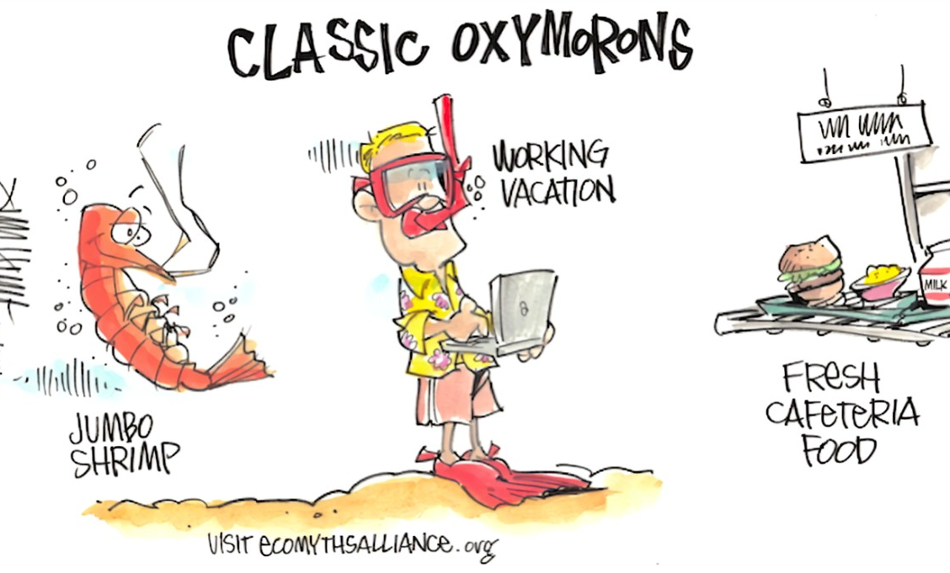
II. WE MUST LIVE BY CHRIST (Galatians 2:20b)
“Continuity Error” where something is one thing in one shot and something totally different in another
Oxymoron is made up of contradictory elements.
Notes:
Being crucified with Christ is a concept in Christian theology that refers to the believer's identification with the death and resurrection of Jesus. It signifies dying to one's old self and sinful nature, and living a new life through faith in Christ. This transformation involves embracing the sacrificial love of Christ, leading a life of obedience to God's will, and experiencing spiritual renewal and freedom.

Slide 10
II. WE MUST LIVE BY CHRIST (Galatians 2:20b)
Moulton Marston asked three thousand people, “What have you to live for?”
94% were simply enduring the present while waiting for the future
They were all waiting, without realizing that all anyone ever has is today because yesterday is gone and tomorrow may never come.
Notes:
Being crucified with Christ is a concept in Christian theology that refers to the believer's identification with the death and resurrection of Jesus. It signifies dying to one's old self and sinful nature, and living a new life through faith in Christ. This transformation involves embracing the sacrificial love of Christ, leading a life of obedience to God's will, and experiencing spiritual renewal and freedom.

Slide 11
II. WE MUST LIVE BY CHRIST (Galatians 2:20b)
Every born again Christian has had to be completely dead before they were brought back to life.
Notes:
Being crucified with Christ is a concept in Christian theology that refers to the believer's identification with the death and resurrection of Jesus. It signifies dying to one's old self and sinful nature, and living a new life through faith in Christ. This transformation involves embracing the sacrificial love of Christ, leading a life of obedience to God's will, and experiencing spiritual renewal and freedom.

Slide 12
III. WE MUST HAVE FAITH IN CHRIST (Galatians 2:20c)
“The life I live in the body, I live by faith in the Son of God.”
Galatians 2:20c
It is NOT a faith in faith, or a faith in others or even a faith in things. It is rather a faith that believes even though there is no evidence that supports it.
Notes:
Being crucified with Christ is a concept in Christian theology that refers to the believer's identification with the death and resurrection of Jesus. It signifies dying to one's old self and sinful nature, and living a new life through faith in Christ. This transformation involves embracing the sacrificial love of Christ, leading a life of obedience to God's will, and experiencing spiritual renewal and freedom.

Slide 13
III. WE MUST HAVE FAITH IN CHRIST (Galatians 2:20c)
“The life I live in the body, I live by faith in the Son of God.”
Galatians 2:20c
“my eye is not on the density of the fog, but on the living God who controls every circumstance of my life.”
Notes:
Being crucified with Christ is a concept in Christian theology that refers to the believer's identification with the death and resurrection of Jesus. It signifies dying to one's old self and sinful nature, and living a new life through faith in Christ. This transformation involves embracing the sacrificial love of Christ, leading a life of obedience to God's will, and experiencing spiritual renewal and freedom.

