Slide 1
Have you Met my Jesus – Part 2
Text: Luke 2:40

Slide 2
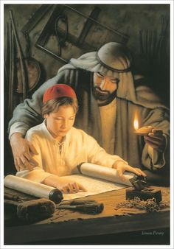
I. HE EXPRESSES THE FAVOUR OF GOD - (Luke 2:40)
“The child grew and became strong, filled with wisdom; and the favor of God was upon him.”
Luke 2:40

Slide 3
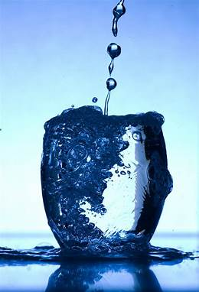
II. HE EXPRESSES THE FULNESS OF GOD - (Ephesians 3:14-21)
For this reason I kneel before the Father,
15. from whom his whole family in heaven and on earth derives its name.
16. I pray that out of his glorious riches he may strengthen you with power through his Spirit in your inner being,
17. so that Christ may dwell in your hearts through faith. And I pray that you, being rooted and established in love,
Ephesians 3:14-17

Slide 4
II. HE EXPRESSES THE FULNESS OF GOD - (Ephesians 3:14-21)
18. may have power, together with all the saints, to grasp how wide and long and high and deep is the love of Christ,
19. and to know this love that surpasses knowledge—that you may be filled to the measure of all the fullness of God.
20. Now to him who is able to do immeasurably more than all we ask or imagine, according to his power that is at work within us,
21. to him be glory in the church and in Christ Jesus throughout all generations, for ever and ever! Amen.
Ephesians 3:18-21

Slide 5
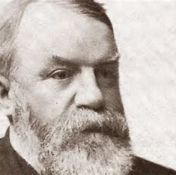
II. HE EXPRESSES THE FULNESS OF GOD - (Ephesians 3:14-21)
W. R. Moody
“The Life of D. L. Moody”
New York: 1900, p. 149

Slide 6
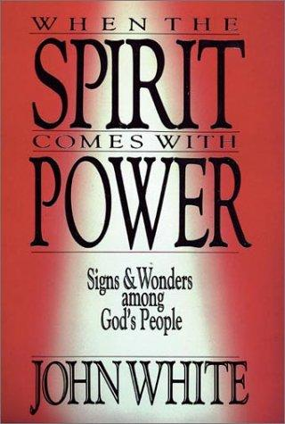
II. HE EXPRESSES THE FULNESS OF GOD - (Ephesians 3:14-21)

Slide 7
III. HE EXPRESSES THE FREEDOM OF GOD - (Isaiah 61:1-3)
“The Spirit of the Sovereign LORD is on me, because the LORD has anointed me to preach good news to the poor. He has sent me to bind up the brokenhearted, to proclaim freedom for the captives and release from darkness for the prisoners,
2. to proclaim the year of the LORD’s favor and the day of vengeance of our God, to comfort all who mourn, ”
Isaiah 61:1-2

Slide 8
III. HE EXPRESSES THE FREEDOM OF GOD - (Isaiah 61:1-3)
“and provide for those who grieve in Zion— to bestow on them a crown of beauty instead of ashes, the oil of gladness instead of mourning, and a garment of praise instead of a spirit of despair. They will be called oaks of righteousness, a planting of the LORD for the display of his splendor.”
Isaiah 61:3

Slide 9
III. HE EXPRESSES THE FREEDOM OF GOD - (Isaiah 61:1-3)
“Now the Lord is the Spirit, and where the Spirit of the Lord is, there is freedom.”
II Corinthians 3:17
“It is for freedom that Christ has set us free. Stand firm, then, and do not let yourselves be burdened again by a yoke of slavery.”
Galatians 5:1

Slide 10
III. HE EXPRESSES THE FREEDOM OF GOD - (Isaiah 61:1-3)
“his intent was that now, through the church, the manifold wisdom of God should be made known to the rulers and authorities in the heavenly realms,
11. according to his eternal purpose which he accomplished in Christ Jesus our Lord.
12. In him and through faith in him we may approach God with freedom and confidence.”
Ephesians 3:10-12

Slide 11
III. HE EXPRESSES THE FREEDOM OF GOD - (Isaiah 61:1-3)
“Be careful, however, that the exercise of your freedom does not become a stumbling block to the weak.”
I Corinthians 8:9
“Live as free men, but do not use your freedom as a cover-up for evil; live as servants of God.”
I Peter 2:16

