Slide 1
Hope For The Humble Heart
Matthew 11:28-30

Slide 2
Matthew 11:28 - 30 "Come to me, all you who are weary and burdened, and I will give you rest. Take my yoke upon you and learn from me, for I am gentle and humble in heart, and you will find rest for your souls. For my yoke is easy and my burden is light."

Slide 3
Stuck in….

Slide 4
Matthew 5:3-10 “Blessed are the poor in spirit, For theirs is the kingdom of heaven. Blessed are those who mourn, For they shall be comforted. Blessed are the meek, For they shall inherit the [a]earth. Blessed are those who hunger and thirst for righteousness, For they shall be filled. Blessed are the merciful, For they shall obtain mercy. Blessed are the pure in heart, For they shall see God. Blessed are the peacemakers, For they shall be called sons of God. Blessed are those who are persecuted for righteousness’ sake, For theirs is the kingdom of heaven.

Slide 5
Jeremiah 17:9 “The heart is deceitful above all things and beyond cure. Who can understand it?”

Slide 6
Romans 1:28-31
“And even as they did not like to retain God in their knowledge, God gave them over to a reprobate mind, to do those things which are not convenient; Being filled with all unrighteousness, fornication, wickedness, covetousness, maliciousness; full of envy, murder, debate, deceit, malignity; whisperers, Backbiters, haters of God, despiteful, proud, boasters, inventors of evil things, disobedient to parents, Without understanding, covenant breakers, without natural affection, implacable, unmerciful:
Mark 7:21-23
For from within, out of the heart of men, proceed evil thoughts, adulteries, fornications, murders, Thefts, covetousness, wickedness, deceit, lasciviousness, an evil eye, blasphemy, pride, foolishness: All these evil things come from within, and defile the man.

Slide 7
A) The Heart of Pride

Slide 8
B) The Heart of Guilt

Slide 9
C) The Heart of Fear

Slide 10
D) Heart of Grace – James 4:6

Slide 11
E) The Heart of Freedom

Slide 12
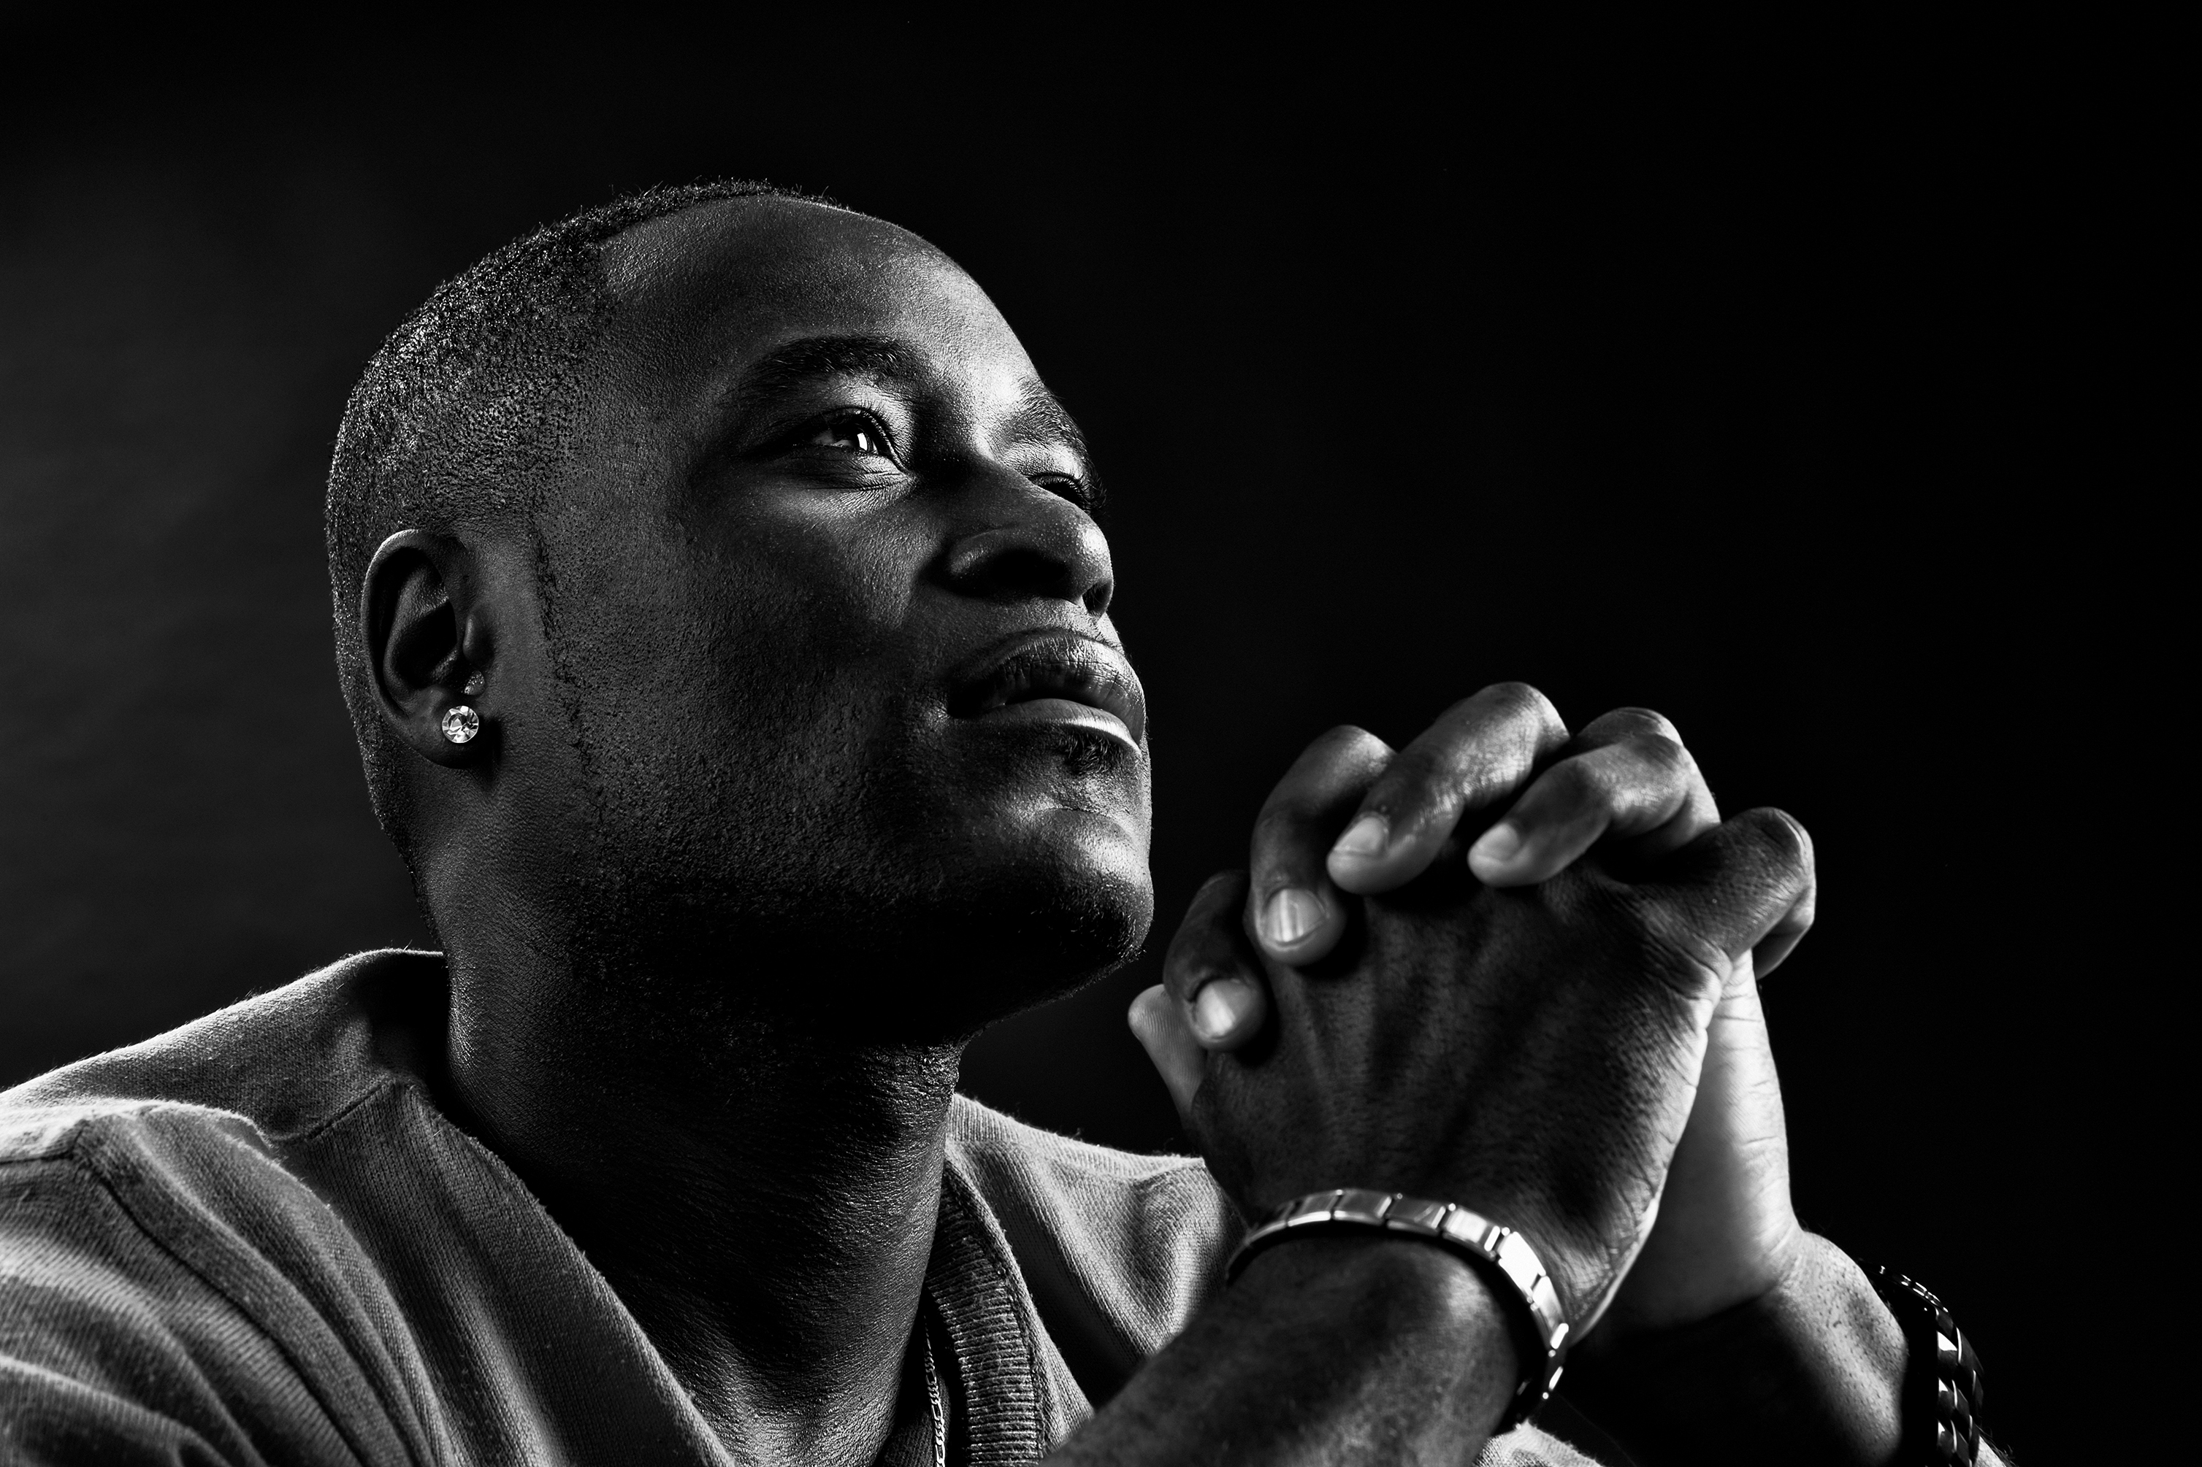
1. Pray About It
2. Write About it - Journal
3. Share About It

Slide 13
F) The Humble Heart

