Slide 1
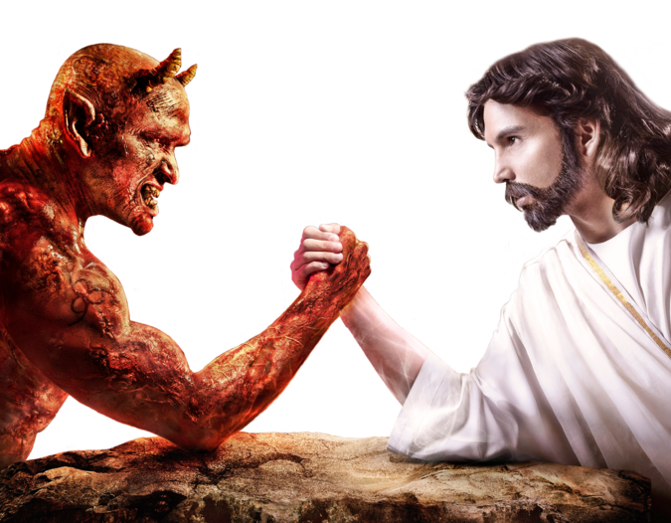
HOPE IN YOUR BATTLES
Psalm 27:1-6

Slide 2

I. OUR CONFIDENCE IN THE LORD PROVIDES HOPE

Slide 3

II. OUR COMMITMENT TO THE LORD PROVIDES Hope

Slide 4
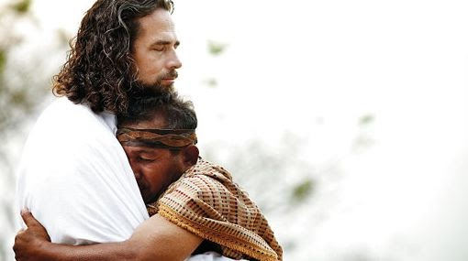
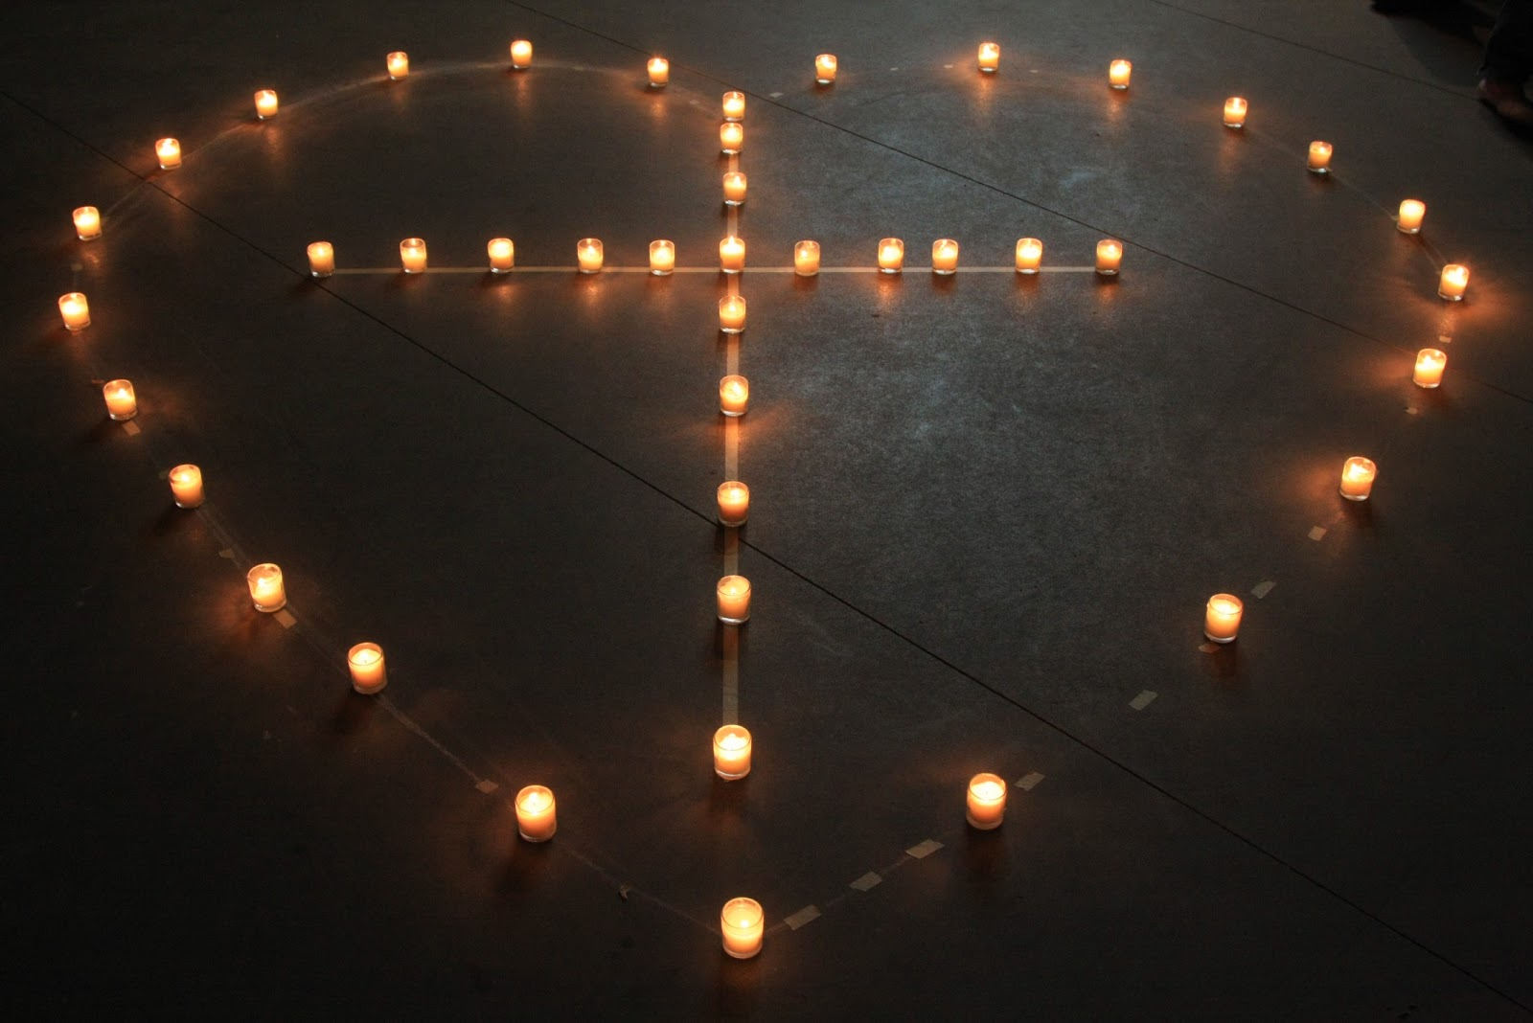
I Linger near Him; Love on Him and Lean on Him
This Photo by Unknown Author is licensed under CC BY-SA-NC

Slide 5


IIII. OUR COMFORT IN THE LORD PROVIDES HOPE
This Photo by Unknown Author is licensed under CC BY-NC
I am a child of God

Slide 6

Victory in our battles

Slide 7

Hope In your battles surrender your heart

