Slide 1
Text: Ezekiel 38, 39

Slide 2
What Can We Expect to Take Place in End-time Prophecies?

Slide 3
I. Who Will Be Involved?
Ancient Nations Modern Nations
Gog and Magog Russia
Meshech and Tubal Moscow and Tobolsk
Persia Iran, Iraq, Afghanistan
Ethiopia (Cush) Ethiopia and the Sudan
Libya (Put) Libya
Ashkenaz Austria, Germany
Gomer Eastern Europe
Togarmah Southeastern Europe
Many nations with you Nations allied to Russia

Slide 4
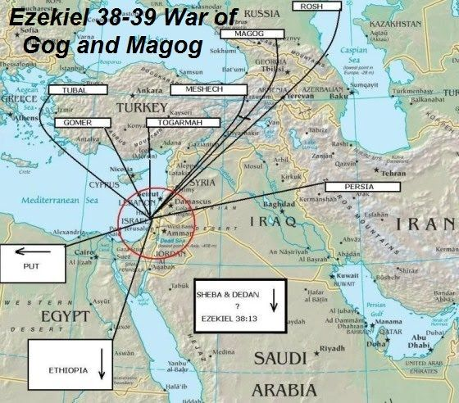

Slide 5
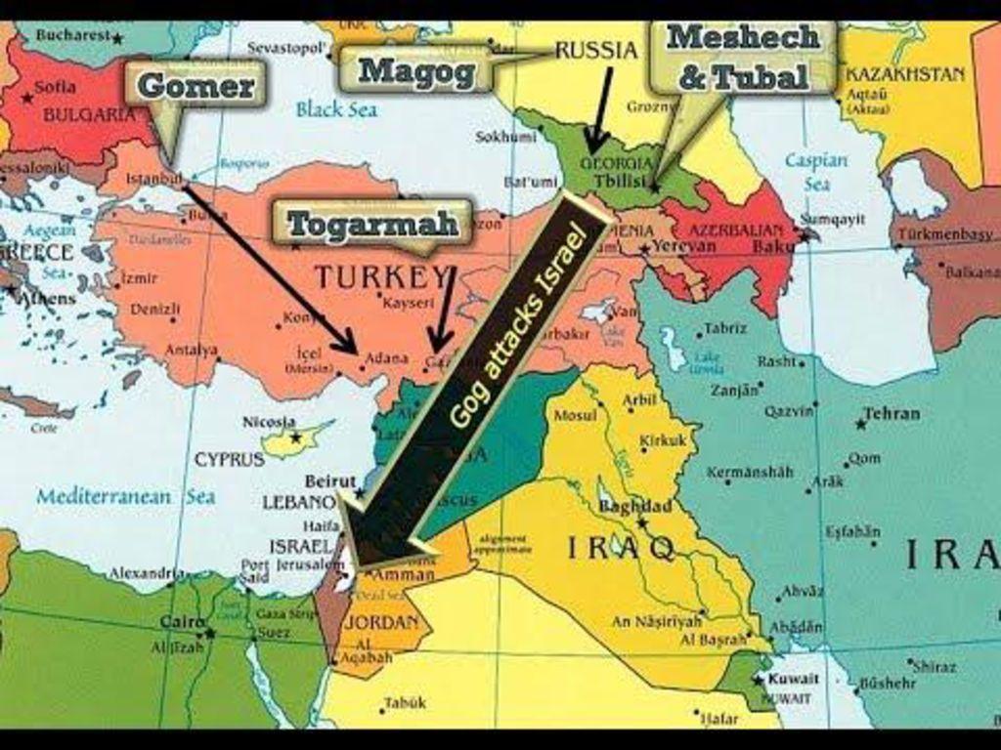

Slide 6
I. Who Will Be Involved?
There are only a few nations that stand in opposition
to these advancing armies.
Ancient Nations Modern Nations
Tarshish Great Britain, Spain, Sardinia
Sheba Modern Yemen
Dedan Southern Edom
(possibly Jordan)
Young Lions United Kingdom, U.S.A., All the Commonwealth Nations

Slide 7
II. What Will Happen?
“‘Get ready; be prepared, you and all the hordes gathered about you, and take command of them.
⁸ After many days you will be called to arms. In future years you will invade a land that has recovered from war, whose people were gathered from many nations to the mountains of Israel, which had long been desolate. They had been brought out from the nations, and now all of them live in safety.
Ezekiel 38:7-8

Slide 8
II. What Will Happen?
“⁹ You and all your troops and the many nations with you will go up, advancing like a storm; you will be like a cloud covering the land.
Ezekiel 38:9

Slide 9
III. Where Will It Happen?
“ . . . to the mountains of Israel, which had long been desolate.”
^{Ezekiel 38:8}
“ I will invade a land of unwalled villages.”
Ezekiel 38: 11

Slide 10
III. Where Will It Happen?
“ . . . When Gog attacks the land of Israel”
Ezekiel 38:18
“ . . . living at the center (navel) of the land.”
Ezekiel 38:12

Slide 11
III. Where Will It Happen?
“ . . . I will bring you against my land”
Ezekiel 38:16

Slide 12
III. Where Will It Happen?
“ I will turn you around and drag you along. I will bring you from the far north and send you against the mountains of Israel.”
Ezekiel 39:2

Slide 13
III. Where Will It Happen?
North – Ezekiel 38:15
South – Ezekiel 38:5
East – Ezekiel 39:11
West – Ezekiel 38:5

Slide 14
IV. When Will It Happen?
“After many days you will be called to arms”
Ezekiel 38:8
“In the days to come (latter days)”
Ezekiel 38:17 KJV
“In that day when my people Israel are living in safety.”
Ezekiel 38:14

Slide 15
IV. When Will It Happen?
First, it must come about in . . .
“. . . a land that has recovered from war”
Ezekiel 38:8

Slide 16
IV. When Will It Happen?
Secondly,
“ . . . whose people are gathered out of every nation”
Ezekiel 38:8

Slide 17
IV. When Will It Happen?
Thirdly,
“ now all of them live in safety”
Ezekiel 38:8

Slide 18
IV. When Will It Happen?
Fourthly,
“. . . I will invade a land of unwalled villages, I will attack a peaceful and unsuspecting people – all of them without walls and without gates and bars.”
Ezekiel 38:11

Slide 19
VI. Why Will It Happen?
A. Evil Thoughts
“On that day thoughts will come to your mind and you will devise an evil scheme.”
Ezekiel 38:10

Slide 20
VI. Why Will It Happen?
B. To Take a Spoil
1. Livestock
(Ezekiel 38:12)
2. Silver and Gold (Ezekiel 38:13)

Slide 21
VI. Why Will It Happen?
C. To Take a Prey
“ Have you come to plunder? Have you gathered your hordes to loot?”
Ezekiel 38:13

Slide 22
VI. Why Will It Happen?
D. To Retore a Pride of Power

Slide 23
VI. Why Will It Happen?
E. So that God may be Glorified
“And so I will show my greatness and my holiness, and I will make myself known in the sight of many nations.”
Ezekiel 38:23

Slide 24
VI. Why Will It Happen?
E. So that God may be Glorified
“I will make known my holy name among my people Israel, I will no longer let my holy name be profaned and the nations will know that I am the LORD and the Holy One of Israel.”
Ezekiel 39:7

Slide 25
VI. Why Will It Happen?
E. So that God may be Glorified
“ I will display my glory among the nations.”
Ezekiel 39:21

