Slide 1
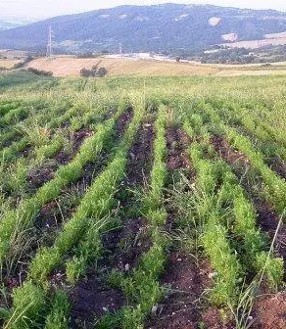
I’M NOT LEAVING THIS PEA-PATCH
Text: II Samuel 23:11-12

Slide 2
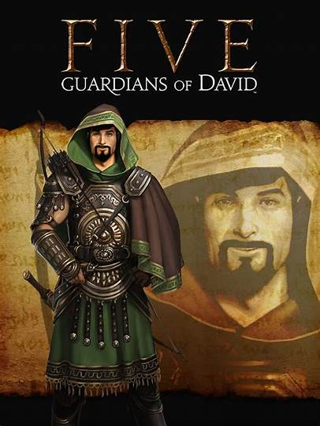
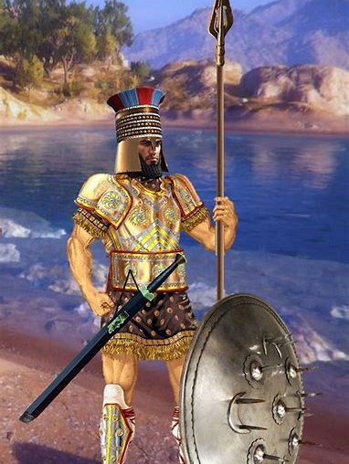
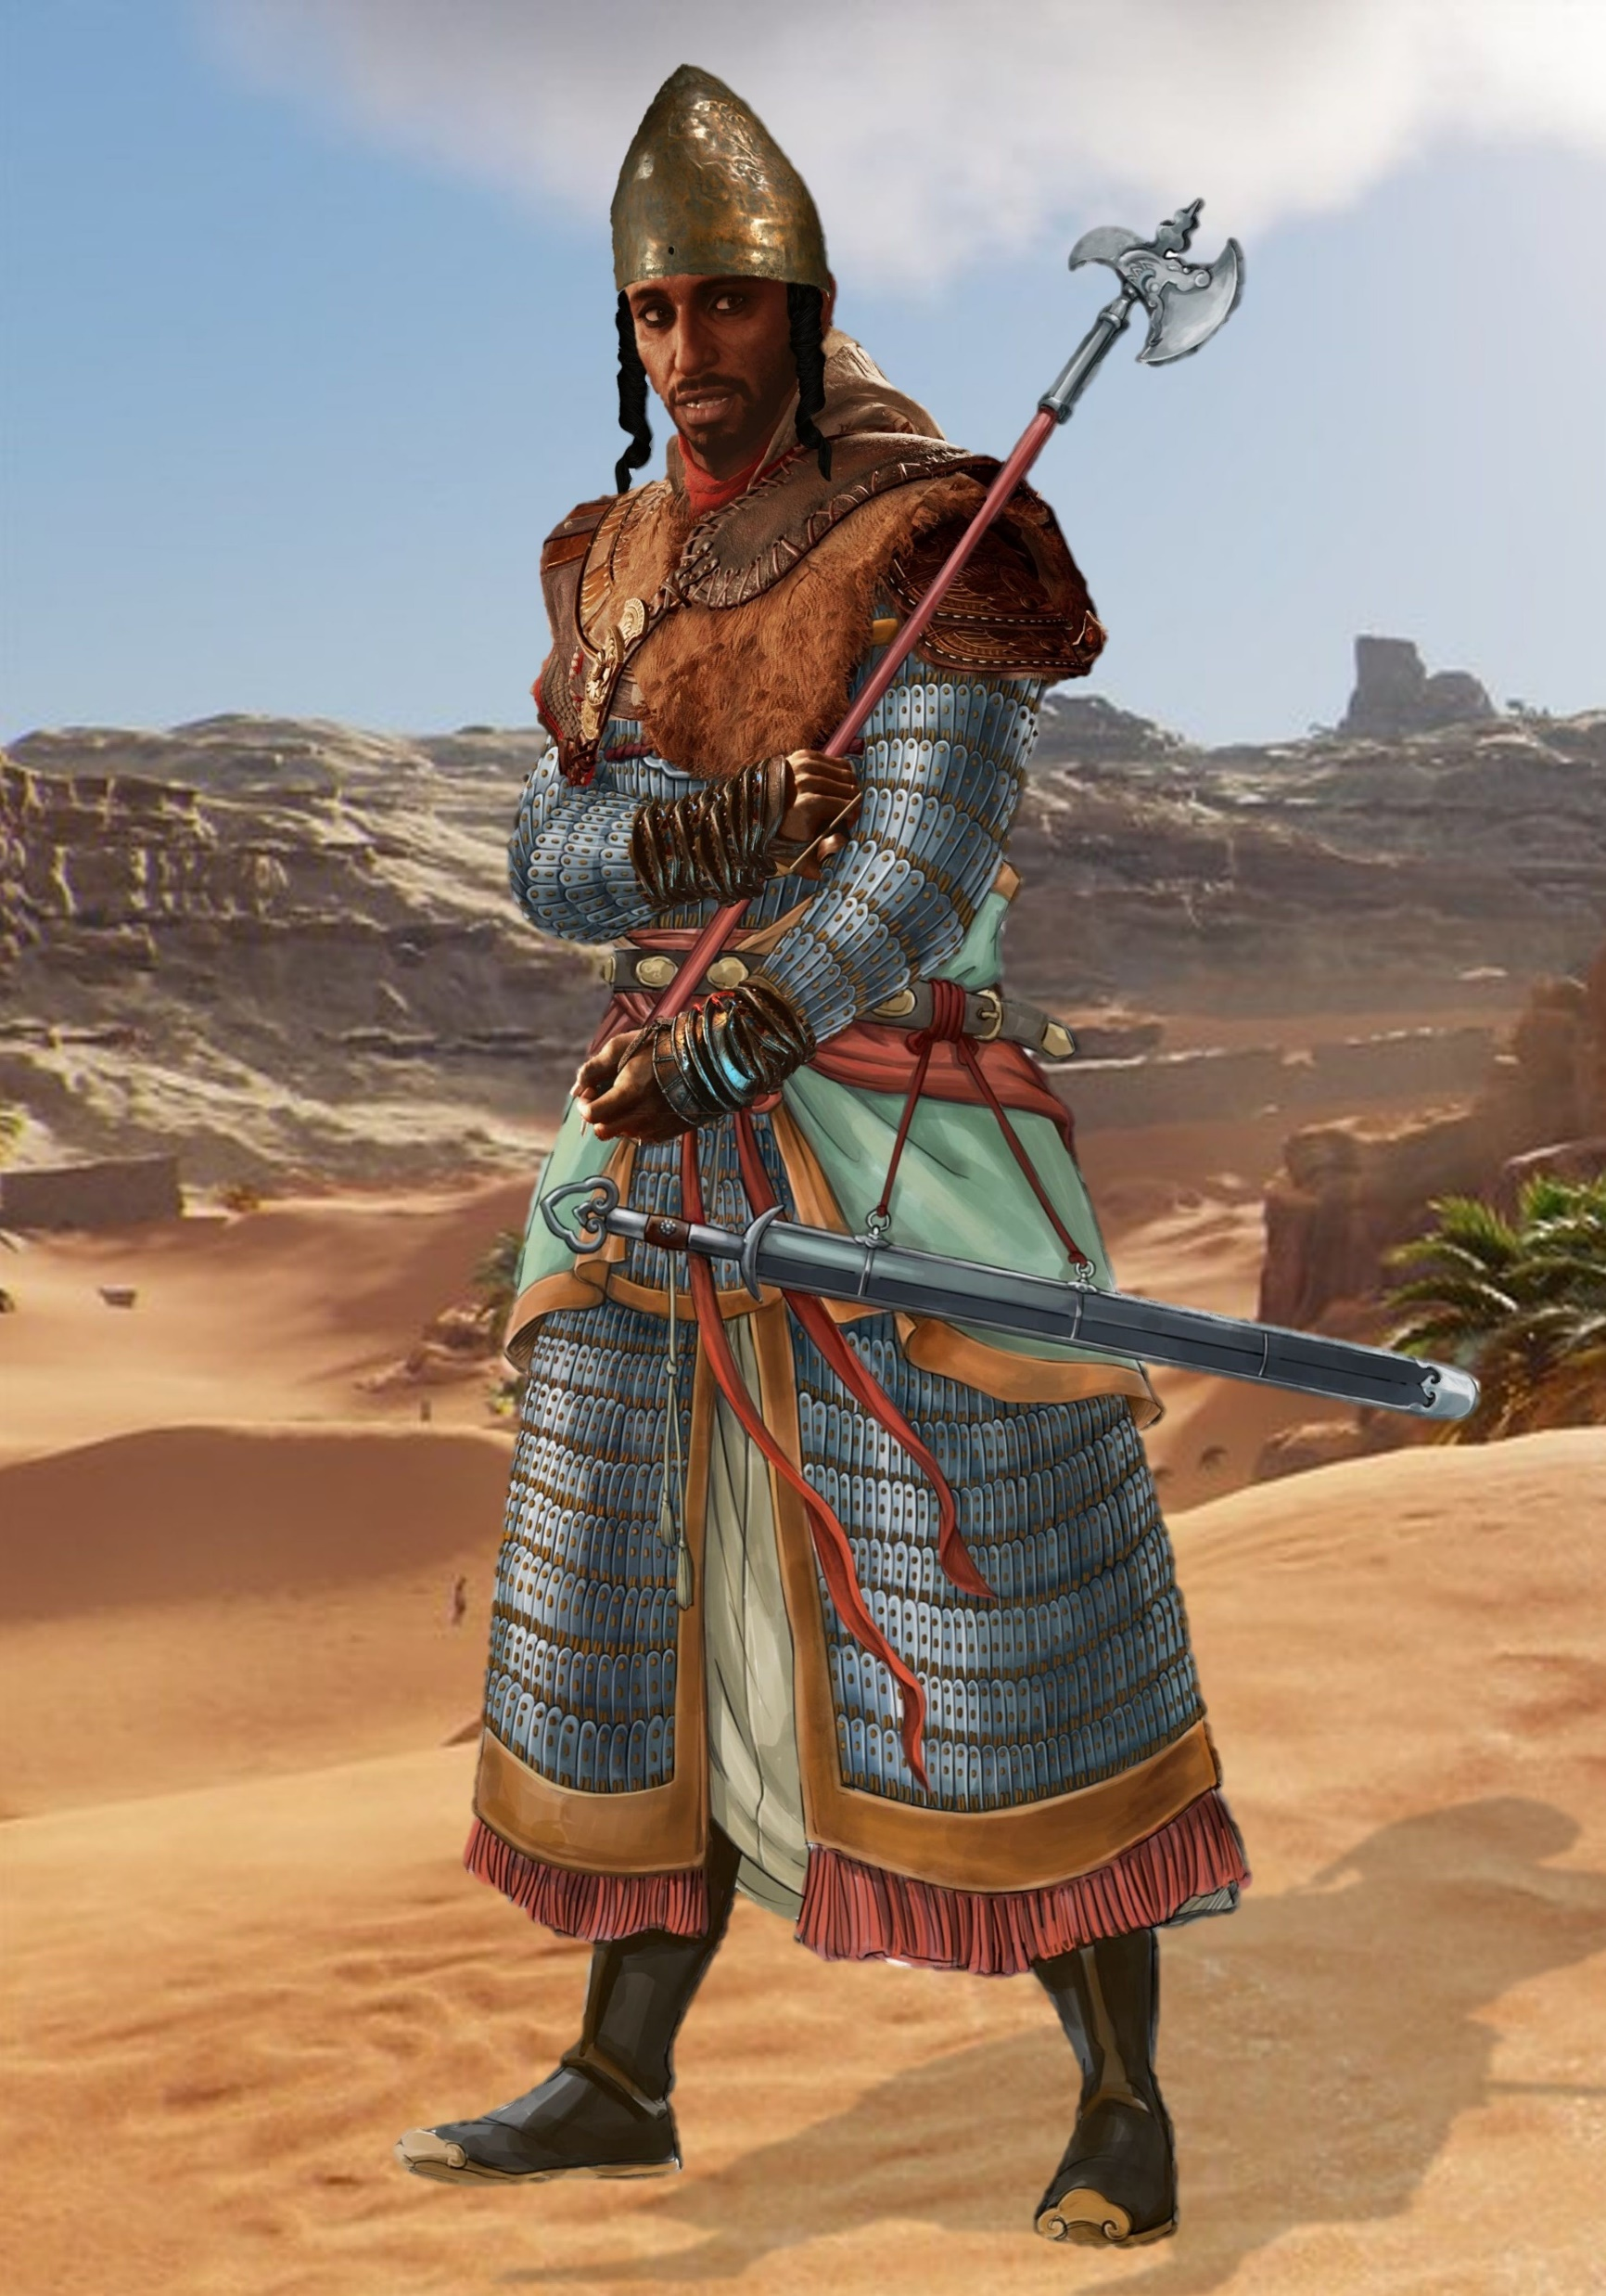
I. THE TITLE (II Samuel 23:11a)
Text: II Samuel 23:11-12
Shammah means
The LORD is There
Philistine Warrior
(1200-332 BCE)
Philistine Soldier

Slide 3
I. THE TITLE (II Samuel 23:11a)
A. Living Stones; Holy Priesthood/Nation; Chosen People (I Peter 2:5,9)
“you also, like living stones, are being built into a spiritual house[a] to be a holy priesthood, offering spiritual sacrifices acceptable to God through Jesus Christ.
9 But you are a chosen people, a royal priesthood, a holy nation, God’s special possession, that you may declare the praises of him who called you out of darkness into his wonderful light.”
I Peter 2:5,9
Shammah means
“The LORD is There”

Slide 4
II. THE BATTLE (II Samuel 23:11b)
Salvation is free but we must still work at driving out the forces that try to take back what legally belongs to us.
They would encompass the land and take the peas (lentils) before the children of Israel could benefit from them.
Shammah means
“The LORD is There”

Slide 5
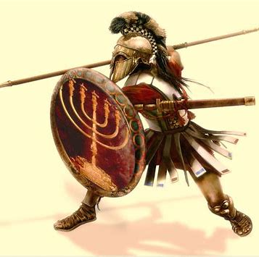
II. THE BATTLE (II Samuel 23:11b)
“Next to him was Eleazar son of Dodai the Ahohite. As one of the three mighty warriors, he was with David when they taunted the Philistines gathered at Pas Dammim [lit. gathered there] for battle. THEN THE ISRAELITES RETREATED,”
II Samuel 23:9

Slide 6
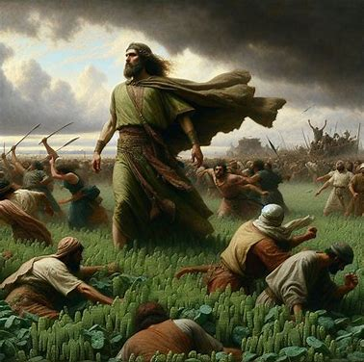
II. THE BATTLE (II Samuel 23:11b)
“Next to him was Shammah son of Agee the Hararite. When the Philistines banded together at a place where there was a field full of lentils, ISRAEL’S TROOPS FLED FROM THEM.
12. BUT SHAMMAH TOOK HIS STAND IN THE MIDDLE OF THE FIELD. HE DEFENDED IT AND STRUCK THE PHILISTINES DOWN, AND THE LORD BROUGHT ABOUT A GREAT VICTORY.”
II Samuel 23: 11,12

Slide 7
II. THE BATTLE (II Samuel 23:11b)
“For no matter how many promises God has made, they are “Yes” in Christ. And so through him the “Amen” is spoken by us to the glory of God.
21. Now it is God who makes both us and you stand firm in Christ. He anointed us,
22. set his seal of ownership on us, and put his Spirit in our hearts as a deposit, guaranteeing what is to come.”
II Corinthians 1:20-22

Slide 8
III. THE VICTORY (II Samuel 23:12)
“But Shammah took his stand in the middle of the field.”
II Samuel 23:12a

Slide 9
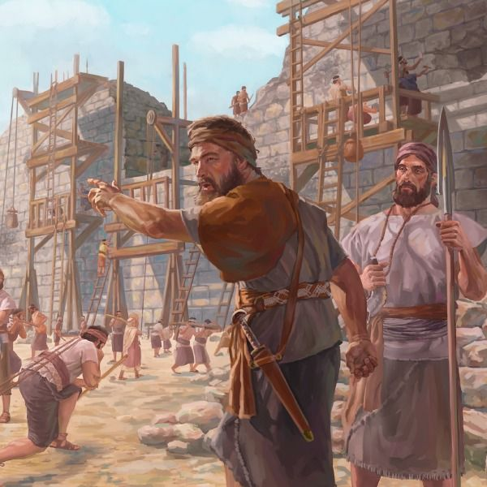
III. THE VICTORY (II Samuel 23:12)
I answered them by saying, “The God of heaven will give us success. We his servants will start rebuilding, but as for you, you have no share in Jerusalem or any claim or historic right to it.”
Nehemiah 2:20

Slide 10
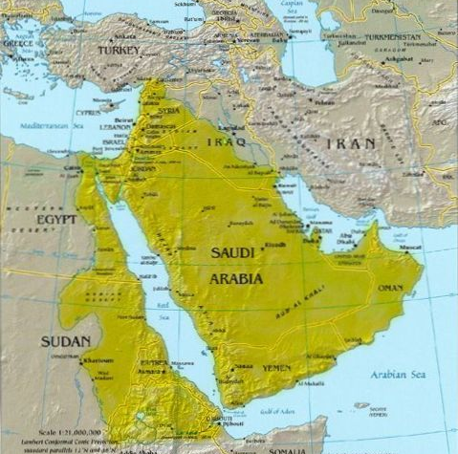
III. THE VICTORY (II Samuel 23:12)
“And the LORD brought about a great victory.”
II Samuel 23:12

Slide 11
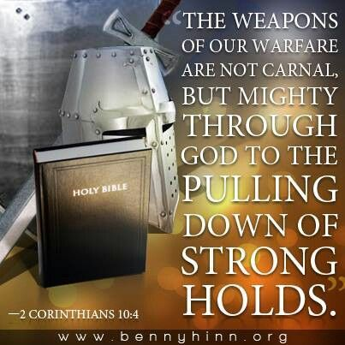
III. THE VICTORY (II Samuel 23:12)
“The weapons we fight with are not the weapons of this world. On the contrary, they have divine power to demolish strongholds.
5. We demolish arguments and every pretension that sets itself up against the knowledge of God, and we take captive every thought to make it obedient to Christ.
6. And we will be ready to punish every act of disobedience, once your obedience is complete.”
II Corinthians 10:4-6

