Slide 1
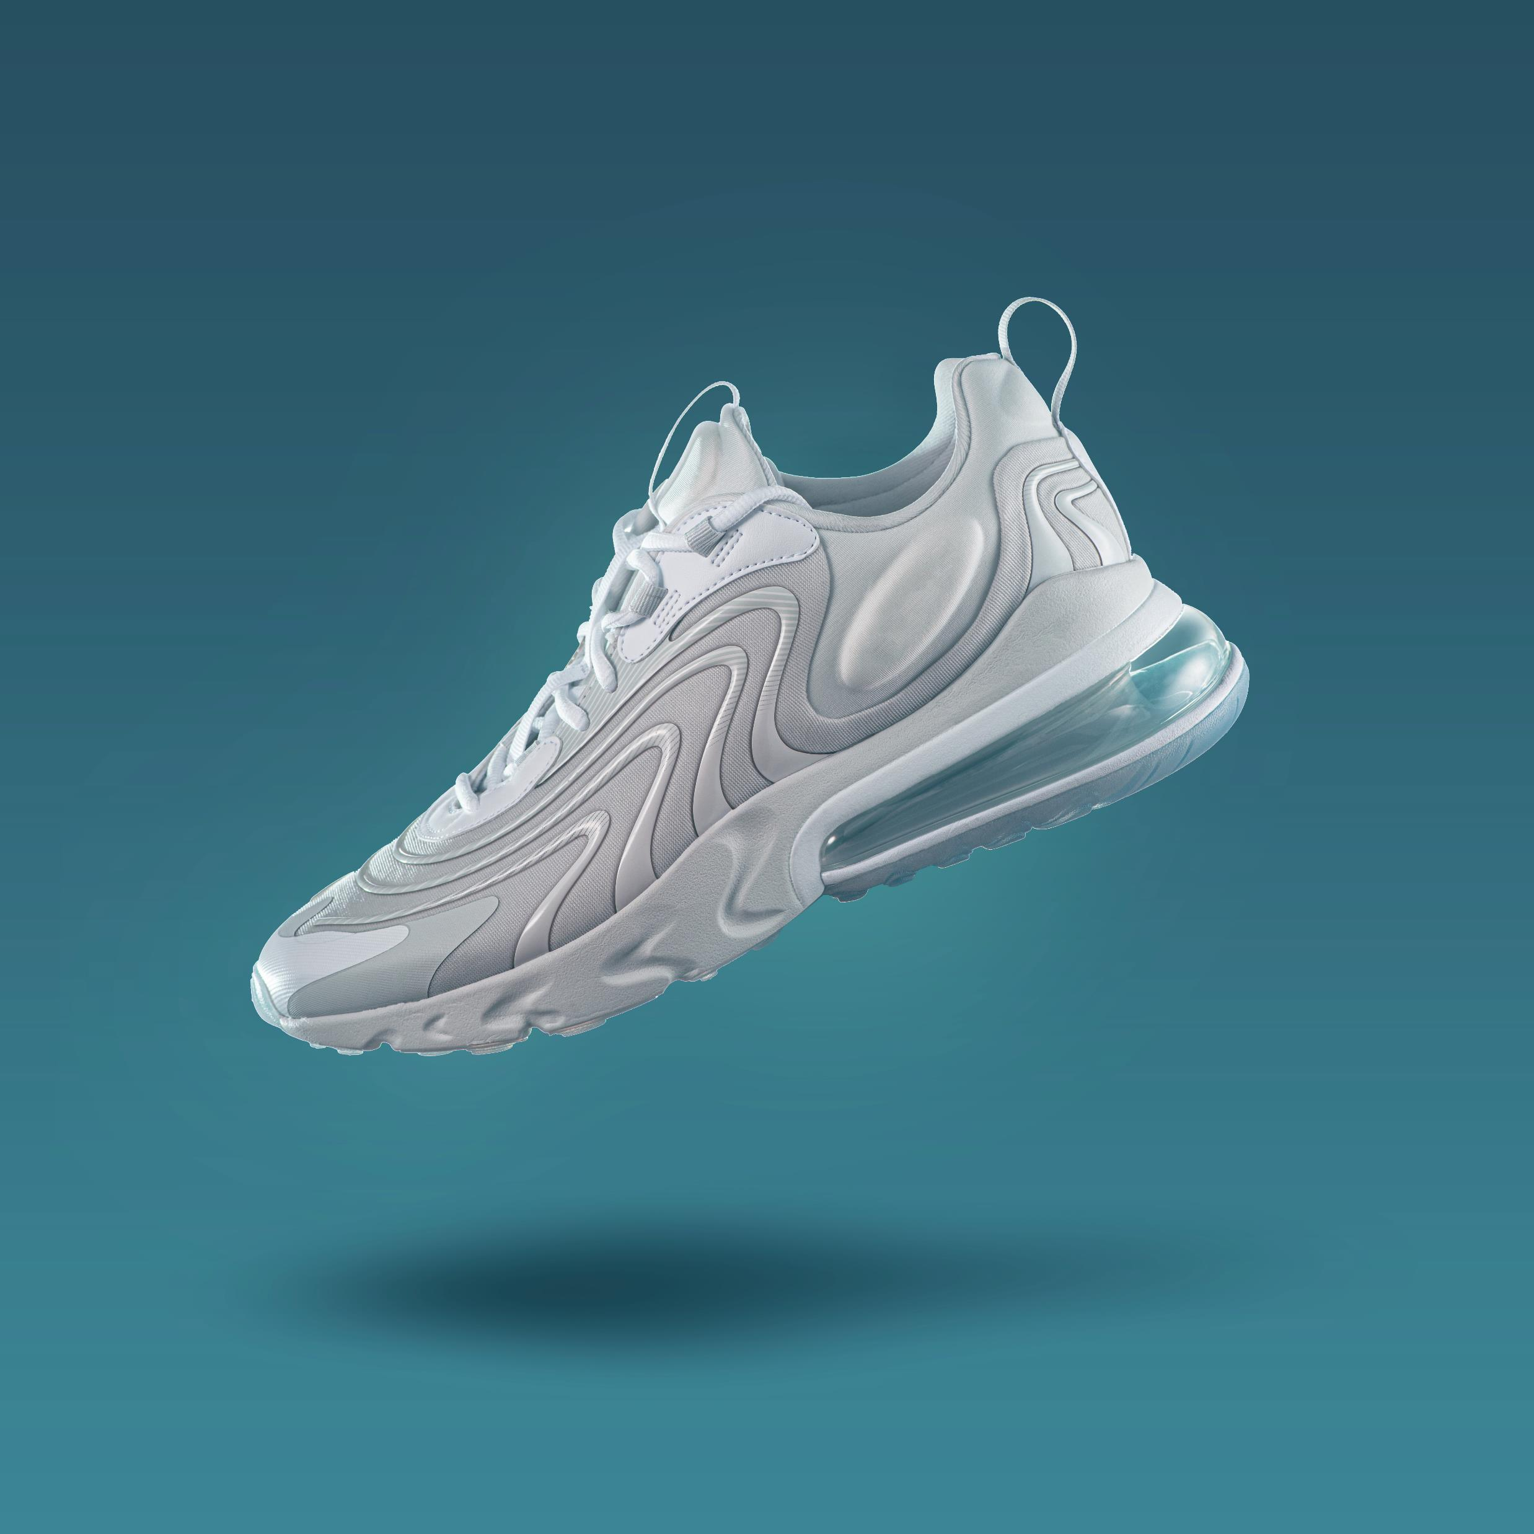
JUST DO IT
Galatians 2:20

Slide 2
GALATIANS 2:20
“I have been crucified with Christ and I no longer live, but Christ lives in me. The life I now live in the body, I live by faith in the Son of God, who loved me and gave himself for me.”

Slide 4
I. BY REALIZING YOUR POSITION IN CHRIST
A. WE MUST REALIZE OUR PAST POSITION

Slide 5
I. BY REALIZING YOUR POSITION IN CHRIST
A. WE MUST REALIZE OUR PRESENT POSITION

Slide 6
II. BY RELYING ON THE POWER OF CHRIST
A. WE HAVE THE POWER OF HIS RESURRECTION

Slide 7
II. BY RELYING ON THE POWER OF CHRIST
A. WE HAVE THE POWER OF HIS RESIDENCE

Slide 8
III. BY RESTING IN THE PROVISIONS OF CHRIST
A. THERE IS THE SUPPLY OF FAITH

Slide 9
III. BY RESTING IN THE PROVISIONS OF CHRIST
A. THERE IS THE SACRIFICE OF HIS FLESH

Slide 10
I BOUGHT THE SHOES…CAN I RUN THE RACE?

