Slide 1
LEAVING THINGS BEHIND Part I
Text: Mark 1:14-20

Slide 2
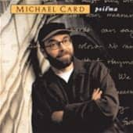
What Will We Leave Behind to Follow Jesus?

Slide 3
Every heart needs to be set free
From possessions that hold it so tight
‘Cause freedom’s not found in the things that we hold . . .
And we can’t imagine
the freedom we find
From the things we leave behind.
Written by Michael Card, Scott Roley and Phil Madeira
© 1982 Mole End Music
(Admin. By the Sparrow Corp)

Slide 4
SIMON/
ANDREW/
JAMES/
JOHN
Nets/Families
What Will We Leave Behind to Follow Jesus?

Slide 5
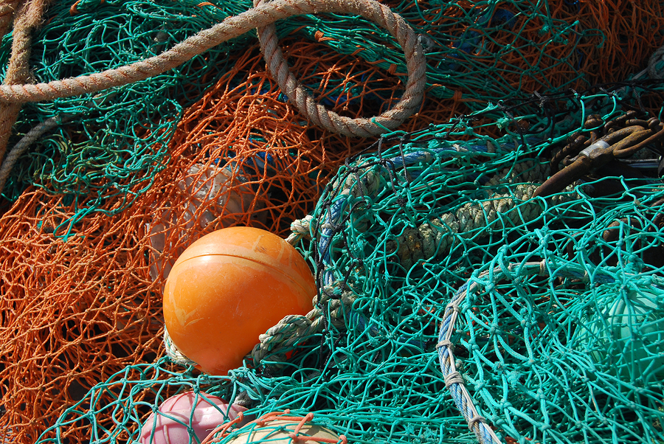
What Will We Leave Behind to Follow Jesus?
Our Nets of Significance and Security?

Slide 6
Our Nets of Significance and Security?
As Jesus walked beside the Sea of Galilee, he saw Simon and his brother Andrew casting a net into the lake, for they were fishermen.
17. “Come, follow me,” Jesus said, “and I will make you fishers of men. 18 At once they left their nets and followed him.”
Mark 1:16-18?

Slide 7
Our Nets of Significance and Security?
19 When he had gone a little farther, he saw James son of Zebedee and his brother John in a boat, preparing their nets.
20 Without delay he called them, and they left their father Zebedee in the boat with the hired men and followed him.
Mark 1:19-20?

Slide 8
Our Nets that impede (hinder or obstruct) us
“Net” - anything thrown around one to impede his motions, as chains, a garment, a net for fishing.
Thayer’s Greek Definition

Slide 9
Our Nets that we need to
cast aside
The second word used for “nets” finds it root from the word “to cast.” So once James and John cast aside their “casting nets” they were able to follow Jesus.

Slide 10
Our Nets that we need to
Leave behind
“left or forsook - KJV”
their nets before following Jesus.
This same verb is used to denote a man divorcing his wife; describing one who has expired (died); to forgive a debt; to go away leaving something behind; to abandon or leave destitute.

Slide 11
Our Nets that we need to
Leave behind
“In the same way, any of you who does not give up everything he has cannot be my disciple.”
Luke 14:33

Slide 12
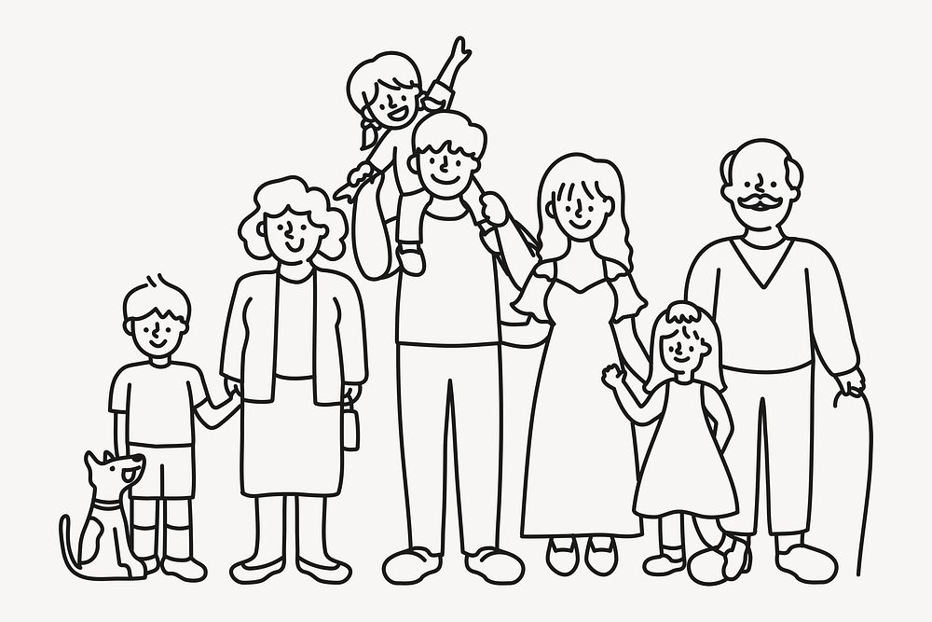
Our Families
Peter said to him, “We have left everything to follow you!”
29. “I tell you the truth,” Jesus replied, “no one who has left (forsook (KJV) home or brothers or sisters or mother or father or children or fields for me and the gospel
Mark 10:28,29

Slide 13
Our Families
30. will fail to receive a hundred times as much in this present age: homes, brothers, sisters, mothers, children and fields—and with them, persecutions – and in the age to come, eternal life.”
Mark 10:30

Slide 14
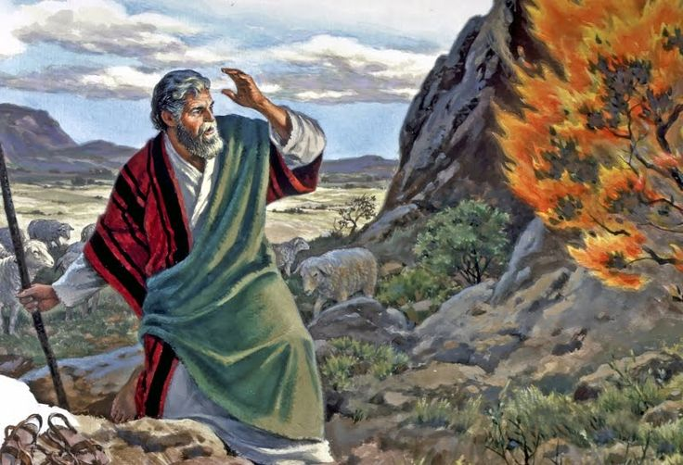
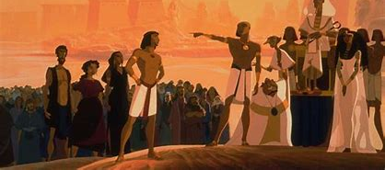
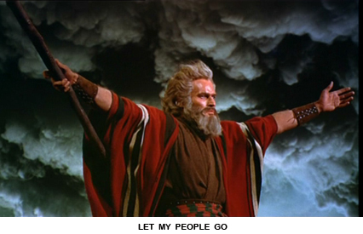
Our Families
“He regarded disgrace for the sake of Christ as of greater value than the treasures of Egypt, because he was looking ahead to his reward.” Hebrews 11:26

Slide 15
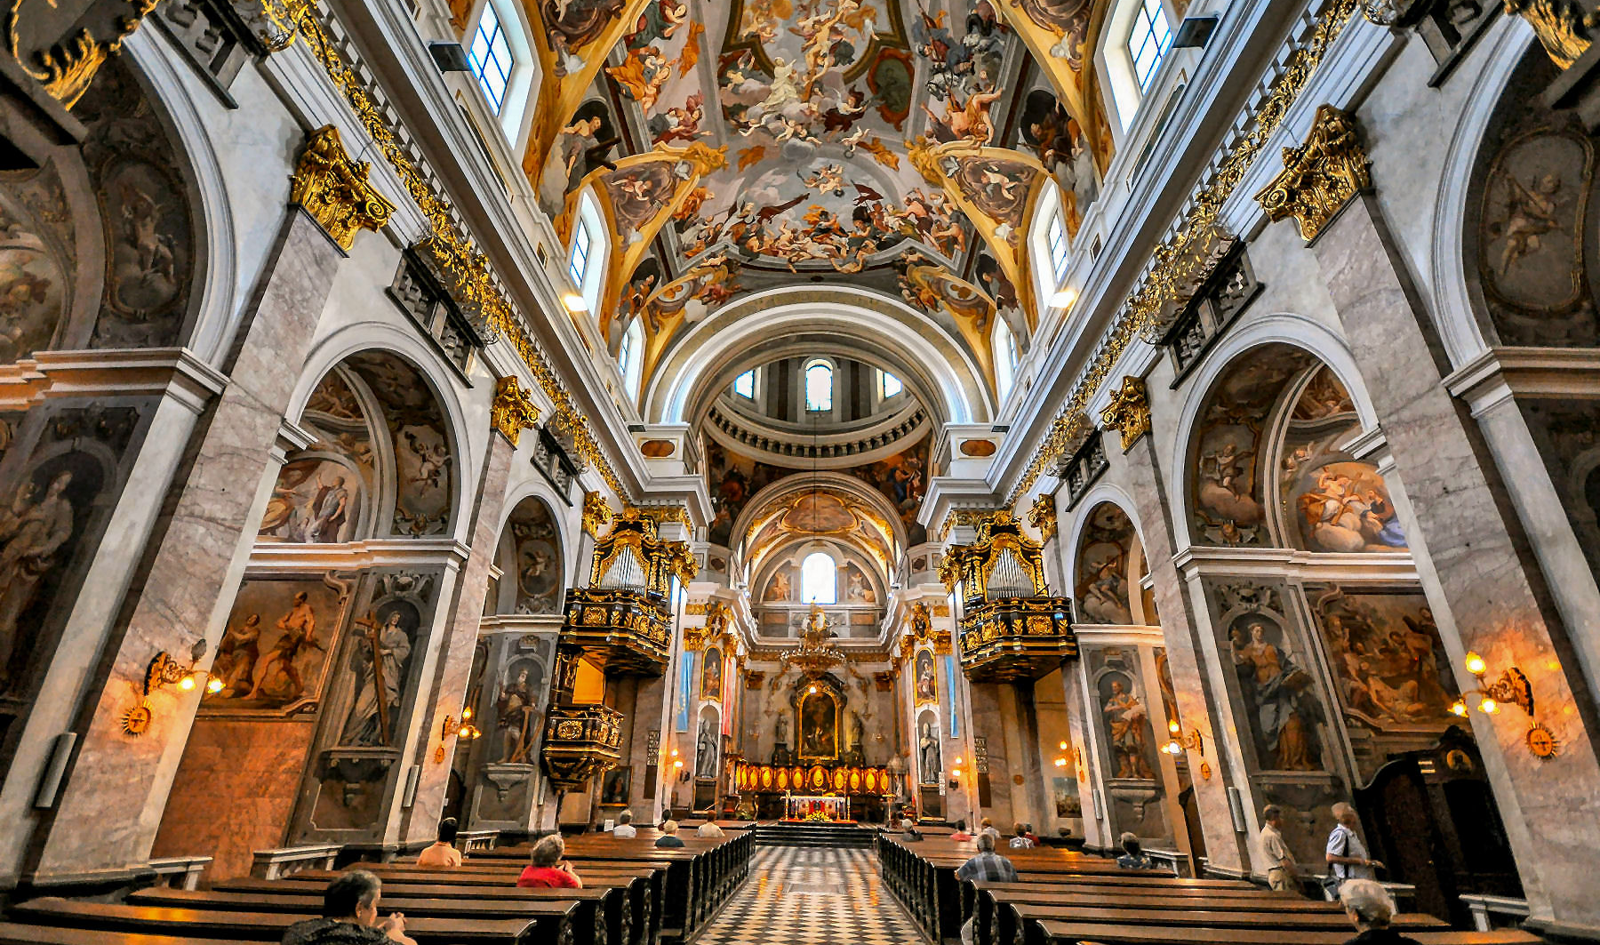
WHY CAN’T WE BUILD SO TODAY?
"They had convictions; we have opinions."

Slide 16
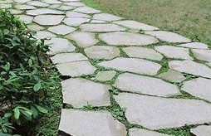
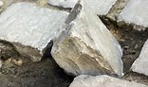
Use what you have
as a stepping stone
NOT a stumbling stone.
"They had convictions; we have opinions."

