Slide 1
LEAVING THINGS BEHIND - Part 2
Text: Mark 1:14-20

Slide 2
Every heart needs to be set free
From possessions that hold it so tight
‘Cause freedom’s not found in the things that we hold . . .
And we can’t imagine
the freedom we find
From the things we leave behind.
Written by Michael Card, Scott Roley and Phil Madeira
© 1982 Mole End Music
(Admin. By the Sparrow Corp)

Slide 3
What Will We Leave Behind to Follow Jesus?

Slide 4
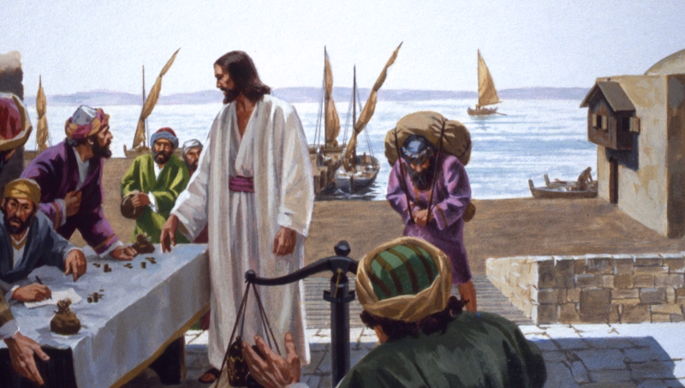
What Will We Leave Behind to Follow Jesus?
II. LEVI - Tax Table/Money

Slide 5
II. LEVI - Tax Table/Money
“Once again Jesus went out beside the lake. A large crowd came to him, and he began to teach them.
14. As he walked along, he saw Levi son of Alphaeus sitting at the tax collector’s booth. “Follow me,” Jesus told him, and Levi got up and followed him.”
Mark 2:13-14

Slide 6
II. LEVI - Tax Table/Money
There Comes a Time in Some People’s Lives That They must Leave Behind the past That They Were Never Really to be a Part of.

Slide 7
II. LEVI - Tax Table/Money
“all will be condemned who have not believed the truth but have delighted in wickedness (had pleasure in unrighteousness - KJV).”
II Thessalonians 2:12

Slide 8
II. LEVI - Tax Table/Money
“It is not the healthy who need a doctor, but the sick. I have not come to call the righteous, but sinners.”
Mark 2:17

Slide 9
II. LEVI - Tax Table/Money
“History is the record of an encounter between character and circumstance.”
Donald Creighton
“Towards the Discovery of Canada”
Canadian Historian

Slide 10
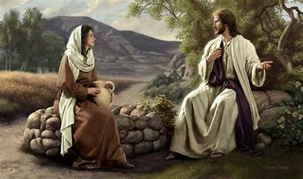
What Will We Leave Behind to Follow Jesus?
III. THE WOMAN AT THE WELL - Water Jar

Slide 11
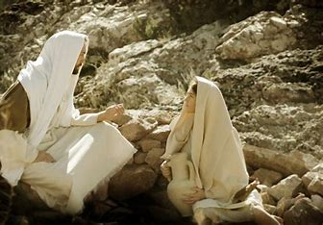
III. THE WOMAN AT THE WELL - Water Jar
“The fact is, you have had five husbands, and the man you now have is not your husband. What you have just said is quite true.“
John 4:18

Slide 12
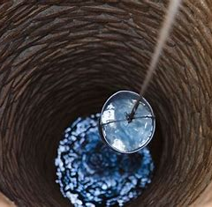
III. THE WOMAN AT THE WELL - Water Jar
Carnal hearts look no higher than carnal means to reach their end.
Spiritual hearts desire that which comes from a spiritual vein of life.

Slide 13
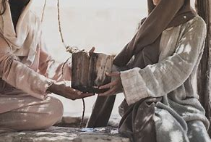
III. THE WOMAN AT THE WELL - Water Jar
“The woman said to him, ‘Sir, give me this water so that I won’t get thirsty and have to keep coming here to draw water.’”
John 4:15

Slide 14
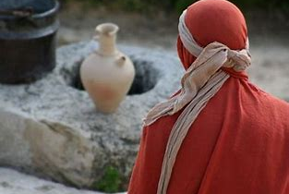
III. THE WOMAN AT THE WELL - Water Jar
“Then, leaving her water jar, the woman went back to the town and said to the people,
29. ‘Come, see a man who told me everything I ever did. Could this be the Christ?’”
John 4:28,29

Slide 15
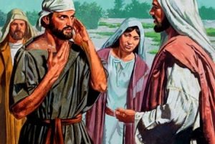
III. THE WOMAN AT THE WELL - Water Jar
“Many of the Samaritans from that town believed in him because of the woman’s testimony, “He told me everything I ever did.”
40. So when the Samaritans came to him, they urged him to stay with them, and he stayed two days.
John 4:39-40

Slide 16
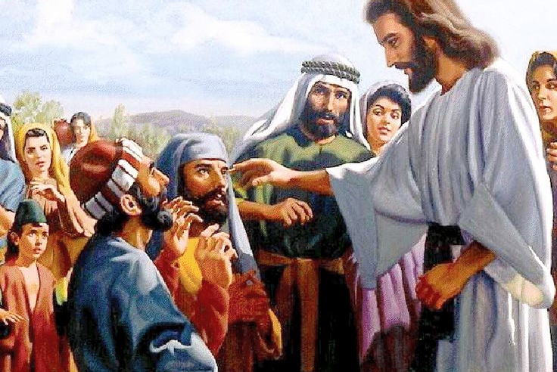
III. THE WOMAN AT THE WELL - Water Jar
“41. And because of his words many more became believers.
42. They said to the woman, ‘We no longer believe just because of what you said; now we have heard for ourselves, and we know that this man really is the Savior of the world.’”
John 4:41-42

Slide 17
III. THE WOMAN AT THE WELL - Water Jar
“When you find yourself, what will you do with yourself?”
Public Opinion Expert

Slide 18
Is it time to leave something behind that has hindered your spiritual growth?

