Slide 1
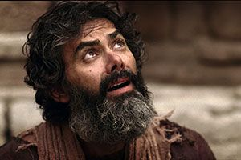
LEAVING THINGS BEHIND - Part 3
Text: Mark 10:46-52

Slide 2
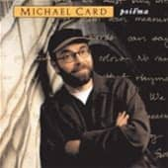
Every heart needs to be set free
From possessions that hold it so tight
‘Cause freedom’s not found in the things that we hold . . .
And we can’t imagine
the freedom we find
From the things we leave behind.
Written by Michael Card, Scott Roley and Phil Madeira
© 1982 Mole End Music
(Admin. By the Sparrow Corp)

Slide 3
What Will We Leave Behind to Follow Jesus?

Slide 4
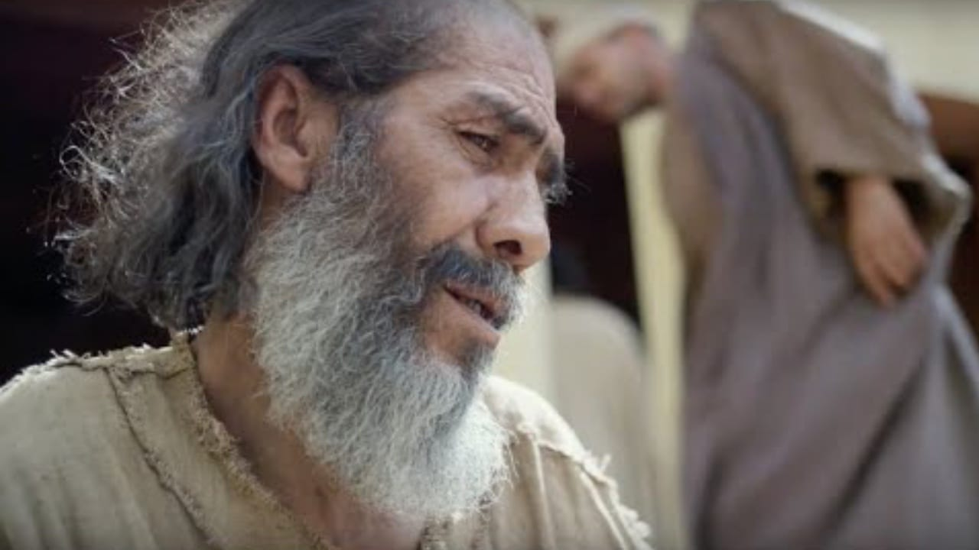
What Will We Leave Behind to Follow Jesus?
IV. THE BLIND MAN – Beggar’s Cloak

Slide 5
IV. THE BLIND MAN – Beggar’s Cloak
“Throwing his cloak aside, he jumped to his feet and came to Jesus.”
Mark 10:50
“What do you want me to do for you?
Mark 10:51

Slide 6
IV. THE BLIND MAN –
Beggar’s Cloak
“Rabbi, I want to see.”
Mark 10:51b
“‘Go’ said Jesus, ‘your faith has healed you.’”
Mark 10:52

Slide 7
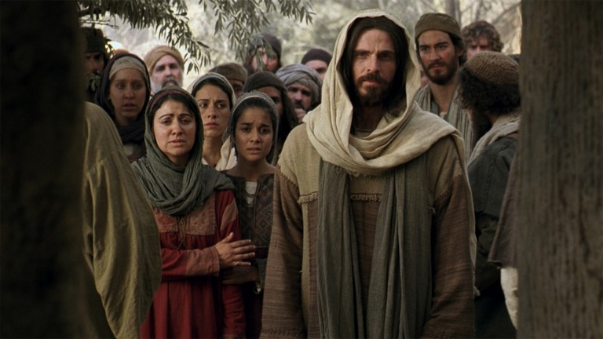
What Will We Leave Behind to Follow Jesus?
V. LAZARUS - Grave Clothes

Slide 8
Lazarus which means “God helps”
lived at Bethany “House of Affliction.”
(John 11:1)

Slide 9
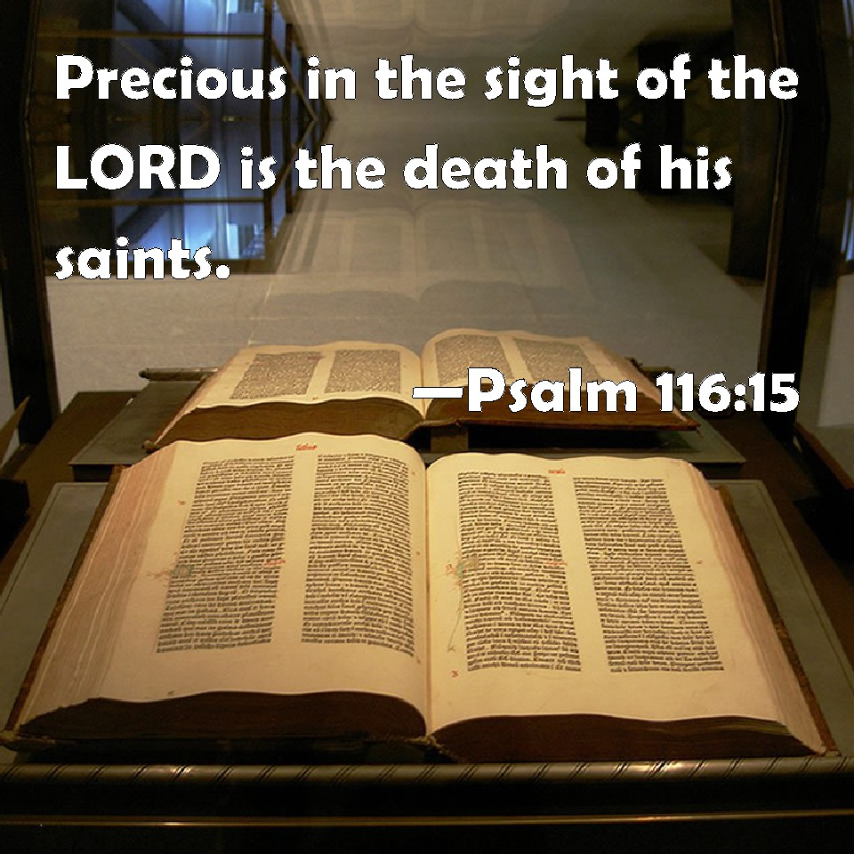

Slide 10
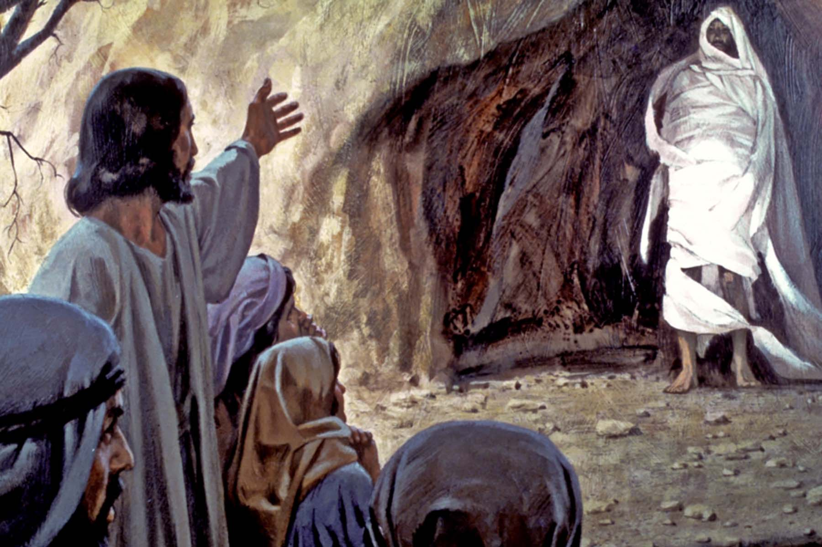
V. Lazarus – Grave Clothes
“O death, where is thy sting? O grave, where is thy victory?”
I Corinthians 15:55 KJV

Slide 11
V. Lazarus – Grave Clothes
“I am come that they might have life, and that they might have it more abundantly.”
John 10:10 KJV

Slide 12
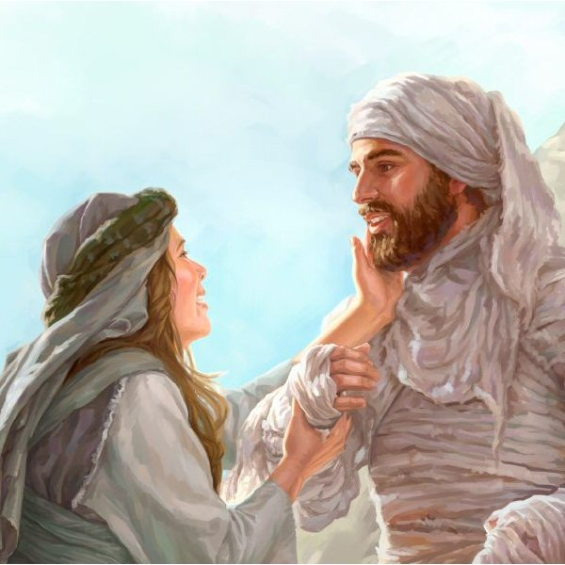
V. Lazarus – Grave Clothes
“ . . . and let him go.”
John 11:44

Slide 13
Is it your day to be let loose of the things that have kept you from being set free?

