Slide 1
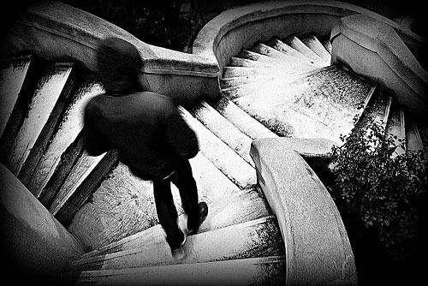
LIFE IS COMPLICATED
Text: Job 11:1-20

Slide 2
The Hebrew word for “Naamah” means
“sweet” or “pleasant.”
“Beth Dagon” was one of the oldest deities in Mesopotamia. Ancient texts referred to him as
the father of “Baal.”
“Makkedah” was a place mentioned in Joshua 10:1-29 where five kings from Jerusalem, Hebron, Jarmuth, Lachish and Eglon hid in a cave.

Slide 3
“Do not be afraid; do not be discouraged. Be strong and courageous. This is what the LORD will do to all the enemies you are going to fight.”
Joshua 10:25

Slide 4
“Zophar?” I was shocked to find out that when you Google this name you come to web sites full of the “Zophar’s Domain.” What does this include? It is full of demonic games and the background music.
One site called “Raine” is a main focus upon “emulating Taito and Jaleco.”
“Taito Jujutsu Kaisen
Kugisaki Nobara
Prize Figure”

Slide 5
“Oh, how I wish that God would speak, that he would open his lips against you
6. and disclose to you the secrets of wisdom, for true wisdom has two sides. Know this: God has even forgotten some of your sin” . . .
11. Surely he recognizes deceivers; and when he sees evil, does he not take note?
12. But the witless can no more become wise than a wild donkey’s colt can be born human.
Job 11:5,6,11,12

Slide 6
““You will lie down, with no one to make you afraid, and many will court your favor.
20. But the eyes of the wicked will fail, and escape will elude them;”
Job 11:19,20

Slide 7
“See to it that no one takes you captive through hollow and deceptive philosophy, which depends on human tradition and the elemental spiritual forces of this world rather than on Christ.”
Colossians 2:8

Slide 8
PSALM 73

Slide 9
II Timothy 3:1-5

