Slide 1
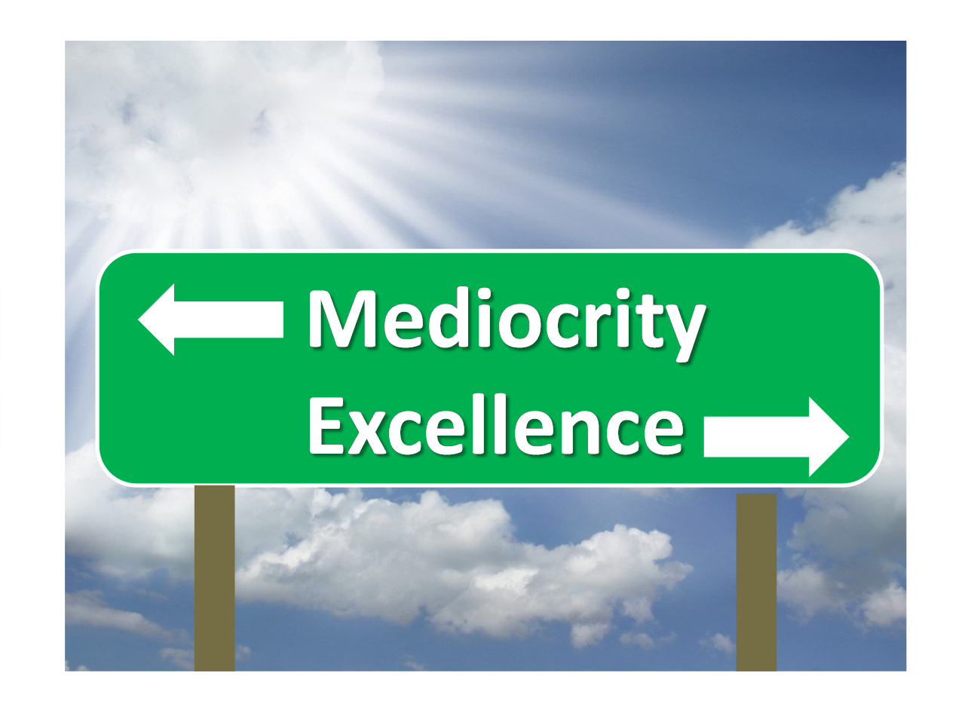
THE BOOK OF JOB “Living Above Mediocrity”
Text: Job 1:1-3

Slide 2
I. JOB’S PERSONALITY (Job 1:1) A. He was NOT a Fictional Character - He was Real “There was a man in the land of Uz whose name was Job.” Job 1:1a

Slide 3
A. He was NOT a Fictional Character - He was Real “Son of man, if a country sins against me by being unfaithful and I stretch out my hand against it to cut off its food supply and send famine upon it and kill its people and their animals, 14. even if these three men—Noah, Daniel and Job—were in it, they could save only themselves by their righteousness, declares the Sovereign Lord.” Ezekiel 14:13-14

Slide 4
A. He was NOT a Fictional Character - He was Real “As you know, we count as blessed those who have persevered. You have heard of Job’s perseverance and have seen what the Lord finally brought about. The Lord is full of compassion and mercy.” James 5:11

Slide 5
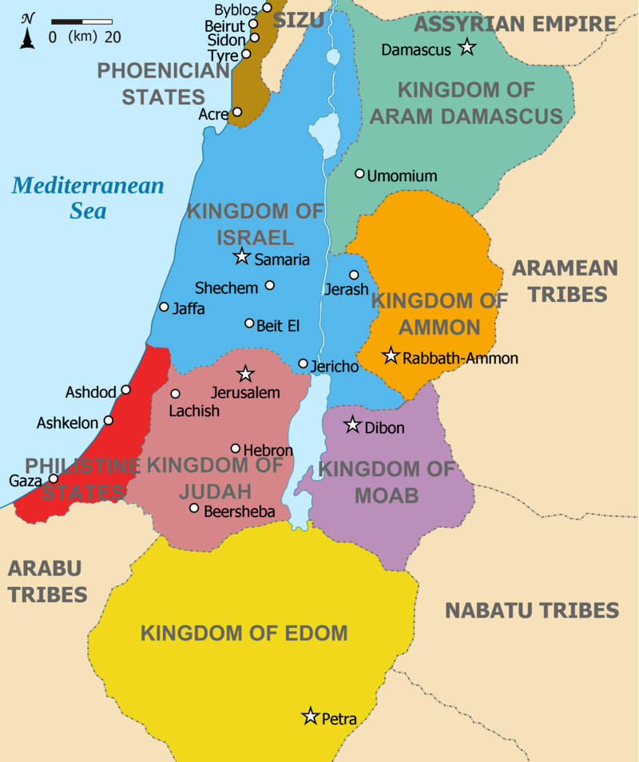
B. He Came from the Land of Uz

Slide 6
C. The Meaning of Job’s Name
The name “Job”
means “the persecuted” or “the penitent.”

Slide 7
II. JOB’S PERFECTION (Job 1:1b)
“And this man was blameless and upright, fearing God and shunning evil.”
Job 1:1b
“Let perseverance finish its work so that you may be mature and complete, not lacking anything.”
James 1:4

Slide 8
II. JOB’S PERFECTION (Job 1:1b)
“Oh, that my ways were steadfast in obeying your decrees!
6. Then I would not be put to shame when I consider all your commands.
Psalm 119:5-6

Slide 9
III. JOB’S PROSPERITY (Job 1:2-3) A. His Children (Job 1:2)
“He had seven sons and three daughters.”
Job 1:2

Slide 10
A. His Children (Job 1:2)
“Children are a heritage from the Lord, offspring a reward from him.
4. Like arrows in the hands of a warrior are children born in one’s youth.
5. Blessed is the man whose quiver is full of them. They will not be put to shame when they contend with their opponents in court.”
Psalm 127:3-5

Slide 11
B. His Property (Job 1:3)
“and he owned seven thousand sheep, three thousand camels, five hundred yoke of oxen and five hundred donkeys (Hebrew - female donkeys that could reproduce), and had a large number of servants. He was the greatest man among all the people of the East.”
Job 1:3

Slide 12
B. His Property (Job 1:3)
“Listen, my dear brothers and sisters: Has not God chosen those who are poor in the eyes of the world to be rich in faith and to inherit the kingdom he promised those who love him?”
James 2:5

Slide 13
B. His Property (Job 1:3)
Jesus never even needed a place on earth to “lay his head” (Matthew 8:20) because He owned everything He created.
“Heaven is my throne and the earth is my footstool”
Isaiah 66:1; Acts 7:49

